Slide 1
Scratch in Irish Secondary Schools
Clare McInerney - Lero
Scratch@MIT Aug 11-14 2010

Slide 2
Lero Education and Outreach Programme
No high-school computing curriculum
Aimed at second-level students
Emphasis on hands-on experience

Slide 3
Scratch Materials
45 hours of Scratch teaching materials on www.scratch.ie developed with teachers
10 modules
483 downloads
Age group target: 14-16 year olds, but many younger using it

Slide 4
National Rollout
Teaching Materials
Competition

Slide 5
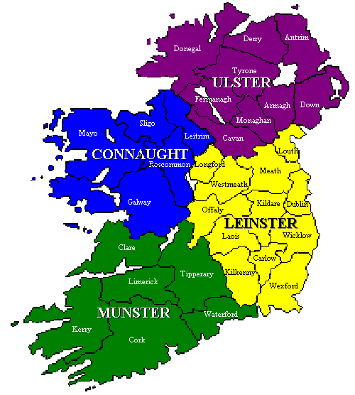
Scratch Competition
September 2009-May 2010
69 projects from 12 schools
Munster, Connaught and Leinster regional competitions
National Finals in Dublin on Scratch Day 22 May 2010

Slide 6
Competition Logistics
Regional Competitions (Two virtual, One actual)
Winners and runners up received vouchers
Winners proceed to national finals
National Final Competition
9 projects
Scratch Galleries really useful here
Judging Panel
Permission Slips for attendance and photos/videos

Slide 7
Galleries

Slide 8
1st, 2nd and 3rd prize
3rd prize : St. Clare's Comprehensive, Manorhamilton, Co. Leitrim for “Star Wars”.
2nd prize : Scoil Uí Mhuirí, Dunleer, Co. Louth for “Avalanche”
1st prize : Conor Foy and Matthew Mulqueen from Coláiste Chiaráin, Co. Limerick for “Ultimo Dance”.
"Stop Bullying” : Primary Scoil Bhríde Ranelagh received an honourable mention award.

Slide 9
Competition Winners

Slide 10
Lessons Learned
Need to have different age categories
Transition Year and Above
Below Transition Year
Need to have different categories of projects
Games
Animations/Story telling

Slide 11
Certificates for Competition Entries

Slide 12
Promoting Scratch in Ireland
Annual Computer Education Society of Ireland Conference
Annual ICT in Education Conference
Annual mailing from Irish Computer Society to Irish Secondary schools

Slide 13
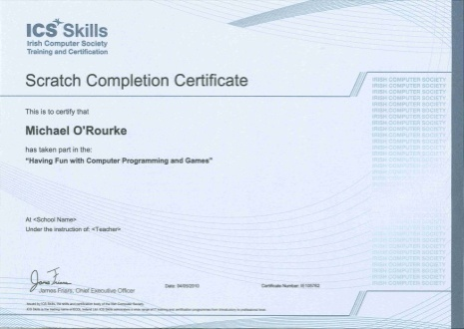
Summary of Results
20 schools (that we know about) using Scratch/Scratch Teaching Materials
1500 students
185 teachers participated in Scratch workshops or presentations
250 Scratch Completion Certificates awarded

Slide 14
Future Plans
More physical devices: dance mats, Scratch sensor boards, xbox controllers
Workbook for students
September 2010
Increase uptake of Scratch in schools
Include primary level
Updated website www.scratch.ie
Launch of Scratch Competition 2011

Slide 15
Thank you
clare.mcineney@lero.ie

Slide 16
Scratch Competition National Finals

