Slide 1
How do you grade students projects in programming?
Nicole Reitz-Larsen

Slide 2
Computational Thinking
Three Key Dimensions
Computational Concepts
Computational Practices
Computational Perspectives

Slide 3
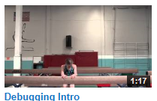
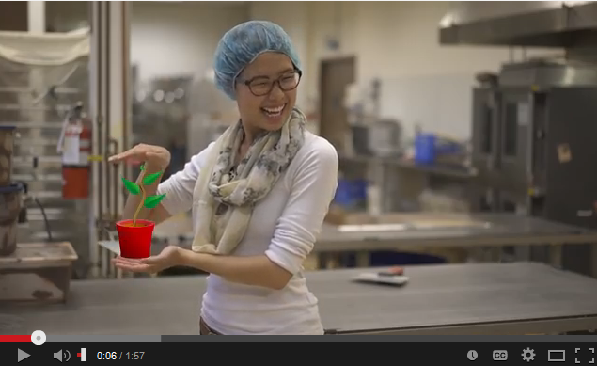
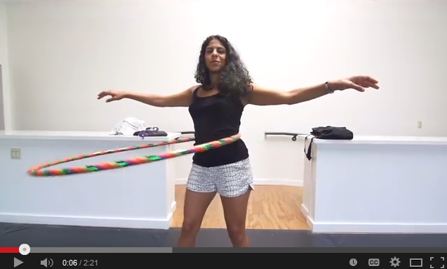
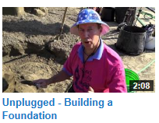
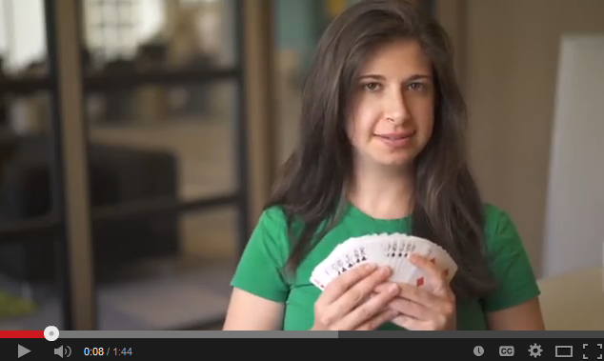
Concepts - common in programming languages
Sequence
Loops
Parallelism
Events
Conditionals
Operators
Data
https://www.youtube.com/user/CodeOrg/videos

Slide 4
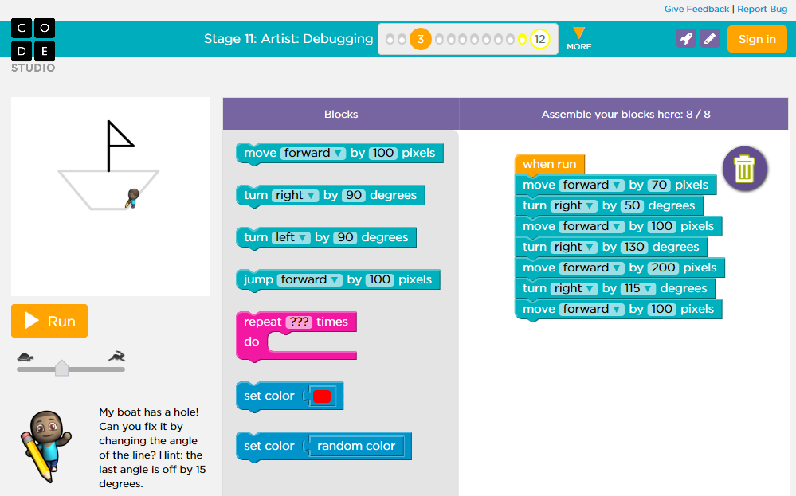
Practices - kids engage in while creating
Experimenting and Iterating
Testing and Debugging
Reusing and Remixing
Abstracting and modularizing
http://scratched.gse.harvard.edu/ct/assessing.html
http://scratched.gse.harvard.edu/ct/files/Student_Assessment_Rubric.pdf
http://scratched.gse.harvard.edu/ct/files/Teacher_Reflection_Tool.pdf
http://studio.code.org/s/course2/stage/11/puzzle/3

Slide 5
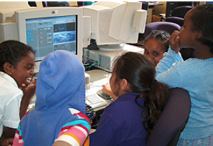
Perspectives - that students should have
Expressing
I can create...
Connecting
I can use… to do...
Questioning
I can use…. to make sense of...

Slide 6
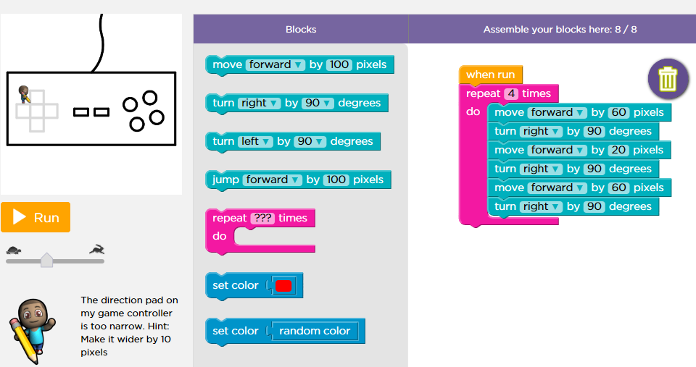
Assessing Computational Thinking
Artifact-Based Interviews
Design Scenarios
Learner Documentation
http://scratched.gse.harvard.edu/ct/files/Student_Interview_Protocol.pdf

Slide 7
Interview - Define
If someone new came to our class and asked you about the program we are using (Scratch, Blockly, Java), - what it is, how it works and what you can do with it -
what would you tell them?

Slide 8
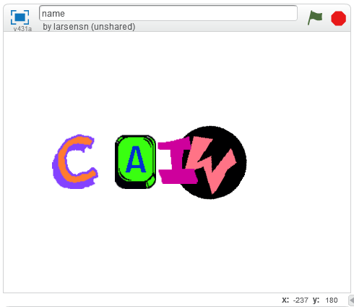
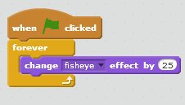
Interview - Project Feedback
Is there anything you would want to ask the creator before giving feedback?
How do you think the project could be improved?
What suggestions would you give the creator to make it more…
Any ideas on how you would….
http://scratch.mit.edu/projects/15015565/#editor

Slide 9
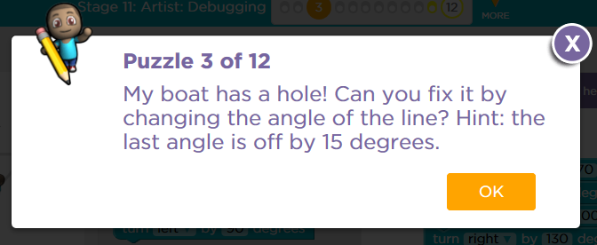
Interview - Debug It
What is going on on the program or
line of code?
How would you fix it?
Try your solution -
Did it work like you expected it to?
What did you need to change?
Why did it work?
Why part of your change didn’t work?
Where would you go for help if you wanted to fix this?
http://studio.code.org/s/course2/stage/11/puzzle/3

Slide 10
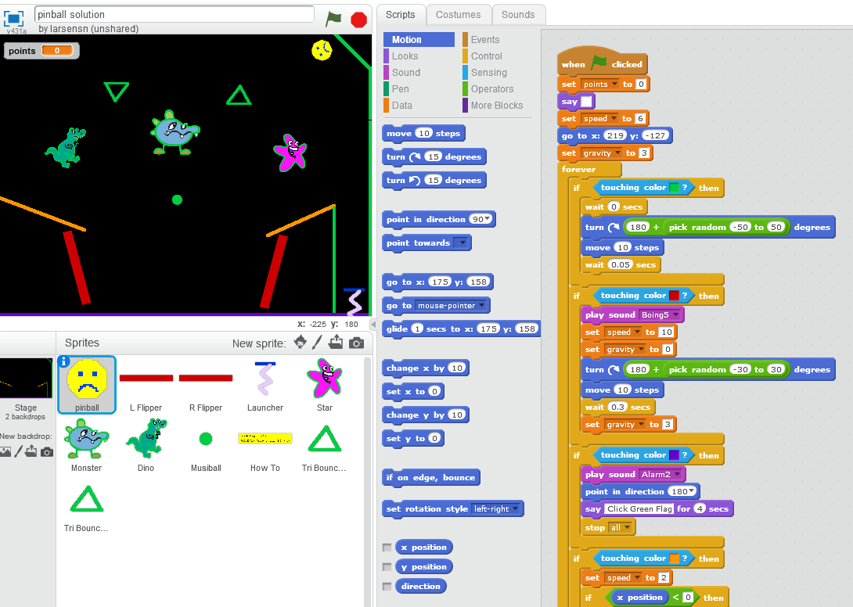
Interview - Project Process
Show me what you are working on.
What is it about?
Why did you choose this project to share?
What steps did you take to plan the project?
Did the plan change at all over time?
What did you do when you had to change the plan and how did the program then work?
http://scratch.mit.edu/projects/14918756/#editor

Slide 11
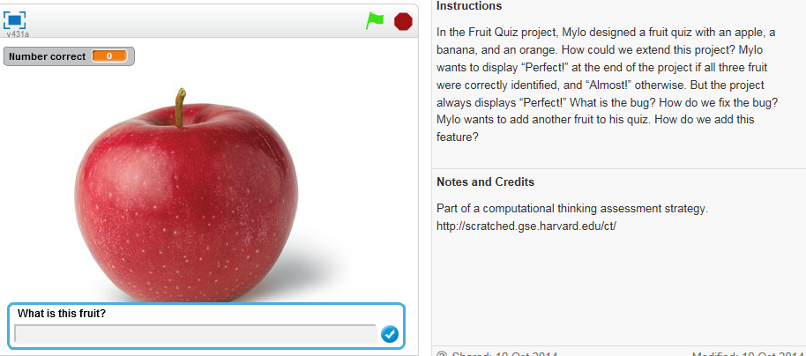
Design Scenarios
Critiquing
Extending
Debugging
Remixing
http://scratch.mit.edu/studios/573426/

Slide 12
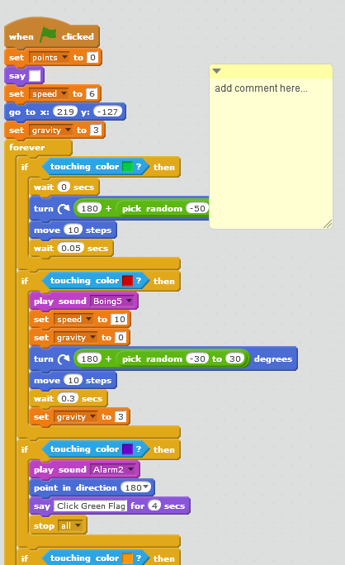
Learner Documentation
Journals
paper-based or digital - https://docs.google.com/a/code.org/presentation/d/1MZUaYZlJZYQonJv3QAlQw8XG3S8LEWINNY0Rwg0p2fM/edit#slide=id.p20
Annotating Code
explaining design
implementation decisions
Visual Gallery Walk of their Code
screencast/narrate their code
observations of someone elses code is made - stickies

Slide 13
Expect Computational Thinking
Creativity used with interests and passions
Empowerment to create interactive media
Computing to use different perspectives to create artifacts to solve real world problems.

Slide 14
Resources
http://scratched.gse.harvard.edu/ct/defining.html
http://studio.code.org/s/course2/stage/11/puzzle/3
http://scratch.mit.edu/
http://scratched.gse.harvard.edu/guide/files/CreativeComputing20141015.pdf
www.code.org

