Slide 1
Lesson 6
Interpretation, Ideation, Experimentation

Slide 2
Warm Up
What is design thinking?
What happens in the Discovery phase?
What is a persona?

Slide 3
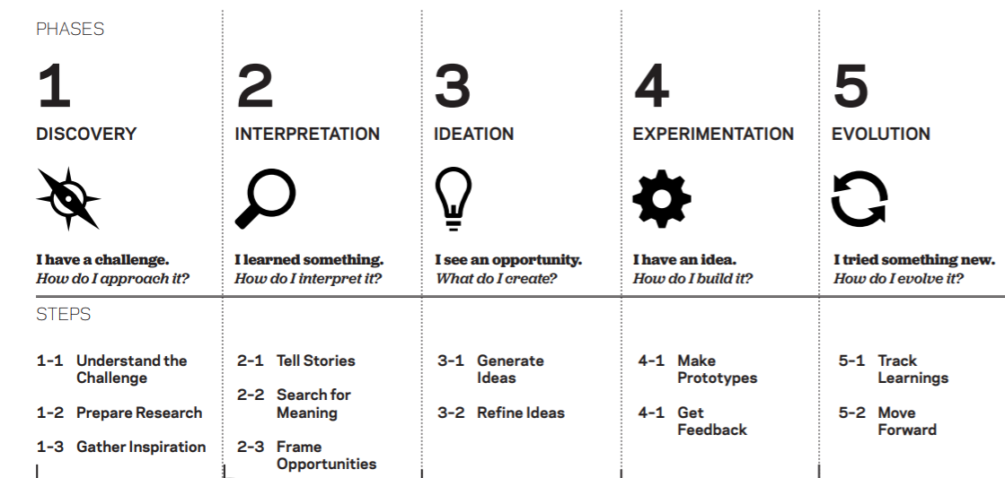
© 2012 IDEO LLC. All rights reserved. http:// designthinkingforeducators.com/
(This diagram is borrowed from the Design Thinking for Educators toolkit, which is created by IDEO.)

Slide 4
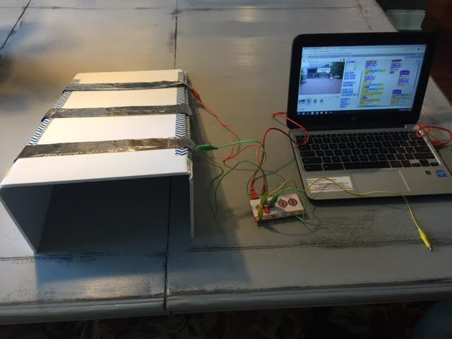
Scenario Interpretation
Think back to the example of the dynamic therapy game that involved reaching the dog on the screen
A scenario was used to help drive the decision making process
The scenario helped make purposeful decisions about the theme, look, and purpose of the game
Using the scenario to make decisions is part of the next phase of design thinking, called Interpretation

Slide 5
Interpretation
During Interpretation, you synthesize all the information you gathered during Discovery, and use it to create meaning.
Think about the scenario that your group picked. What do you know about the persona portrayed? What connections can you make between information in the scenario and the real world?

Slide 6
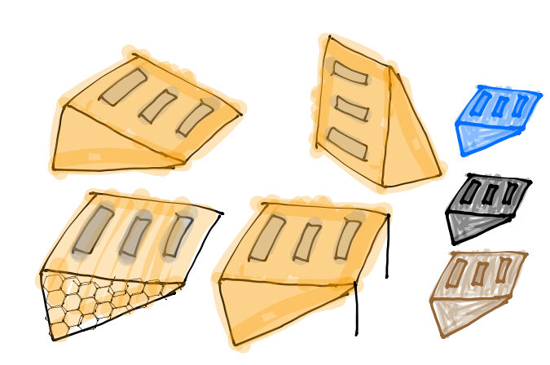
How can you use the scenarios to help you with design thinking?
The next slide shows a persona for Susan. This information was used to develop the example game you learned about previously. You can then see how the information was purposefully used to help create the design of the game and controller.

Slide 7
Persona Example
Susan is a 26 year old who is recovering from an accident. She is in a wheelchair and is learning to walk again. Susan needs to practice leaning forward to help her stand.
What do you like about therapy? It’s like working out at a gym and there is a variety of exercise equipment.
What do you dislike about therapy? Sometimes the equipment is intimidating looking and it is not always intuitive. Some exercises can get old if it is repetitive each session.
What motivates you to do your therapy? There is a lot of encouragement. The key for me to is to focus on the long term goals. I feel like I am getting stronger and I am actually getting a real work out, just as if I were in a regular gym.
Describe the setting where you do your therapy: I go to a therapist’s office, and again, it is like a gym. Some of the equipment is modified so it can be used by people in wheelchairs. Some of the equipment is not very modern looking, but it actually is highly engineered.

Slide 8
Persona Example
How has your injury affected your life? I cannot stand up by myself and I cannot stand for long once I get up. I am learning to walk again on my own, but I am very early in my therapy.
What are your interests? I enjoy pop culture. I am a tv buff! I am passionate about helping animals.
What kind of games do you like? I like playing golf at Top Golf and I am re-learning how to bowl from a wheelchair.
What are your favorite activities? I like being out and about with my friends and family. I like shopping at outdoor malls and going to restaurants.
What do you think about technology? I am all about it as long as it is intuitive. I am not afraid to try new things.

Slide 9
Interpretation
What do you know about Susan?
What kind of games do you think she would like and why?
What would motivate her in a therapy game?
What would be a game that Susan could relate to?

Slide 10
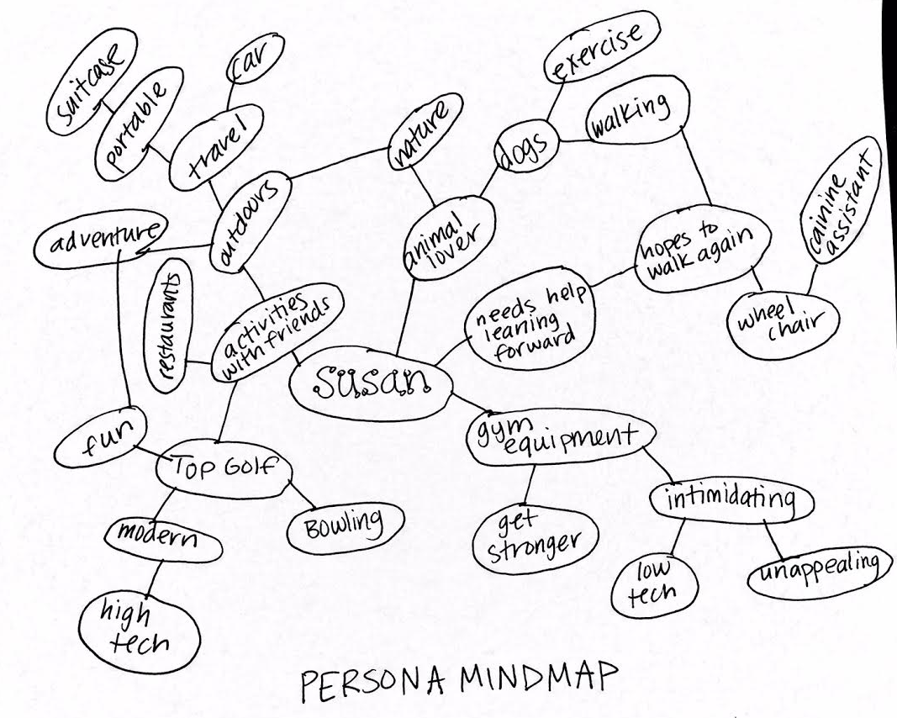

Slide 11
Make a mind map to help with interpretation
Review your scenario.
You are going to make a mind map of your persona to pull out key findings that might could influence your game design.
Pull out key words and then keep branching off from those words; jot down whatever the first ideas are that pop in your head.
Start by putting the persona’s name in the center of the page.
Write down 4-5 main key words that remind you of that persona.
Then continue to connect other ideas off of those main words.
Connect any words that are related. Take 10 minutes to make the mindmap of your persona.
Use the Lesson 6 Project Planner handout.

Slide 12
Translating the persona into design
Discover Information | Interpretation
Therapy equipment is intimidating, strange looking | Controller is clean and simple
Wants to get stronger | Wedge shape design is like sports equipment, color could be orange to evoke energy. Triangles are strong shapes.
Likes Top Golf | Top Golf is modern and high tech, it is fun but not kiddie. The wedge should look modern and mature, but fun and exciting
Likes to be out and about | Controller should be portable and easily stored. The sides fold down so it can lay flat. It is lightweight.

Slide 13
Translating the persona into design
Discovery Information | Interpretation
Likes animals | The character is a dog. Other users might also like dogs, and even have service dogs. Dogs can be motivating to many and the game has motivational phrases on screen.
Enjoys being out and about and socializing | Game setting is an outdoor, public space. Going to a movie is a popular activity.
Likes variety in exercise | Wedge can be used with it lying down or standing upright, depending on difficulty needed

Slide 14
© 2012 IDEO LLC. All rights reserved. http:// designthinkingforeducators.com/
(This diagram is borrowed from the Design Thinking for Educators toolkit, which is created by IDEO.)

Slide 15
Ideation
The key to ideation during design thinking is that this classroom is a judgement free zone!
Let your imagination run wild!
You never know where your ideas can take you, so don’t hold back in fear of what others will think.
It is much easier to create with multiple ideas versus no ideas.
In the end, your group will share ideas. Maybe your group will vote to use one idea, but more than likely, your final product will be a bouquet of everyone’s ideas! Y
Your contribution will be important, even if it isn’t selected.
Use your mindmap to help you get ideas, but don’t let it limit you. Simply use it as inspiration to get your mind going.

Slide 16
Ideation
Grab your thinking caps and 3 notecards.
When the timer begins, list at least 3 ideas you have for the concept/main idea/theme of the therapy game you will code in Scratch.
For example, you could list something like this: A game that involves shooting asteroids by moving your wrist.
You have 2 minutes. Use one notecard per idea.
No need for complete sentences or specific details.
Work silently and independently.

Slide 17
Ideation
Surprise! Let’s do this again!
You have 2 minutes to come up with at least 3 additional ideas.
Use new notecards for each idea.

Slide 18
Ideation
Briefly read your notecards to your group.
Then allow the next person to share.
Keep going until everyone has shared.
Remember, all ideas are good ideas! This is a judgement free zone.
You have 15 minutes to share.
Explain your thoughts in more detail if needed.

Slide 19
Ideation
Now, sort the cards.
As a group, pick the top 3 cards from each team member.
Sort all of the top 3 cards into any of the following categories: the most likely to delight, the rational choice, the most unexpected.
You have 8 minutes.

Slide 20
Ideation
Next, from the cards that were categorized, decide on the top card from each category.
You may combine ideas from other cards if desired.
You have 5 minutes.

Slide 21
© 2012 IDEO LLC. All rights reserved. http:// designthinkingforeducators.com/
(This diagram is borrowed from the Design Thinking for Educators toolkit, which is created by IDEO.)

Slide 22
Experimentation
Next, we are going to blur the design thinking lines slightly between Ideation and the next phase, Experimentation.
You are going to test your ideas by getting feedback from another group.
This is a way to prototype, but you are using ideas instead of physical models.
A prototype is like an early draft or concept. Pick another group to trade ideas with.
Pick one group to be Group A and the other to be Group B.
Have one representative Group A explain the game ideas for each category. After presenting the ideas, have Group B give their thoughts about the pros and cons of each concept. Decide the best route to take for Group A. You have 10 minutes for Group A to present ideas and make a decision based on feedback from Group B.

Slide 23
Experimentation
Have one representative Group A explain the game ideas for each category.
After presenting the ideas, have Group B give their thoughts about the pros and cons of each concept.
Decide the best route to take for Group A. You have 10 minutes for Group A to present ideas and make a decision based on feedback from Group B.
After 10 minutes, have the groups reverse roles so Group B can also make a decision for the best option to pursue.

Slide 24
© 2012 IDEO LLC. All rights reserved. http:// designthinkingforeducators.com/
(This diagram is borrowed from the Design Thinking for Educators toolkit, which is created by IDEO.)

Slide 25
Let’s Play!
Lesson 7 Conditionals and Pseudocode

Slide 26
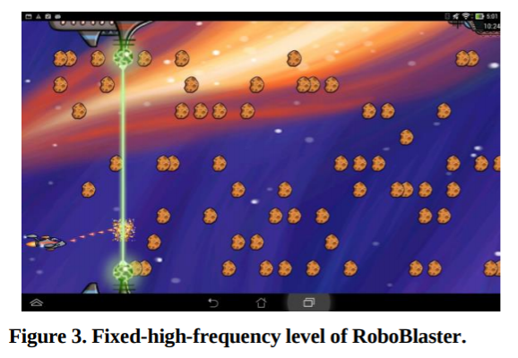
Review
You’ve learned about dynamic games, the nervous system, and design thinking
Let’s refresh our knowledge of pseudocode and conditional statements
What is pseudocode?

Slide 27
Pseudocode Dynamic Game Flowchart example
Mouse caught cat?
Yes!
+1 point
Cat gets smaller
No.
0 points.
Cat gets bigger
Mouse caught cat?
Mouse caught cat?
Yes!
+1 point
Cat gets smaller
No.
0 points.
Cat gets bigger
Yes!
+1 point
Cat gets smaller
No.
0 points.
Cat gets bigger

Slide 28
Review
How will you make your game dynamic?
Conditional statements!
If-then, If-then-else, etc.

Slide 29
Conditional statements
Most programming languages use them!
The purpose of conditional statements is to provide options for the computer to follow.
In a conditional, the command will only be executed if the statement is true, otherwise it doesn’t do the command, or it will move on to the next line of code.
Conditional statements require the computer to evaluate if a statement is true or false, and depending on if it is true or false, it will execute a command or move on.

Slide 30
Conditional statements
You even use them in Geometry and Language arts!
Example: If you do your homework, you will make a good grade, else you won’t. That is a conditional!
Your dynamic game will need conditional statements.

Slide 31
Conditional statements
The conditionals will allow your game to set thresholds so the game can get easier or harder.
For example, in Brittney’s RoboBlaster game, if the player’s accuracy was 50% or higher, then more asteroids appeared, else less asteroids appeared. The use of conditionals allowed the game to make adjustment decisions automatically without Brittney having to adjust the game herself or press any additional buttons.

Slide 32
Rock, Paper Scissors with conditional statements
Look at the handout, which shows a portion of the code from a game of Rock-Paper-Scissors in Scratch.
While this game is not dynamic, it is a good example of how to nest conditionals. In the game, the player competes versus the computer and it works with a Makey Makey.
The player picks either rock, paper, or scissors by selecting an arrow key.
Then, the computer makes a pick.
Look at the code on your handout. Next to each line, explain what is happening. Fill in the first 3 boxes.

Slide 33
Rock, Paper Scissors with conditional statements
Now, write the code for the situation when a player picks paper, using the up arrow.
https://vimeo.com/194241575
(Password: Ryko)

Slide 34
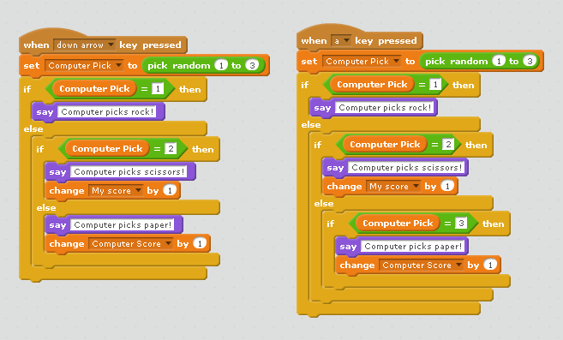
Wrap Up
Why is the code on the left more efficient than the one on the right? Why do you think it is important for code to be efficient?

Slide 35
Wrap Up
Remember to bring any supplies you need for making your game/controller!
You can start building tomorrow if your pseudocode is complete.

Slide 36
Let’s Play!
Lesson 8 Therapy Game Project

Slide 37
Project Day 1
The day has finally arrived! It’s project time!
Refer back to any handouts, PowerPoints, or other materials you need during the project.
Use your pseudocode as you create your Scratch program.
Your task is to apply your knowledge of dynamic games, the nervous system, and conditional statements to create a dynamic game that can be used in physical therapy by someone who has an injury to the nervous system. You will also use the Makey Makey Invention Kit to design the controller.
The type of game you are designing depends on the scenario you chose.
The engineering problem you are solving is how to keep a patient motivated during therapy.
Not only should your game keep a player engaged by having it be dynamic, but also by incorporating the arts. The music, graphics, colors, sounds, and theme of your game and controller can also contribute to the success of your solution.

Slide 38
Project Day 1
Your project will be shared in an exciting event called a Maker Faire! During the event, our class will invite other students, staff, and community members to learn about the projects and play the games. Your upcoming art projects will also be on display.
Prior to the Maker Faire, you should test your project frequently to find areas for improvement.
On days 3, 6, and 9, we will take a few minutes to get feedback from other groups, which is a critical component of design thinking.
When you start your project today, review the group expectations that you set on the Lesson 6 Project Planner. Every member should contribute equally. While this is a team effort, individual contributions will impact grades on an individual basis.

Slide 39
Project Day 1
When you come to class, you can immediately start working on your project.
Any announcements will be written on the board, so be sure to check the board when you arrive.
We will stop the last 5 minutes of class in order to clean up and complete the Daily Work Log.
On the Daily Work Log, use bullet points to fill in the boxes. It requires you to record your progress and set goals for the next day so you know what needs to be accomplished.
The Daily Work Log also contains the project directions for your convenience.

Slide 40
Project Day 1
A copy of the project rubric is provided so you can see how to earn full credit for your work.
The project is a summative assessment.
Are there any questions?
Please have fun and work hard!
Be safe with materials and ask for help when you have questions.

Slide 41
Project Day 3
It’s time to get an early round of feedback!
At some point during class, find 2 volunteers to test your game/controller so far.
Don’t worry if your project is still very early in the prototyping stage. This is the perfect time to get suggestions before going down the wrong path.
Have 2 students try your project and fill in the “I Like, I Wish, I Wonder” feedback handout.
Then, as a group, analyze the feedback results.

Slide 42
Project Day 3
 | I like (Glows) | I wish (Grows) | What If (Suggestions/Ideas)

Slide 43
© 2012 IDEO LLC. All rights reserved. http:// designthinkingforeducators.com/
(This diagram is borrowed from the Design Thinking for Educators toolkit, which is created by IDEO.)

Slide 44
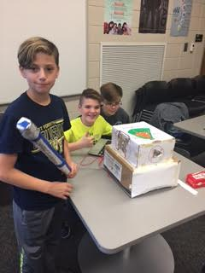
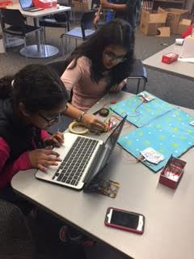
Examples of projects at the Maker Faire

Slide 45
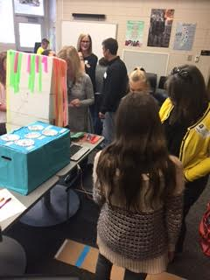
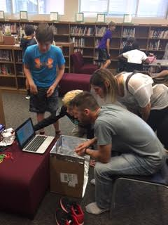
Examples of projects at the Maker Faire

Slide 46
Project Day 6
It’s time to get feedback!
At some point during class, find 2 volunteers to test your game/controller so far.
Have 2 students try your project and fill in the “I Like, I Wish, I Wonder” feedback handout.
Then, as a group, analyze the feedback results.

Slide 47
Project Day 9
It’s time to get feedback!
At some point during class, find 2 volunteers to test your game/controller so far.
Have 2 students try your project and fill in the “I Like, I Wish, I Wonder” feedback handout.
Then, as a group, analyze the feedback results.
Tomorrow is your last day to work on the project before the Maker Faire!
Remind your families about the Maker Faire!

Slide 48
Let’s Play!
Lesson 9 Making Mobiles!

Slide 49
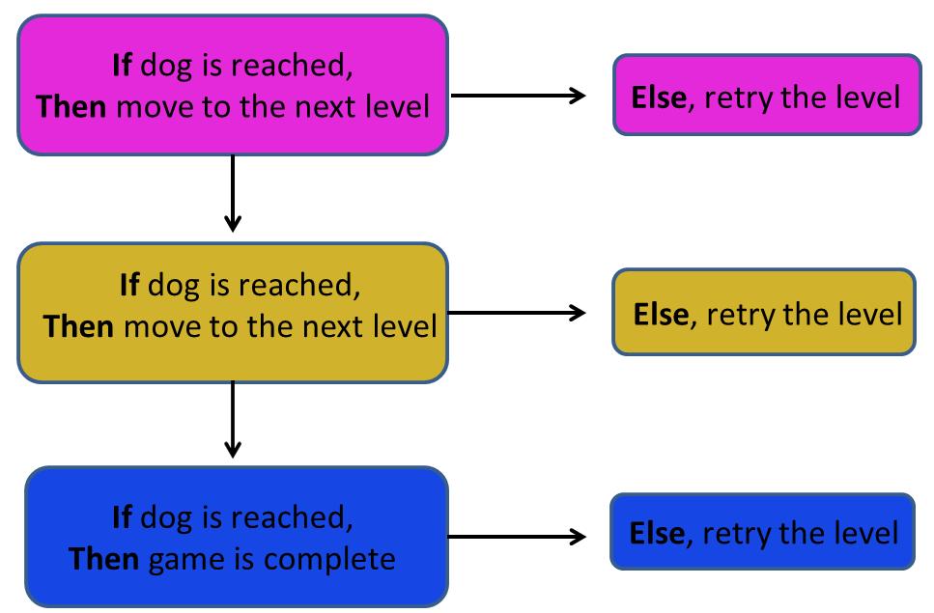
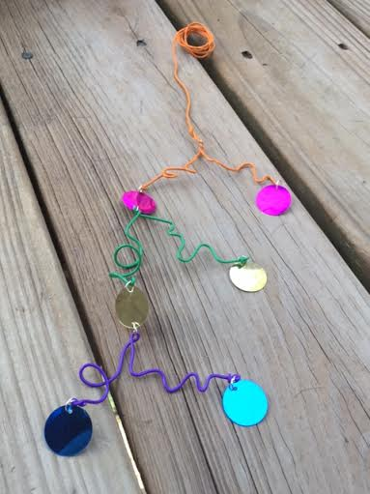
Mobile inspired by pseudocode
When you were programming your dynamic therapy game in Scratch, you wrote pseudocode to help you plan out the needed steps. The pseudocode is a decision tree flowchart. That flowchart is reminiscent of the framework of a mobile. The steps used in the Scratch program can then be represented visually in an artistic mobile design that represents in code in a new, creative way.

Slide 51
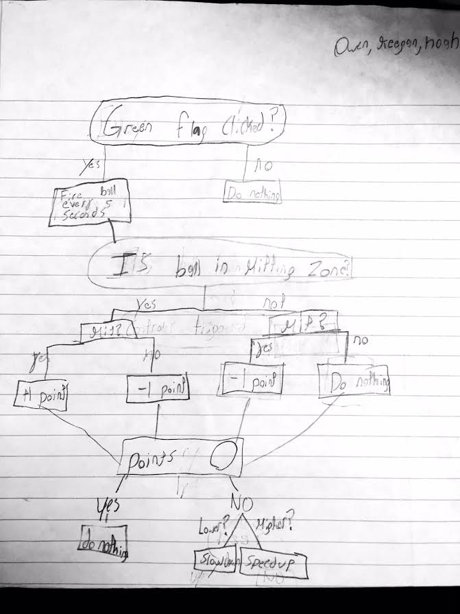
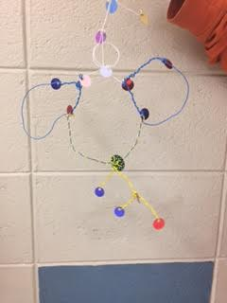

Slide 52
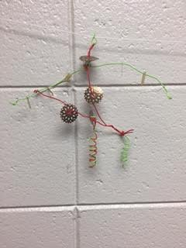
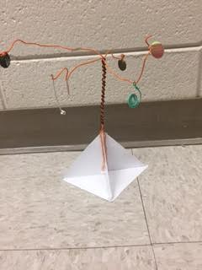

Slide 53
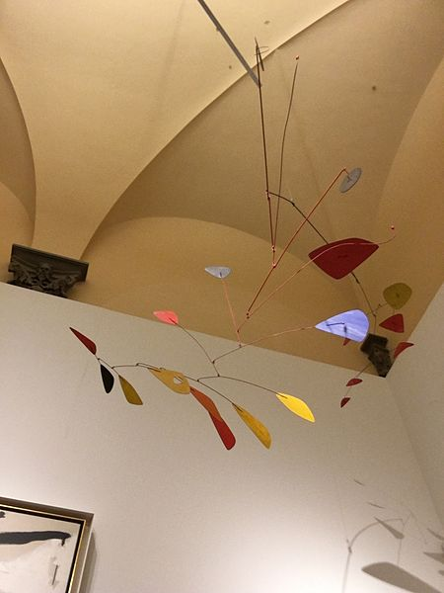
Movement and mobiles
Mobile means to move freely.
A mobile sculpture then is a 3-dimensional art form that is able to freely move.
Most mobiles are suspended and are moved by air or a push.
Mobiles are a type of kinetic art.
Kinetic art is a type of art that uses movement to create an effect.
Alexander Calder. Mobile. 29 April 2016. Manulearosi. CC-BY-SA-3.0

Slide 54
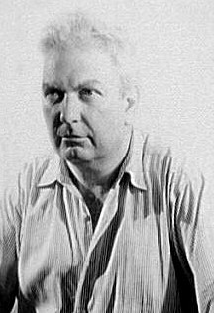
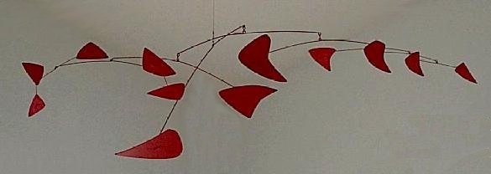
Alexander Calder
Calder created a new artform with his mobiles because they moved and also because they were crafted out of industrial materials.
They were made of a combination of metal, wire, and brightly colored abstract shapes.
Many of his mobiles were very large and occupied entire ceilings.
Van Vechten, Carl, photographer. "Alexander Calder." July 10, 1947. Creative Americans: Portraits by Carl Van Vechten, 1932-1964, Library of Congress.(Found on Wikipedia on the Alexander Calder page.)
Red Mobile, di en:Alexander Calder. 1956. Lamiera verniciata e bacchette di metallo. Montreal Museum of Fine Arts. Foto di Montrealais. Attribution: Montrealais at the English language Wikipedia

Slide 55
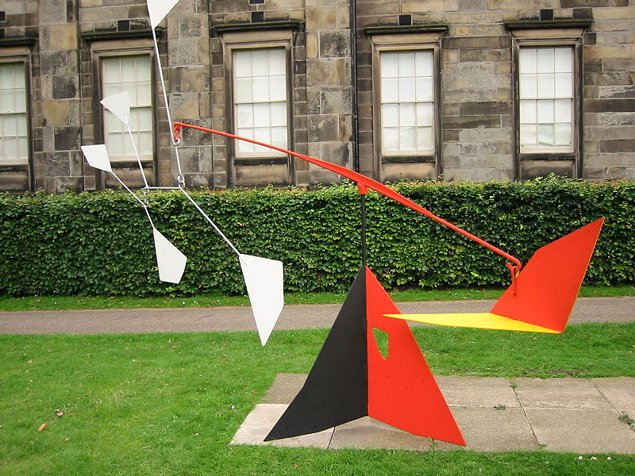
Alexander Calder
Calder also created large installation sculptures that were built from the ground up.
The mobile balanced on the top point of the structure instead of being suspended from the ceiling. These are called standing mobiles.
Alexander Calder's L'empennage (1953) Pictured in 2002 when it was displayed in the sculpture garden of the Scottish National Gallery of Modern Art. Posted to Wikipedia by Finlay McWalter.

Slide 56
Alexander Calder
Born in Pennsylvania in 1898
Died in 1976
Enjoyed making sculptures even as a child and created jewelry and toys regularly.
Pursued a degree in Mechanical Engineering.
To celebrate what would have been Calder’s 113th birthday, the Google Doodle of the day was an interactive mobile that users could manipulate: http://www.google.com/doodles/alexander-calders-113th-birthday
More of his art can be viewed on this site: http://calder.org/
Alexander Calder. Mobile. 29 April 2016. Manulearosi. CC-BY-SA-3.0

Slide 57
Art vocabulary
Mobiles evoke a sense of volume (meaning they physically take up a large space), but they also give a sense of low mass despite the large size (they seem light and airy which allows them to move easily).
The mobiles also exhibit balance and movement.
In terms of design vocabulary, balance means that the art elements are stable and arranged in a pleasing way. A level mobile is balanced.
The movement of the mobile allows for a dynamic viewing experience; the appearance or composition changes as the mobile is pushed.
In terms of design vocabulary, movement refers to how something changes place or position.

Slide 58
Art vocabulary
In art, movement can be either implied or actual motion.
If it is implied, the art piece might suggest movement but not actually move.
In the case of a mobile, it has actual motion.
Watch these clip of Calder’s mobiles to see the movement:
https://www.youtube.com/watch?v=fI5PRaTSMUI
https://www.youtube.com/watch?v=uyIgGb8SgrE

Slide 59
Art + Science
A mobile uses a principle of science called equilibrium.
In the sculptures, each component must balance the other so that the structure doesn’t collapse or lean too heavily toward one side.
Imagine a seesaw. If two children are on opposite sides of the seesaw and they have equal weight, the seesaw stays perfectly horizontal.
If both children sit on the same side of the seesaw, it will hit the ground on that side.
This describes balance and the scenario applies to a mobile as well.

Slide 60
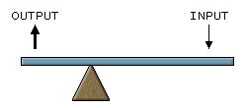
Art + Science
Like a seesaw, a mobile has a fulcrum.
A fulcrum is the center point on which something balances.
The fulcrum is the triangle in the image below.
First Class Lever, 1 December 2005, ChongDae CC-BY-SA-3.0-migrated

Slide 61
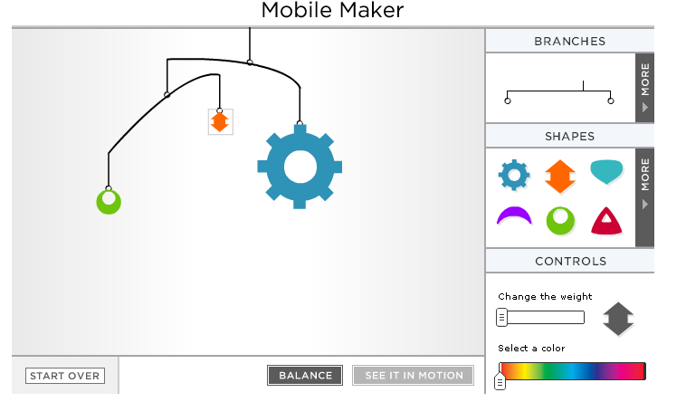
Art + Science
Before you start making a sculpture, first try building one using this interactive. What variables can you manipulate to create equilibrium? http://www.nga.gov/kids/interactive/mobile.htm

Slide 62
Unit Connection
Remember, a mobile is an example of kinetic art. Similarly, your therapy game was kinetic in nature. It was designed to help someone who is working to regain mobility by getting the player to move actively. The mobile creates motion as does your game. Mobiles are also very dynamic, just like the games. To tie it all together, your mobile is inspired by the code you used to create the game.

Slide 63
Let’s Play!
Lesson 11 Therapy Game Project

Slide 64
Yay!
Congrats on an incredible Maker Faire!

Slide 65
© 2012 IDEO LLC. All rights reserved. http:// designthinkingforeducators.com/
(This diagram is borrowed from the Design Thinking for Educators toolkit, which is created by IDEO.)

Slide 66
Let’s reflect
What did you think about the therapy game project? What did you like and dislike?
What have you learned during this unit? (Think back even to the beginning when we had lessons on dynamic games, the nervous system, etc.)
How would you continue to change your game? If you had more time, what would you add or take away?
How could this unit be improved for future classes?
What is the role of art in engineering?
How is computer science creative?

Slide 67
© 2012 IDEO LLC. All rights reserved. http:// designthinkingforeducators.com/
(This diagram is borrowed from the Design Thinking for Educators toolkit, which is created by IDEO.)

