Slide 1
Scratch competition in Tunisia
Scratch conference
From 25 to 28 july 2013
Barcelone, Espagne
EIM

Slide 2
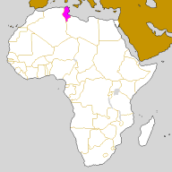
Tunisia

Slide 3
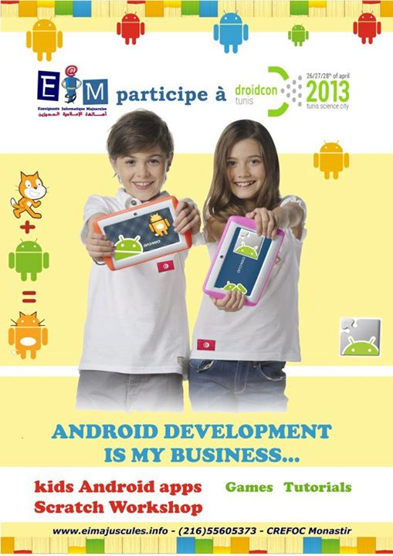
Plan
EIM
Getting started with Scratch
The winter training
The spring training
TUCS
From Scratch to Catroid
Prospects

Slide 4
EIM
Organization of a group of a computer science teachers from differents cities,
Created on may 2010
Main goals:
Improve pupil’s logical skills,
Programming for Youth,
National and International Olympiad,

Slide 5
Getting started with Scratch
In contrast to the great difficulties that meet pupils face to programming, we though to introduce kids from age eleven to organizational skills, creative and logical thinking, this should be done while playing.
After a search, the Scratch software proved that it’s the best,
Our slogan is « Why waiting 16, we hope programming before! »

Slide 6
The winter trainning
The spring trainning
TUCS

Slide 7
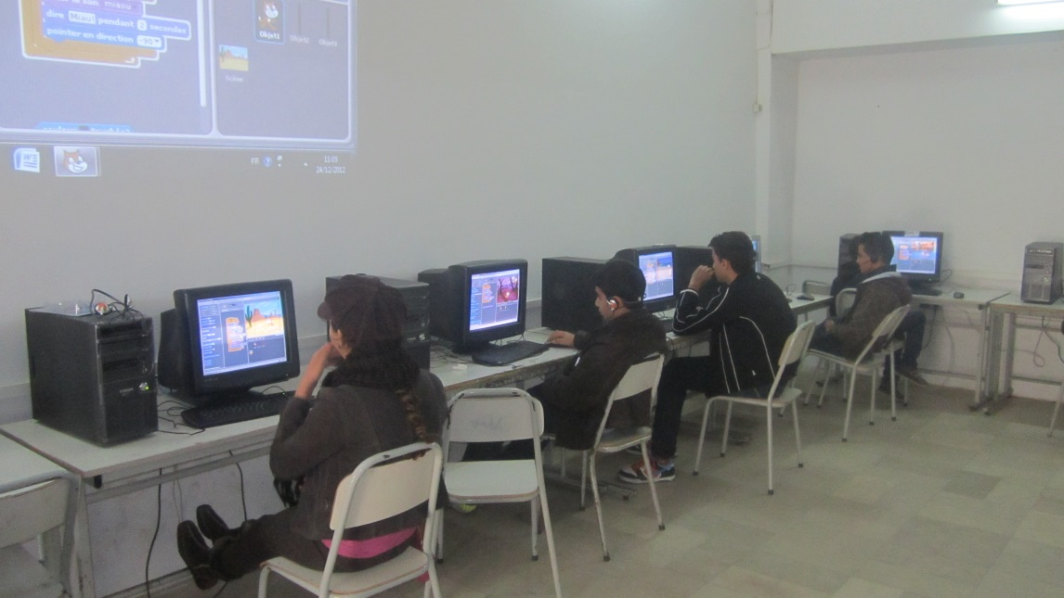
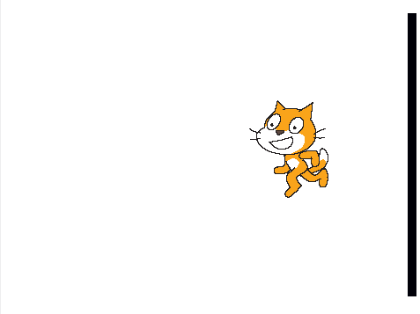
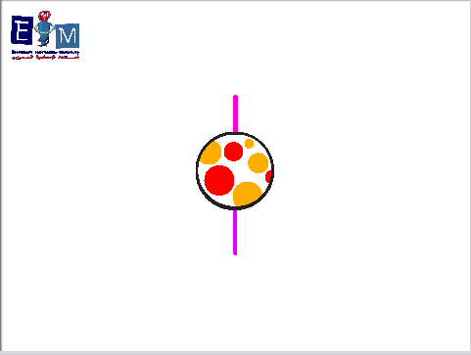
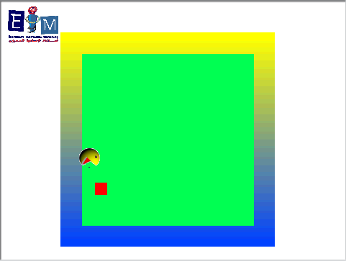
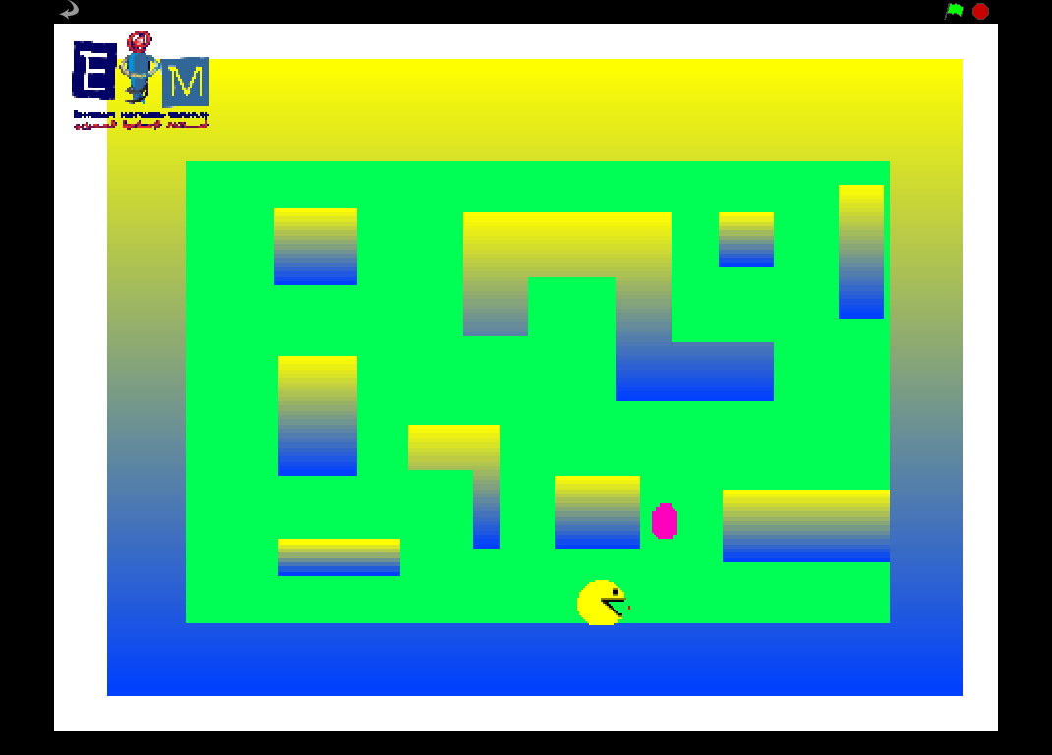
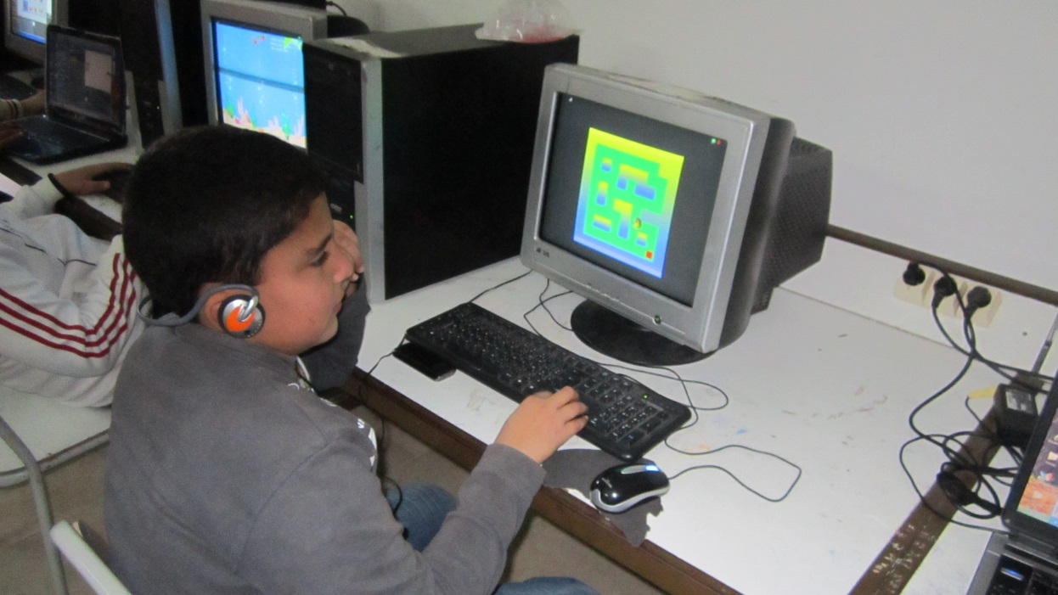
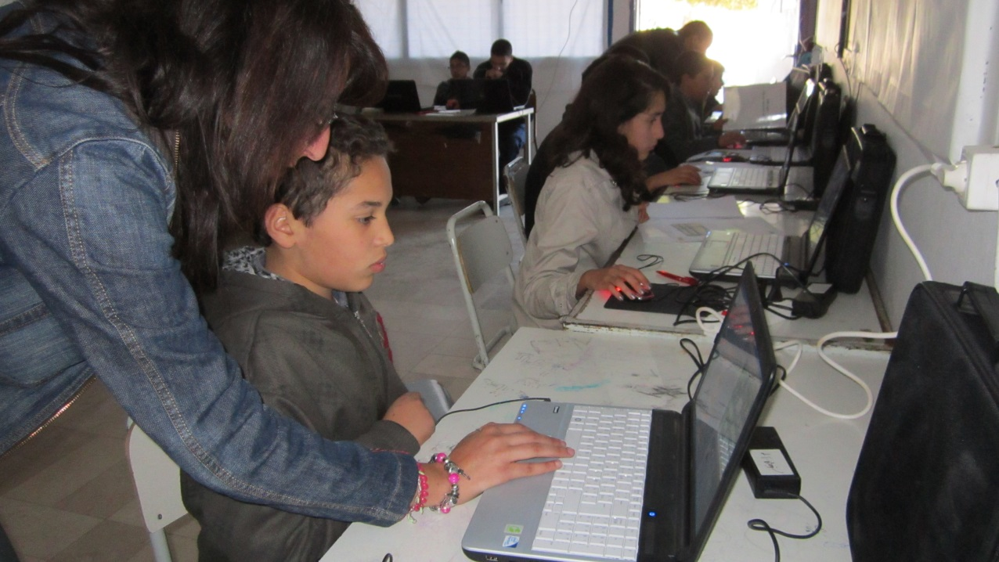
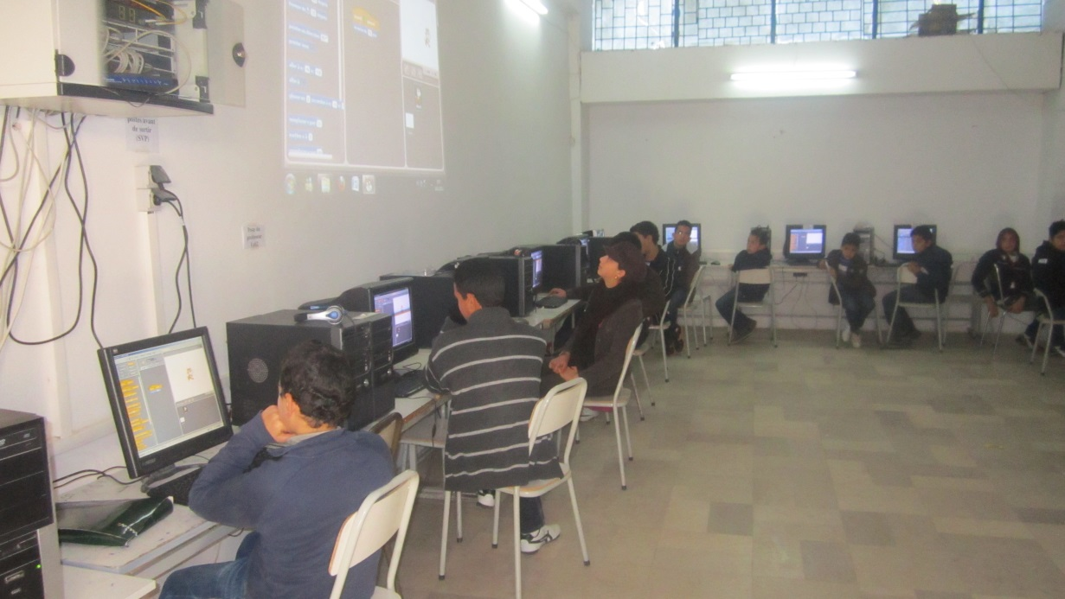
The winter trainning
It started the 24 to 26 december 2012,
More than 68 particpants was present,
What kids created?
A first steps with scratch
The bouncing ball,
The randomly bouncing ball,
PAC-MAN game level 1,
PAC-MAN game level 2,

Slide 8
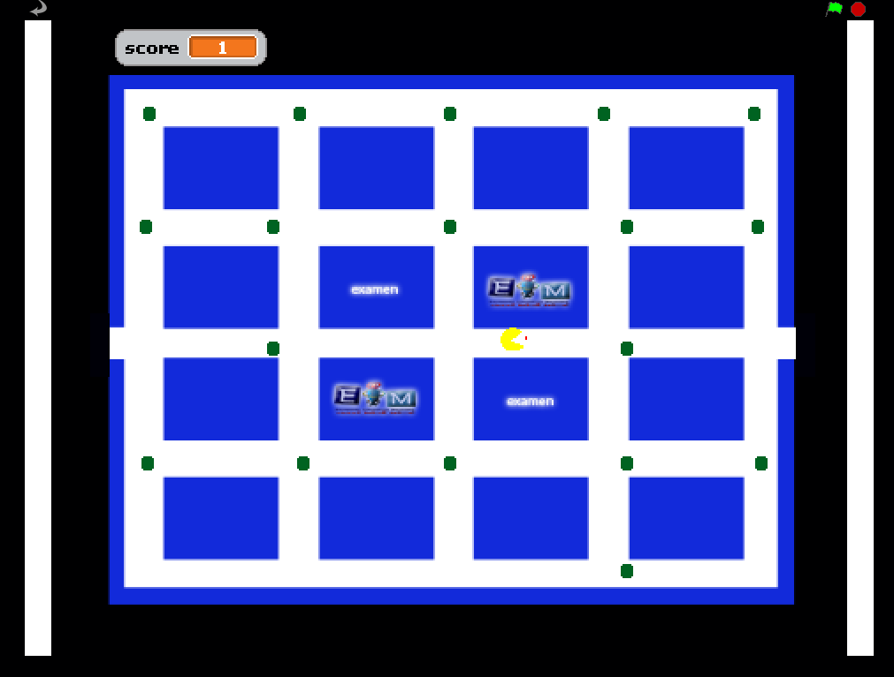
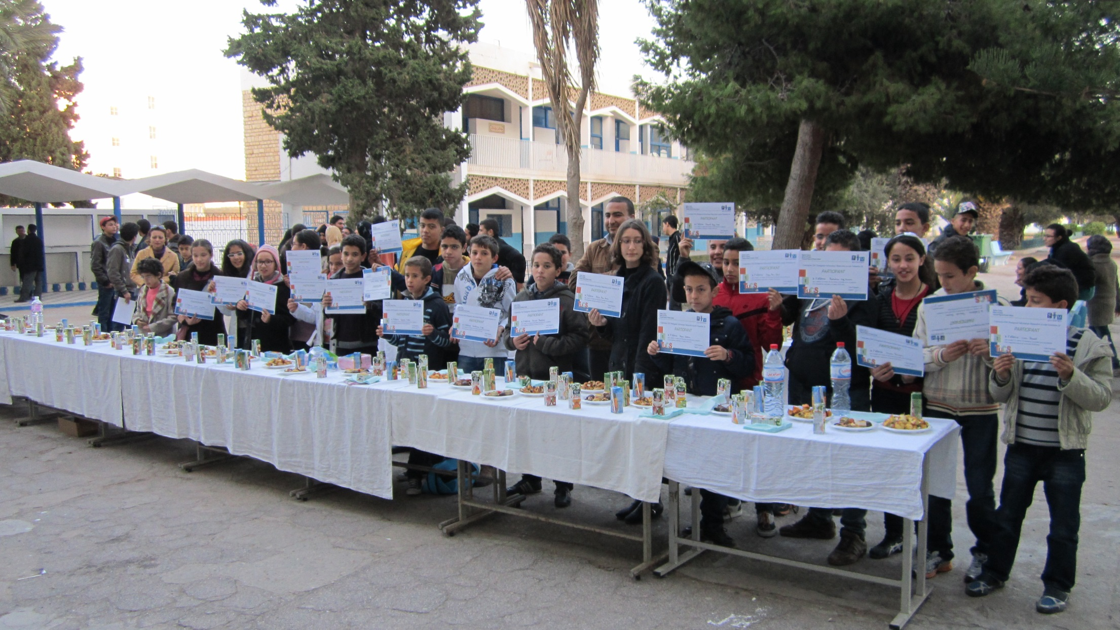
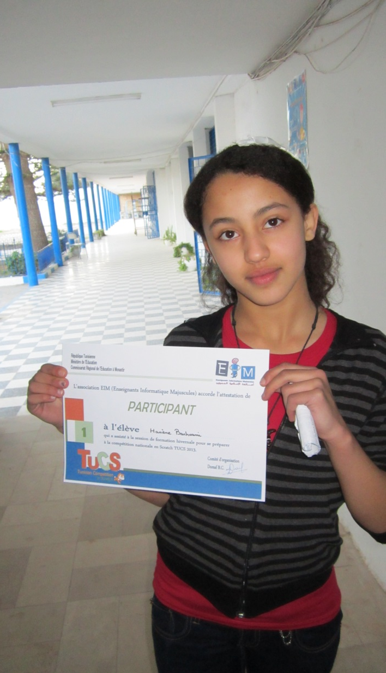
The winter trainning: The end of winter session test
First task
The simulation of the YOYO game
Second task
Pac-MAN : evolved level

Slide 9
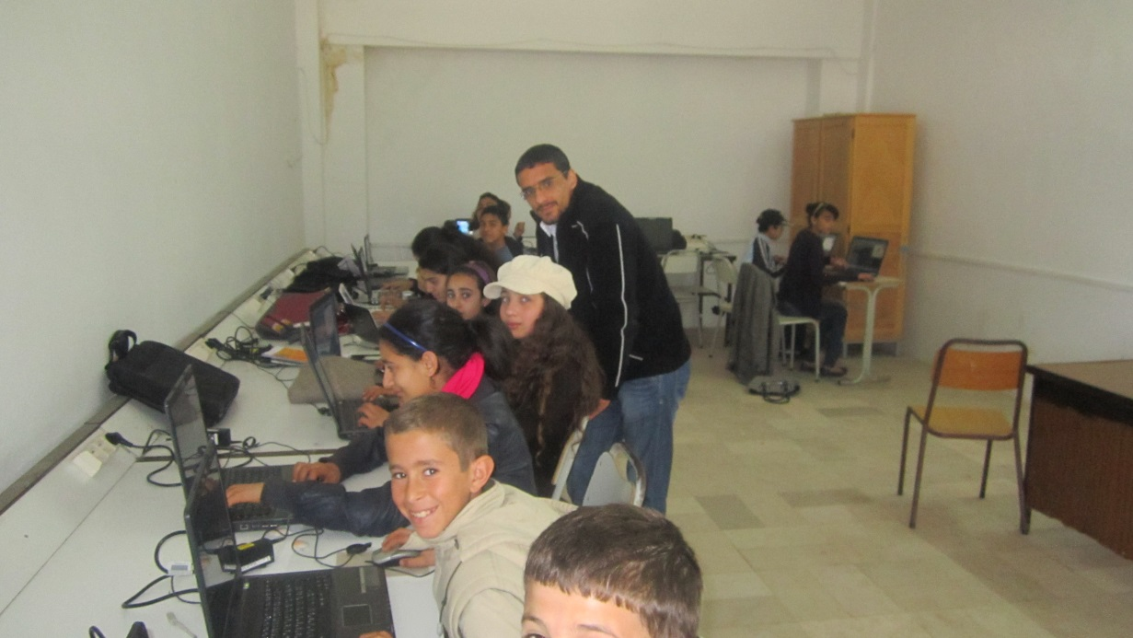
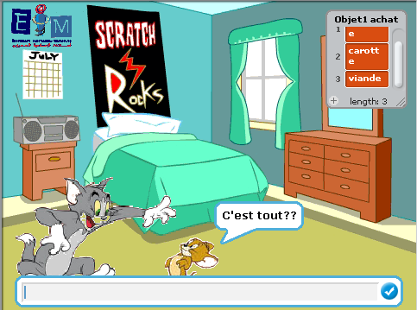
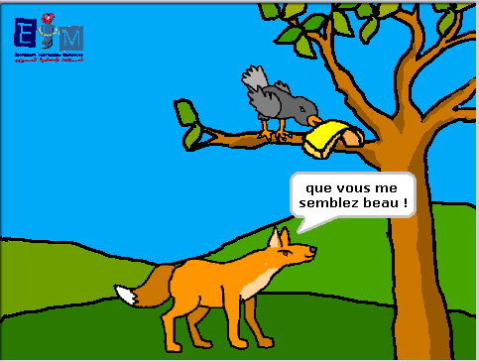
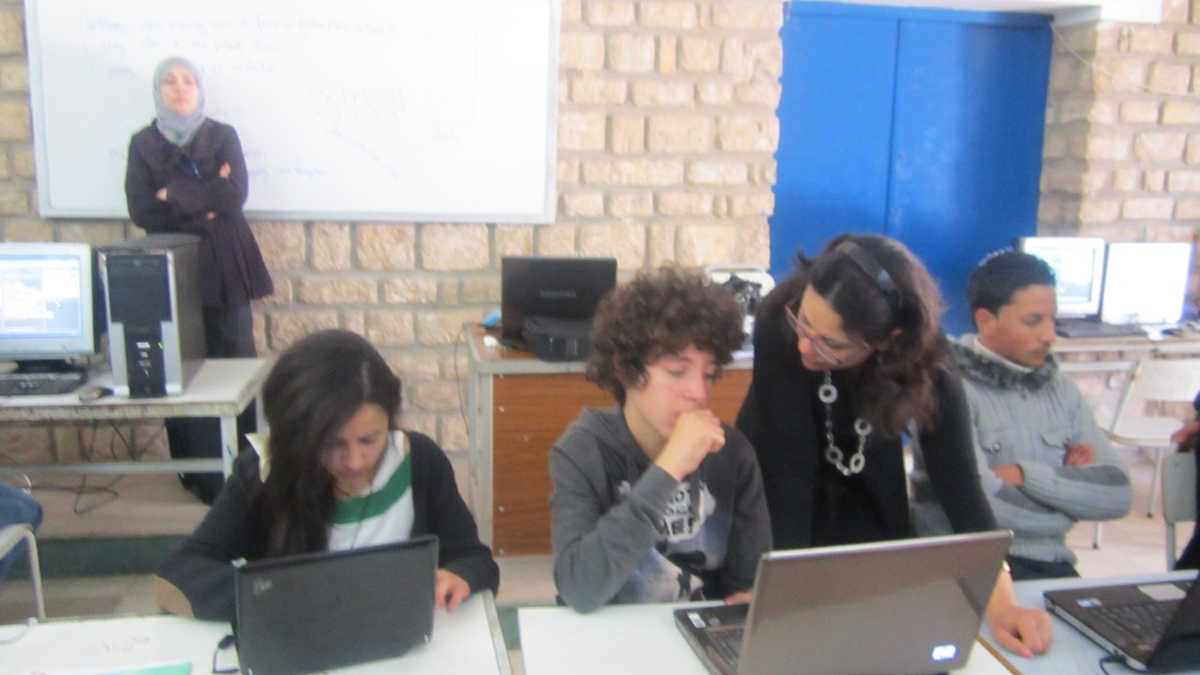
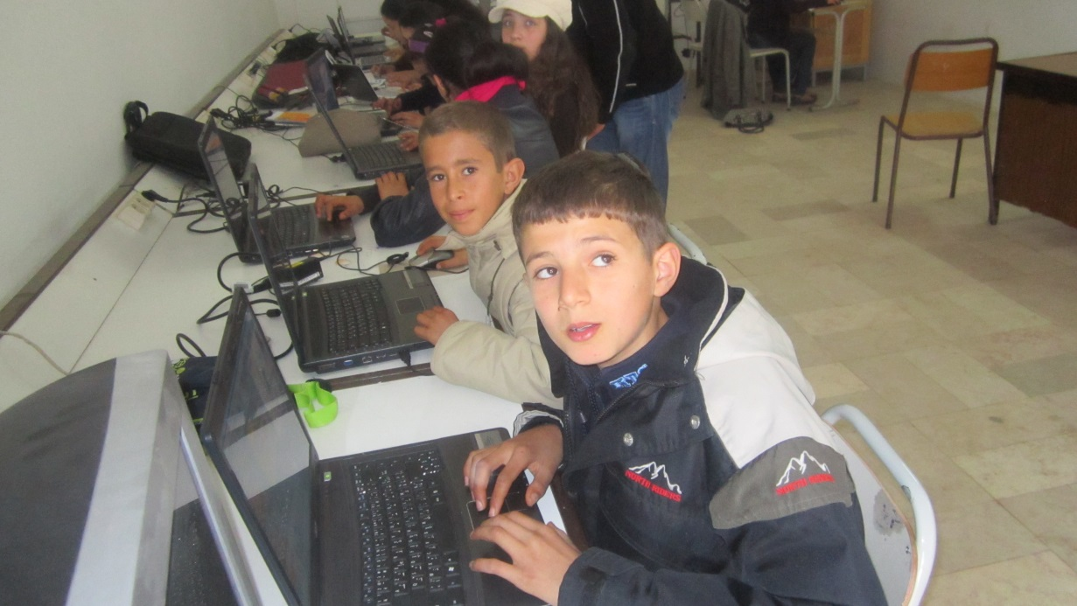
The spring trainning
It started the 19 to 21 of March 2013,
32 participants were present,
What kids created?
The monster and the princess
The fox and the crow
Tom & Jerry
Quiz

Slide 10
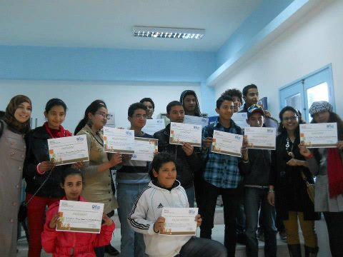
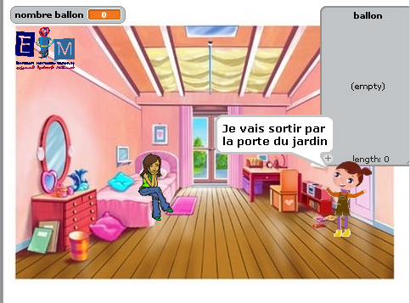
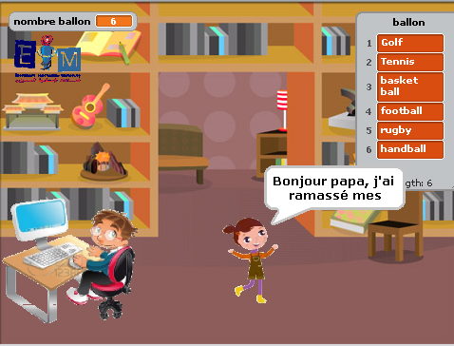
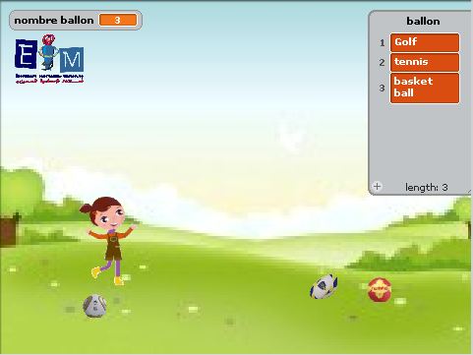
The spring trainning: The end of spring session test
One task composed by three parts

Slide 11
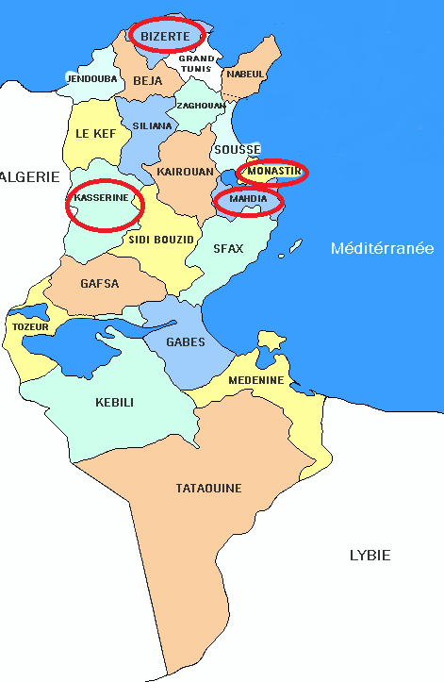
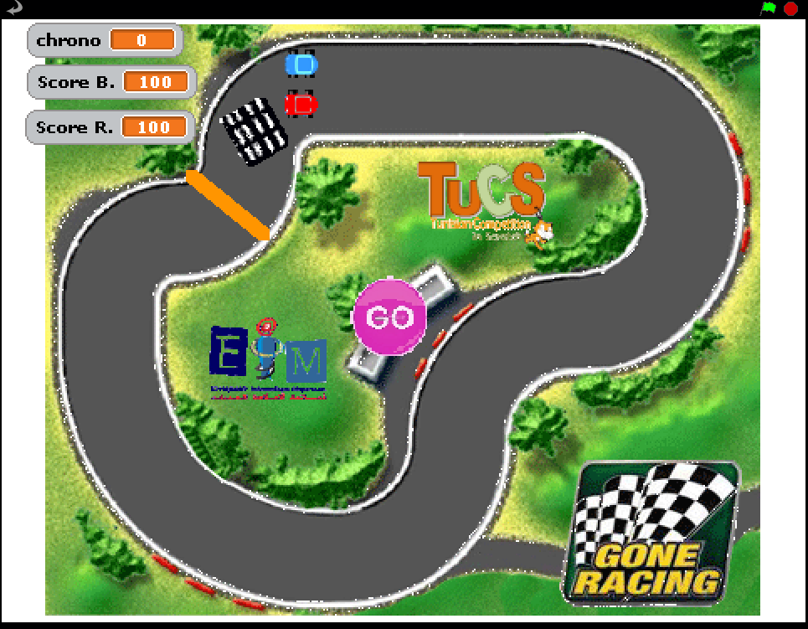
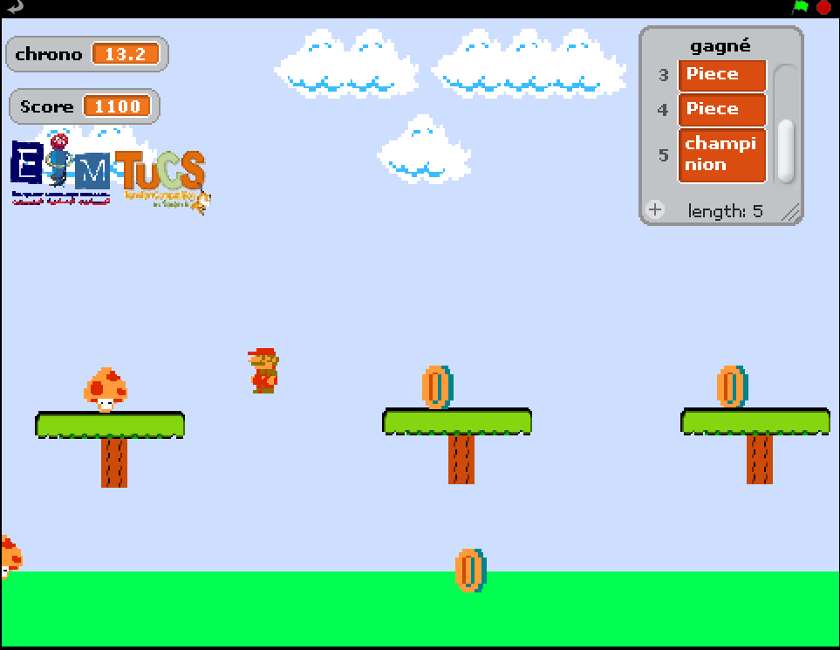
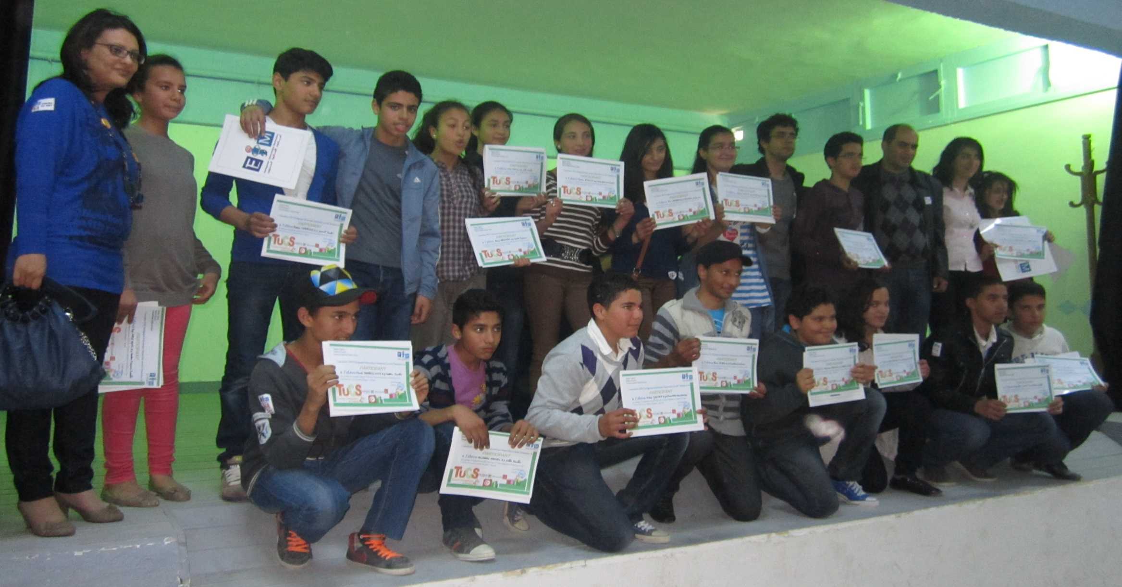
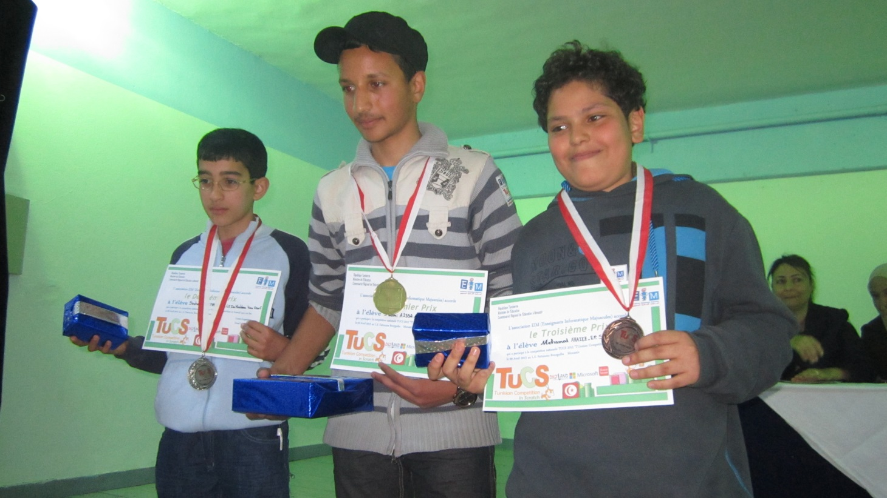
TUCS
The first Tunisian Competition in Scratch was in 9 april 2013,
27 participants from differents cities: Bizerte, Kasserine, Monastir and Mahdia were present.
What kids created?
Racing car game
Mario game

Slide 12
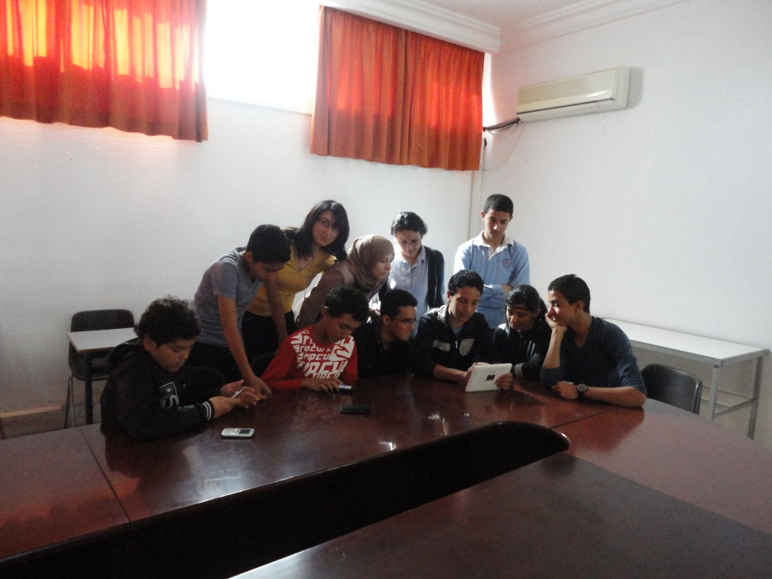
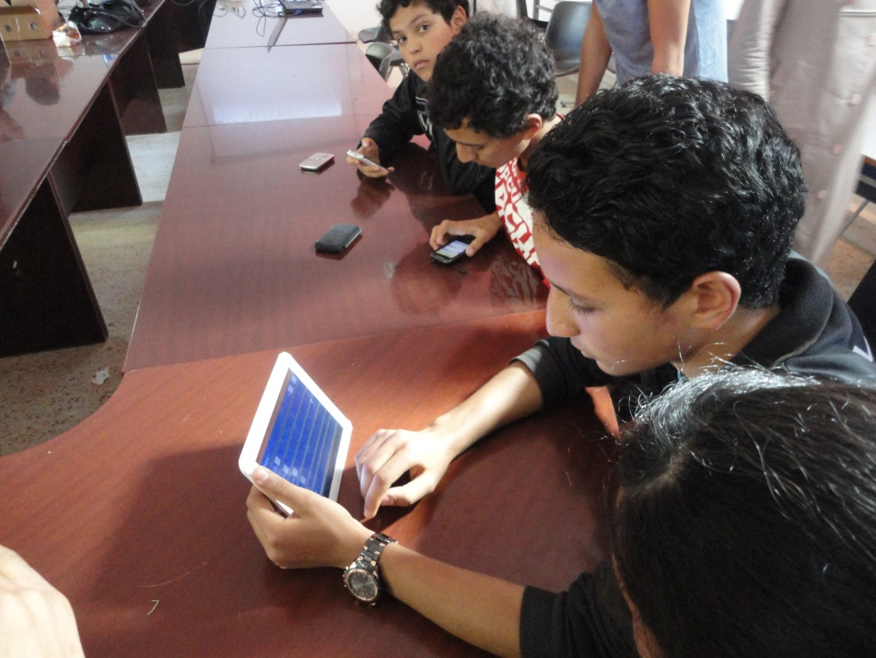
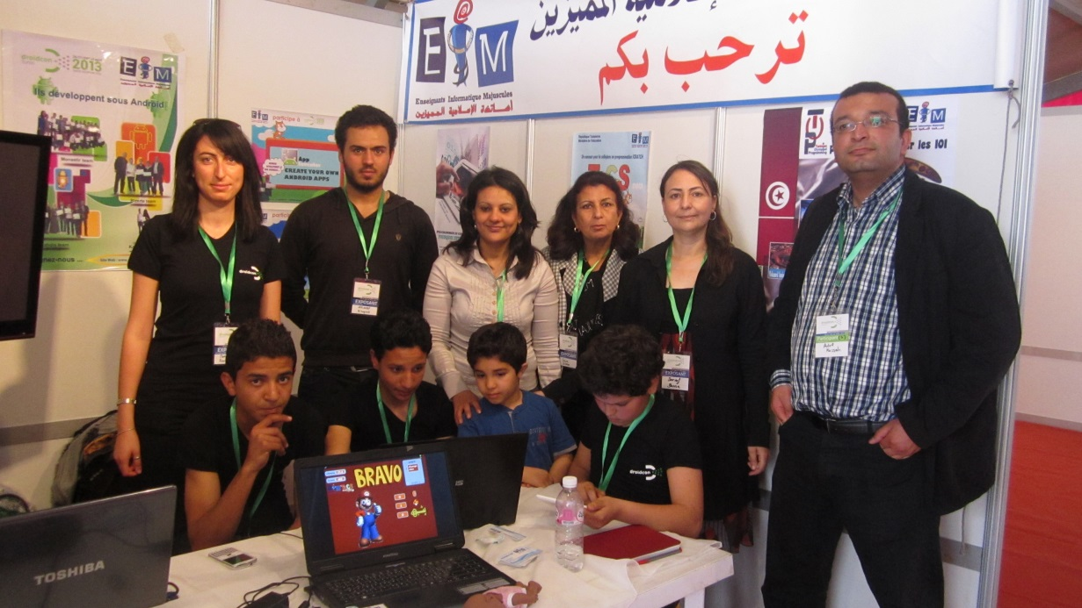
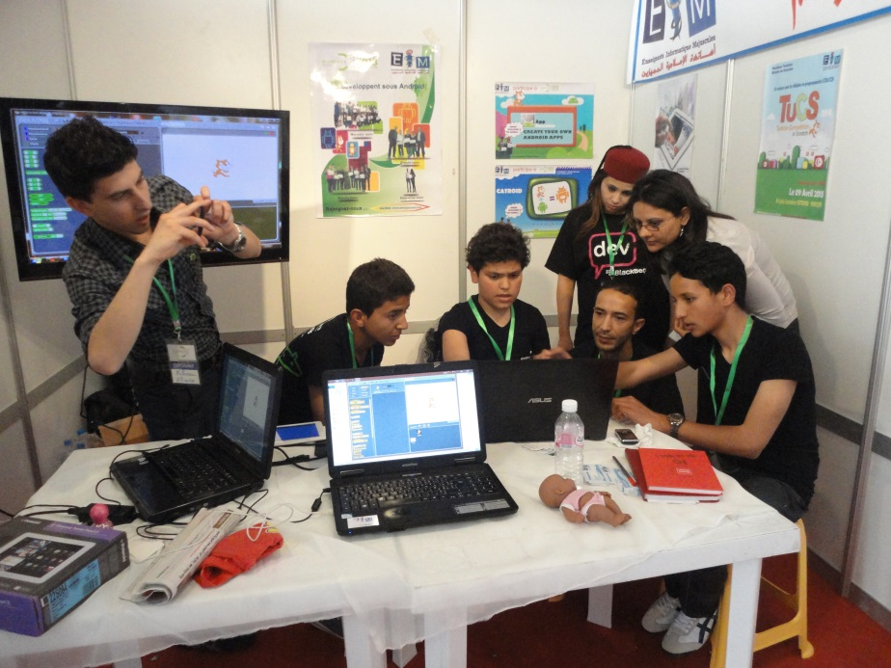
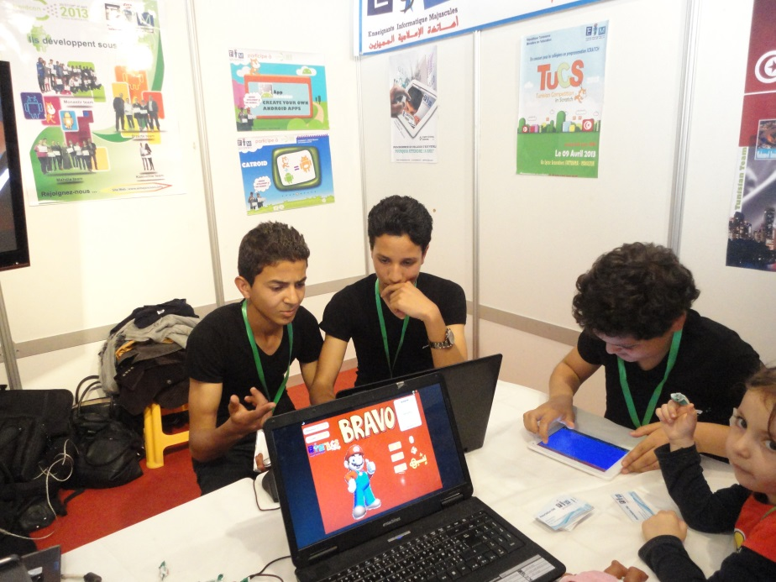
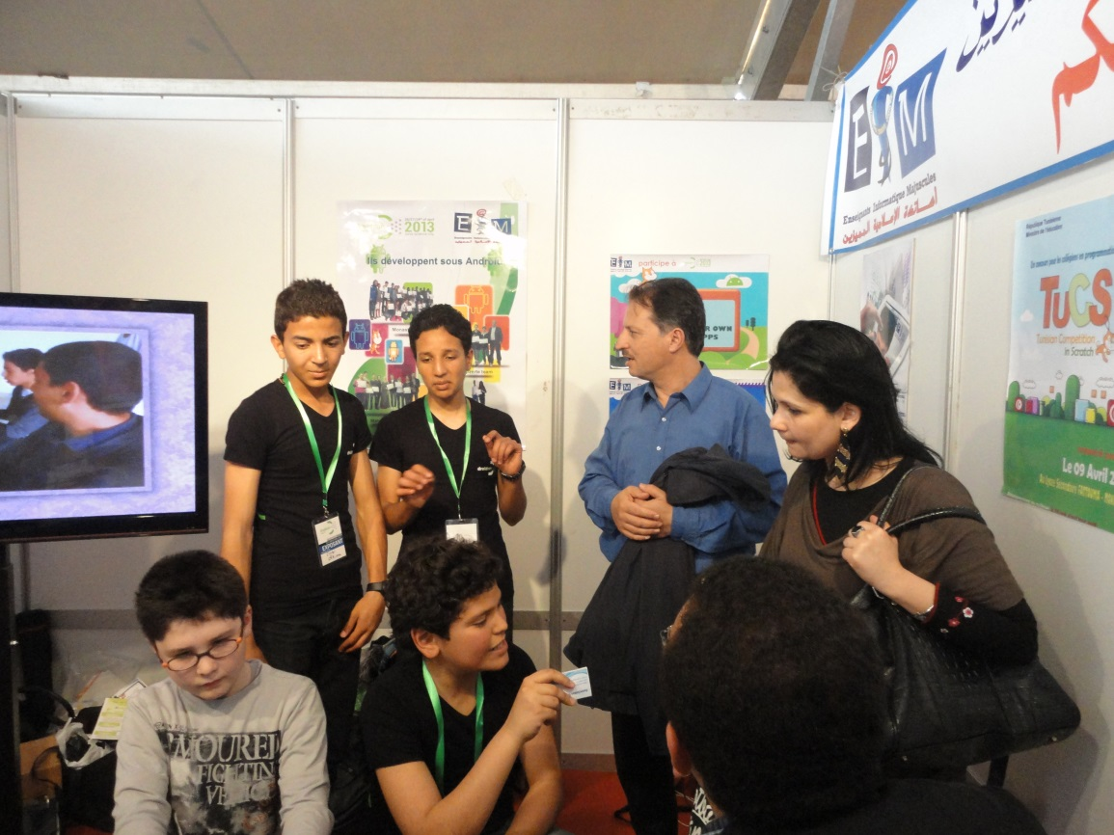
From Scratch to Catroid
The trainning token place in 26 april 2013,
Only the first eleven winers of TUCS participate,
Three of them participate to the show « Droidcon 2013 »
What kids created?
Differents simple games with catroid

Slide 13
Prospects
Generalize the practice of scratch in Tunisia,
Invest in the Catroid,
Training of youth in Arduino,
Propose the organization of an International Olympiad in Scratch IOS,
Tunisia will be honored to host the Scracth conference in two or three years.

Slide 14
Tunisian experience with Scratch
Thanks for your intention
To be continued…

