Slide 1
Improving Student and Teacher Computing Confidence with Scratch
Barbara Ericson
Georgia Institute of Technology
ericson@cc.gatech.edu
http://coweb.cc.gatech.edu/ice-gt/

Slide 2
Who am I?
Director of Computing Outreach for the College of Computing at Georgia Tech
Trying to increase the quantity and quality of secondary computing teachers in Georgia
Trying to increase the quantity and diversity of secondary computing students in Georgia
Member of the AP CS A Development Committee
Responsible for the AP CS A exam
Member of the K-12 Alliance for the National Center for Information Technology (NCWIT)

Slide 3
What does ICE do?
Student Summer Camps
High school camps since 2004
Middle school camps since 2006
4-5th grade camps since 2009
Student afterschool and weekend workshops
YWCA
Girl Scouts
Cool Girls
Teacher Workshops
One-week long summer workshops
One-day workshops during the school year

Slide 4
What else do we do?
Free webinars: see our website
Lending libraries of PicoCrickets, LEGO NXT robots, and Pleo Robots
Competitions
Scratch, Alice, and AP Practice Exam
Help other colleges and universities in Georgia get started running computing summer camps (10 so far)
Provide training and “seed” money

Slide 5
History of ICE and Scratch
We started using Scratch in 2006
At one of our middle school summer camps
We also used PicoCrickets, Alice, and LEGO NXT robots
Gave the kids the ability to choose what they wanted to work on the last day
Most choose Scratch or PicoCrickets
We added Scratch to our afterschool programs and weekend workshops for GirlScouts in 2006
We added Scratch to our teacher workshops in 2008

Slide 6
2009 Summer Camps
1 week of RoboCup Jr., (rising 6+)
1 week of IPRE robots and Media Comp, (rising 9+)
3 weeks of PicoCrickets, Lego robots, and Scratch (rising 4-5th)
1 weeks of LEGO NXT and Alice (rising 6-8th)
1 week of LEGO NXT and Alice (rising 9+)
1 week of Scratch and PicoCrickets (rising 6-8th)

Slide 7
Summer Camp Numbers at GT
Year | 2004 | 2005 | 2006 | 2007 | 2008 | 2009 | Total
# students | 65 | 65 | 90 | 85 | 167 | 177 | 649
# weeks | 2 | 2 | 5 | 5 | 8 | 8 | 30
HS and MS
4-5th added
High School Only

Slide 8
4th-5th grade PicoCrickets/Scratch/LEGO
Statement | Effect size (A) | p
Computers are fun | .69 - medium | .007
Programming is hard | .66 - medium | .055
I am good at computing | .731 - large | .006
I like computing | .723 - large | .008
Notes:
Leech and Onwuegbuzie call for greater use of non parametric statistics, and the American Psychological Association recommends the use of effect sizes when reporting results.

Slide 9
Middle School PicoCricket and Scratch
Statement | Effect size (A) | p
Computers are fun | .667 - medium | .083
I am good at computing | .772 - large | .014

Slide 10
"Seeded" Summer Camps
From 2007-2009 there were 46 “seeded” camps in Georgia. The number of participants in each camp ranged from 6 to 21. We have pre and post survey data for 32 of these camps. There were at least small effect size changes in most camps.
Three camps had statistically significant changes in attitudes: Scratch, PicoCrickets and Scratch, and GameMaker.
Two Alice camps had large effect size changes. There were medium effect size changes in LEGO robots, Alice and LEGO robots, Python, Vex and Alice, and Web Design.

Slide 11
Scratch in afterschool programs
YWCA
Middle school girls and minority majority
Cool Girls
Low income middle school girls and minority majority
Boys and Girls Clubs
Minority majority
Use Scratch, Alice, PicoCricets, LEGO NXT robots, and Pleo robots
YWCA girls said “Scratch was the best thing about the program”

Slide 12
Scratch in Weekend Workshops
Girl Scouts
Mostly middle class girls
Four-hour workshops with a maximum of 60 girls per session
Have had full workshops several times with Scratch and long waiting lists
Last year 100 girls came on a Saturday for Scratch
Cool Girls
Mostly low-income girls
4 hour workshops with about 20-30 girls

Slide 13
Scratch Workshop 1/31/2009

Slide 14
Scratch Workshop 1/31/2009
Notes:
This was a Girl Scout workshop

Slide 15
Girl Scout Workshop Numbers
Year | 05-06 | 06-07 | 07-08 | 08-09 | 09-10 | Total
# workshops | 2 | 4 | 10 | 15 | 12 | 43
# girls | 40 | 80 | 428 | 455 | 361 | 1364

Slide 16
Results with Scratch
Data is from 23 Girl Scout events from 2007-2009. Age range of 7-16. There were 7 LEGO NXT robot workshops, 8 PicoCricket workshops, 4 Scratch, and 4 Alice.
Statement | Crickets | Alice | Scratch
Computing jobs are boring |  | .001 p | .001 p
I am good at computing | .001 p | .001 p | .001 p
Computers are fun | .022 p
I know more than my friends about computers | .003 p

Slide 17
Effect size changes
Type | PicoCrickets | Scratch | Alice | LEGO
# large | 5 | 4 | 5 | 0
# med | 7 | 2 | 3 | 0
# small | 21 | 9 | 5 | 13
# total | 33 | 15 | 13 | 13

Slide 18
Using Scratch with Teachers
In Georgia Computer Science is in the Business and CS department
Anyone with a Business Certificate is in field for computing classes
Even if they have no experience with computing
Keyboarding and Computer Applications courses were moving to middle school
So these teachers needed to learn to teach something else
So we are trying to train them to teach computing classes

Slide 19
Teacher Workshops History
We started with two one-week teacher workshops in 2004
One for each computing course in Georgia
Using Java and Media Computation
Many teachers wanted an easier start
In 2005 we added a Beginning Programming course
Many teachers still needed a lower entry point
In 2007 Georgia revised its computing course
4 courses based on the ACM model curriculum
In 2008 we added Computing in the Modern World
Using CS Unplugged, Scratch, Alice, and LEGO NXT
Higher level of satisfaction with this workshop

Slide 20
Scratch Competition
See http://home.cc.gatech.edu/TeaParty/179
5 elementary school entries
3 middle school entries
44 high school entries
Undergraduate students did the judging
We gave out about $4,000 in prizes

Slide 21
Additional Resources
ICE Distance learning website – tutorials and projects
http://ice-web.cc.gatech.edu/dl
Descriptions of our 4 hour workshops for Girl Scouts
http://coweb.cc.gatech.edu/ice-gt/201
Agenda for our Computing in the Modern World teacher workshop
http://coweb.cc.gatech.edu/ice-gt/1172
Surveys
http://coweb.cc.gatech.edu/ice-gt/1226
Summer camp materials
http://coweb.cc.gatech.edu/ice-gt/1091

Slide 22
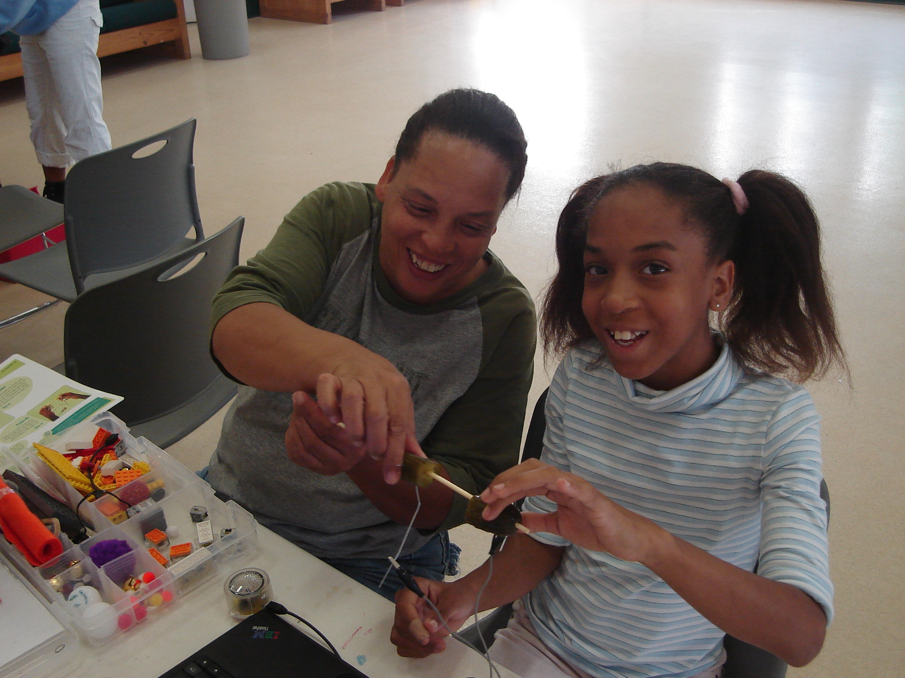
PicoCrickets

Slide 23
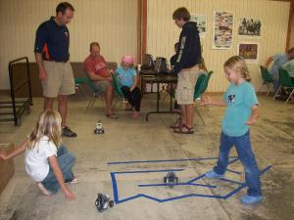
LEGO NXT Robots

Slide 24
Pleo Robots
Notes:
This is a weekend workshop with the Cool Girls.

Slide 25
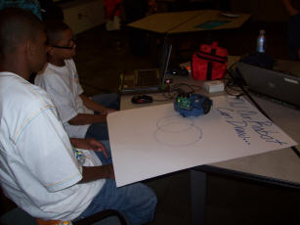
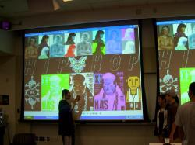
IPRE Robots and Media Comp

