Slide 1
CS4HS CREATIVE COMPUTING
August 8-11, 2012
MIT Media Lab, with support from Google and the National Science Foundation

Slide 2
Wednesday, August 8

Slide 3
What is CS4HS?

Slide 4
What is CS4HS?

Slide 5
What is CS4HS?

Slide 6
What is Creative Computing?

Slide 7
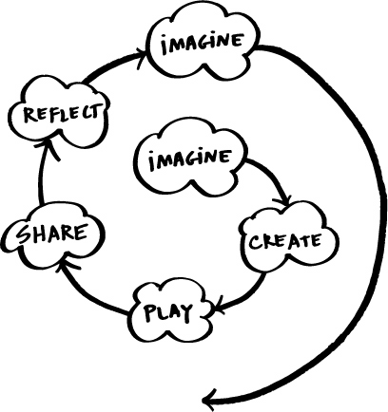

Slide 8
Notes:
demo

Slide 9
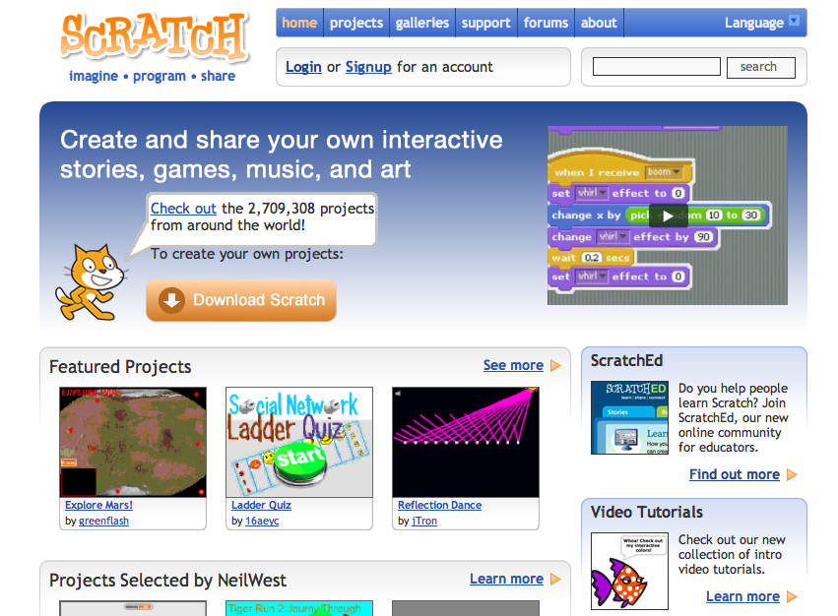

Slide 10
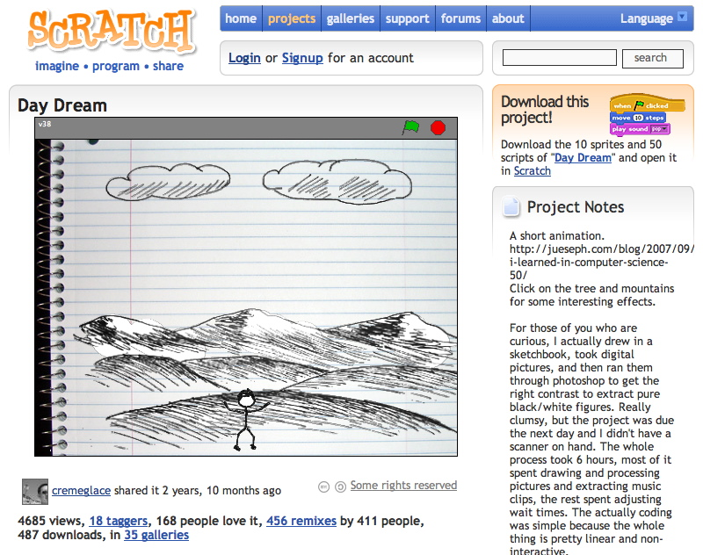

Slide 11
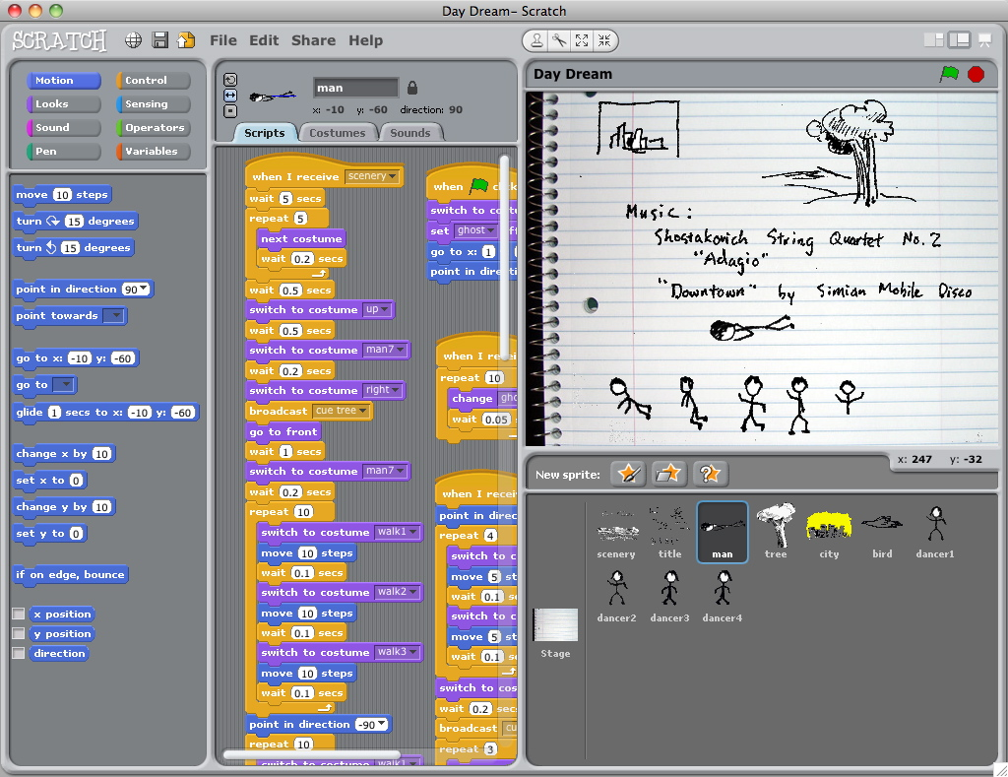

Slide 12
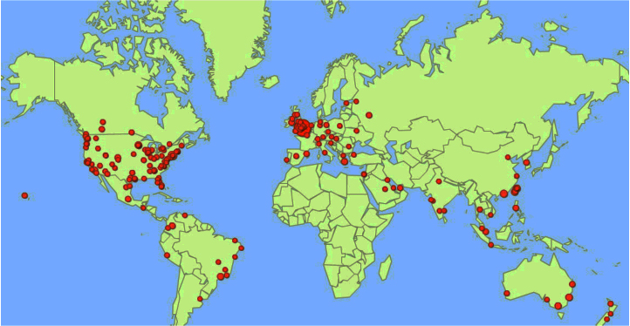

Slide 13
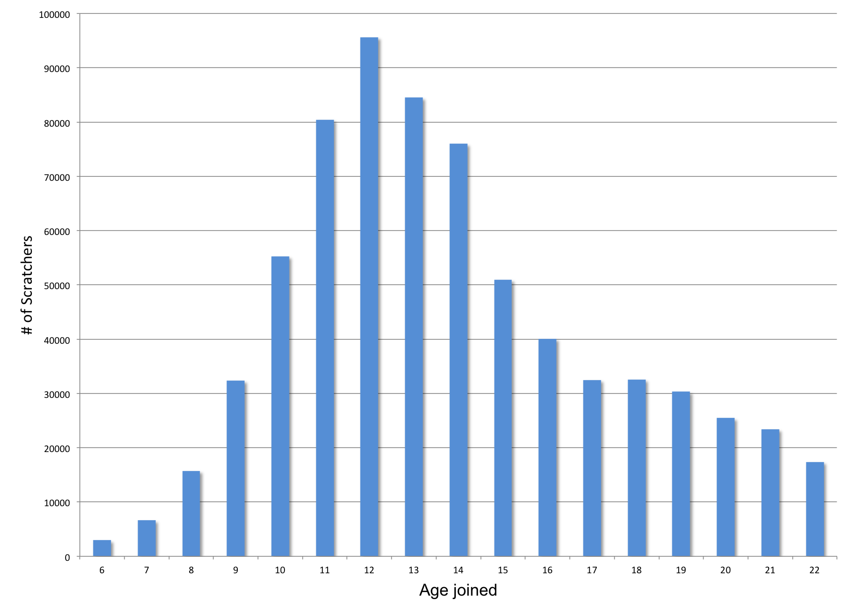
Notes:
The members are mostly between 8 and 16, but there’s a long tail of participation, with adult hobbyists participating in the community.

Slide 14
Example projects

Slide 15
Arts

Slide 18
Humanities

Slide 21
Science

Slide 24
Mathematics

Slide 27
Computer Science

Slide 30
About Me

Slide 31
Resources
Scratch Cards
About Me handout
design journal
Notes:
(handout)

Slide 32
Reflecting on your design process, what worked, what didn’t, what are you learning, what surprised you? Write your thoughts in your design journal.
Reflections

Slide 33
Design Based Learning

Slide 34
Design Based Learning
learning through designing
Notes:
(handout)

Slide 35
Design Based Learning
learning through designing
learning through personalizing
Notes:
(handout)

Slide 36
Design Based Learning
learning through designing
learning through personalizing
learning through collaborating
Notes:
(handout)

Slide 37
Design Based Learning
learning through designing
learning through personalizing
learning through collaborating
learning through reflecting
Notes:
(handout)

Slide 38
Workshop Goals

Slide 39
Workshop Goals
understand creative computing

Slide 40
Workshop Goals
understand creative computing
experience design based learning

Slide 41
Workshop Goals
understand creative computing
experience design based learning
develop computational thinking

Slide 42
Workshop Goals
understand creative computing
experience design based learning
develop computational thinking
connect with other educators

Slide 43
Workshop Activities

Slide 44
Workshop Activities
imagine

Slide 45
Workshop Activities
imagine
program

Slide 46
Workshop Activities
imagine
program
share

Slide 47
Workshop Activities
imagine
program
share
reflect

Slide 48
Notes:
Schedule overview (handout)

Slide 49
Optional Homework
continue working on About Me projects

Slide 50
Optional Homework
continue working on About Me projects
upload your project to the Scratch website

Slide 51
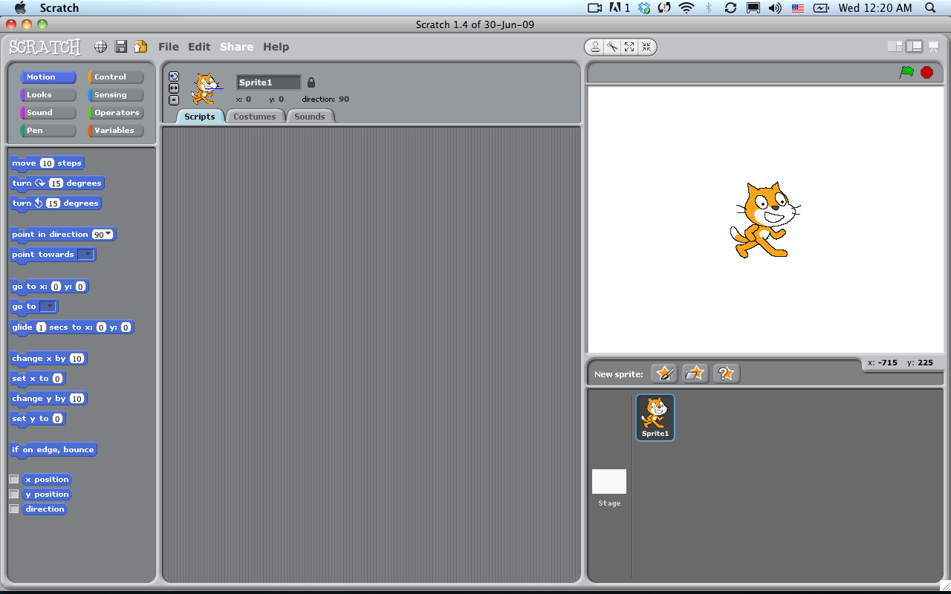

Slide 52
Optional Homework
continue working on About Me projects
upload your project to the Scratch website

Slide 53
Optional Homework
continue working on About Me projects
upload your project to the Scratch website
add your project to the Creative Computing gallery:
http://scratch.mit.edu/galleries/view/173859

Slide 54
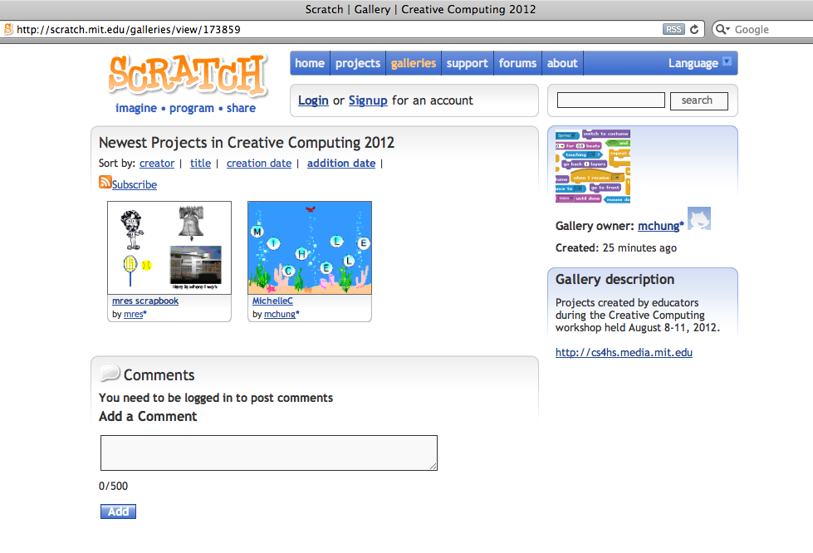

Slide 55
Goodnight!

Slide 56
Thursday, August 9

Slide 57
say hello to your new neighbors
Morning Checklist
check out other About Me projects in the
Creative Computing gallery:
http://scratch.mit.edu/galleries/view/173859
leave comments for 2 other projects

Slide 58
What is your name?
Getting to Know You
What is one of your goals for the workshop?

Slide 59
Arts

Slide 60
Arts
programmed to dance

Slide 61
Arts
programmed to dance
dance party projects

Slide 62
Arts
programmed to dance
dance party projects
work of art

Slide 63
Art examples

Slide 69
What are students learning as they engage with a tool like Scratch?
Notes:
(handout)

Slide 70
Computational Thinking

Slide 71
Computational Thinking
computational concepts

Slide 72
Computational Thinking
computational concepts
sequences
parallelism
conditionals
variables
loops
events
operators
lists

Slide 73
Computational Thinking
computational concepts
computational practices
sequences
parallelism
conditionals
variables
loops
events
operators
lists

Slide 74
Computational Thinking
computational concepts
computational practices
sequences
parallelism
conditionals
variables
loops
events
operators
lists
being incremental/iterative
testing/debugging
reusing/remixing
abstracting/modularizing

Slide 75
Computational Thinking
computational concepts
computational practices
computational perspectives
sequences
parallelism
conditionals
variables
loops
events
operators
lists
being incremental/iterative
testing/debugging
reusing/remixing
abstracting/modularizing

Slide 76
Computational Thinking
computational concepts
computational practices
computational perspectives
sequences
parallelism
conditionals
variables
loops
events
operators
lists
being incremental/iterative
testing/debugging
reusing/remixing
abstracting/modularizing
expressing
connecting
questioning

Slide 77
“I love Scratch. Wait, let me rephrase that –
Scratch is my life. I have made many projects.
Now I have what I call a ‘programmer’s mind’.
That is where I think about how anything is programmed.
This has gone from toasters, car electrical systems,
and soooo much more.”

Slide 78
Afternoon Checklist
upload your dance parties and works of art to the
gallery: http://scratch.mit.edu/galleries/view/173859
in your design journal, jot down 3 art-themed project ideas for either you or your students
share one project idea on the Reflection Wall

Slide 79
Stories

Slide 80
Stories
six word stories

Slide 81
Stories
six word stories
creature construction

Slide 82
Stories
six word stories
creature construction
pass-it-on

Slide 83
Stories
six word stories
creature construction
pass-it-on
performing scripts

Slide 84
Stories
six word stories
creature construction
pass-it-on
performing scripts
story time

Slide 85
Story examples

Slide 91
What have you noticed about other people’s projects and processes? How does this relate to design-based learning and computational thinking?
Reflections
Write your thoughts in your design journal.

Slide 92
Goodnight!

Slide 93
Friday, August 10

Slide 94
Morning Checklist
in your design journal, jot down 3 possible
storytelling project ideas for you or your students
share one story project idea on the Reflection Wall
revisit your pink goals sticky on the Reflection Wall. How is your progress? Have you reached your goals? Have they changed? Have new goals emerged? Write your current goals progress on a yellow post-it and place it next to your original goals.

Slide 95
What is your name?
Getting to Know You
What is one take away from yesterday’s activities?

Slide 96
Games

Slide 97
Games
debugging

Slide 98
Games
debugging
a-maze-ing projects

Slide 99
Games
debugging
a-maze-ing projects
let’s play

Slide 100
Games examples

Slide 101
Notes:
Two-player tennis game created by 16 year old and his father

Slide 102
Notes:
Haiku or die

Slide 106
Notes:
Hungry Bat game: http://scratch.mit.edu/projects/Lightnin/1659457

Slide 107
Notes:
Fish Chomp – Can be found in the Scratch example projects folder

Slide 108
Reflections
What challenges or questions do you have?
Post them on the Reflection Wall.
Revisit your pink goals sticky on the Reflection Wall. How is your progress? Have you reached your goals? Have they changed? Have new goals emerged? Write your current goals progress on a yellow post-it and place it next to your original goals.

Slide 109
Afternoon Checklist
upload your game projects to the gallery:
http://scratch.mit.edu/galleries/view/173859
in your design journal, jot down 3 game project ideas
share one project idea on the Reflection Wall
sign up for dinner excursions

Slide 110
Independent Projects

Slide 111
Independent Projects
breakout sessions

Slide 112
Independent Projects
breakout sessions
project planning

Slide 113
Independent Projects
breakout sessions
project planning
independent project time

Slide 114
How might you incorporate ideas from the workshop in your practice? What are some of the barriers and challenges to doing this?
Reflections
Write your thoughts in your design journal.

Slide 115
Design-Based Learning
Notes:
(handout)

Slide 116
Design-Based Learning
learning through designing
learning through personalizing
learning through collaborating
learning through reflecting
Notes:
(handout)

Slide 117
Design-Based Learning
learning through designing
learning through personalizing
learning through collaborating
learning through reflecting
Computational Thinking
Notes:
(handout)

Slide 118
Design-Based Learning
learning through designing
learning through personalizing
learning through collaborating
learning through reflecting
Computational Thinking
computational concepts
computational practices
computational perspectives
Notes:
(handout)

Slide 119
Goodnight!

Slide 120
Saturday, August 11

Slide 121
Morning Checklist
post one challenge or question you have on the Reflection Wall
in your design journal, jot down 3 possible
game project ideas for you or your students
share one game project idea on the Reflection Wall

Slide 122
What is your name?
Getting to Know You
What is one challenge or question you have?

Slide 123
What is your image of creative computing now? How has it evolved over the workshop?
Final Reflection
How do you plan to take what you’ve learned
at the workshop back to your teaching practice?

Slide 124
THANK YOU!

