Slide 1
Let’s Play!
Lesson 1

Slide 2
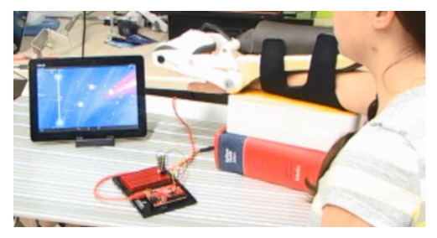
Let’s Play!
Involves computer games, engineering, art, design, and science!
Learn to make video games in Scratch
Make those games dynamic or adjustable
Customize the game so it can be used in Physical therapy
Help someone who has a condition, such as a spinal cord injury
Make an art project

Slide 3
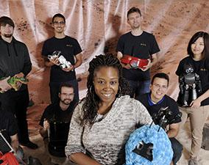
Let’s Play!
Inspired by the HumAnS (Human-Automation Systems) Lab at Georgia Tech
PHD researcher Brittney English is developing a way to help stroke patients complete physical therapy exercises using video games.
Emulate Brittney’s university level research
Experience what it is like to be a computer scientist, game designer, industrial engineer, and a graphic designer, among other careers.

Slide 4
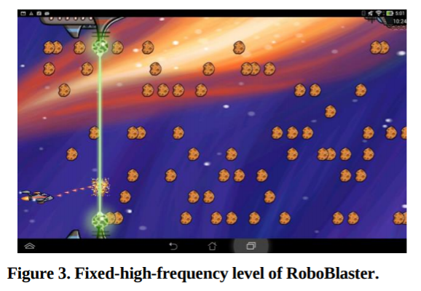
Let’s Play!
You will research an impairment that would require physical therapy exercise
Use Scratch to design an interactive dynamic game that would aid in the exercise
Incorporate the Makey Makey as a game controller

Slide 5
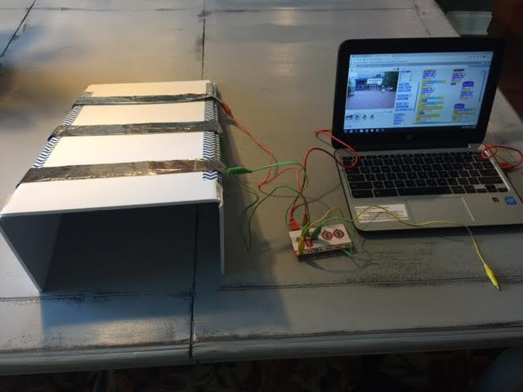
A Game of Cat and Mouse
https://scratch.mit.edu/projects/115651118/
How does it work?
Write pseudocode
Pseudo = trying to be, pretending
Ex: Pseudonym

Slide 6
A Game of Cat and Mouse
Let’s watch a video to learn exactly how A Game of Cat and Mouse works.
Complete the handout and follow the video to create the game yourself
https://vimeo.com/173561009

Slide 7
What is a dynamic game?
https://vimeo.com/173572280

Slide 8
Pseudocode Dynamic Game Flowchart example
Mouse caught cat?
Yes!
+1 point
Cat gets smaller
No.
0 points.
Cat gets bigger
Mouse caught cat?
Mouse caught cat?
Yes!
+1 point
Cat gets smaller
No.
0 points.
Cat gets bigger
Yes!
+1 point
Cat gets smaller
No.
0 points.
Cat gets bigger

Slide 9
Recap!
What is pseudocode?
What is a dynamic game?

Slide 10
Lesson 3
Physical Therapy

Slide 11
Warm Up
In the last webquest, you learned about the how the nervous system works. But what happens if there is an injury or damage to a part of the nervous system? Think about the role of the nervous system and how can life be impacted by damage to the nervous system, such as through a spinal cord injury or stroke.

Slide 12
Nervous System Injuries
Wide variety of impacts, any age
Each injury is unique.
Means that the ability of of the nervous system to relay messages around the body in is impaired some way.
Spinal Cord Injuries: impair movement and affect the ability to walk or move limbs
Brain injuries: impact speech, memory, movement (like Stroke)
Nerve injuries: impact senses.
Other common examples: traumatic brain injuries (like from a collision accident), concussions, etc.

Slide 13
Do you think….
Is it possible to recover from an injury to part of the nervous system? Can anything be done for someone who has damage to the nervous system? Explain.

Slide 14
Recovery can be difficult!
Might not recover to the same ability level
There is hope and there are many strategies
It was believed that neurons were formed only in early human development and that adult brains could not create new neurons, which makes recovering from brain injuries difficult.
However, scientists have recently discovered that there are certain areas of the adult brain that can still create neurons; this process is called neurogenesis.
One area of neuroscience that scientists are researching involves injecting proteins in certain parts of the brain to stimulate the growth of new neurons to help repair damaged areas. It is still a very new area of exploration. http://ed.ted.com/lessons/could-your-brain-repair-itself-ralitsa-petrova

Slide 15
Not sure about brain surgery?
Hooray for physical therapy!
Physical therapy is another way to help people recover.
Goal is to help regain strength, improve flexibility, coordination, etc.
Variety of treatments, such as cardio exercise, games, massage, stretching, weight lifting, etc.
The idea is to help neurons fire and to grow neural pathways to help regain movement
Have you or someone you know ever had to do physical therapy? Describe the experience. (Was it fun? Hard? Frustrating? Did it work?) If you are not sure what PT is, write what you think it means.

Slide 16
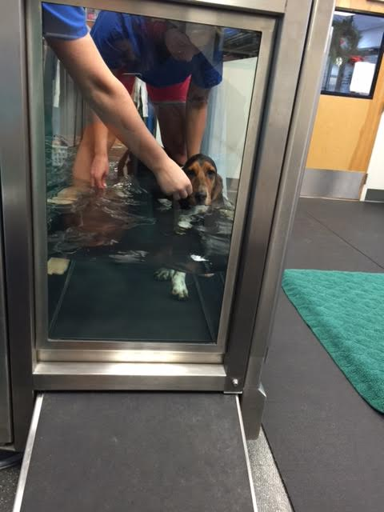
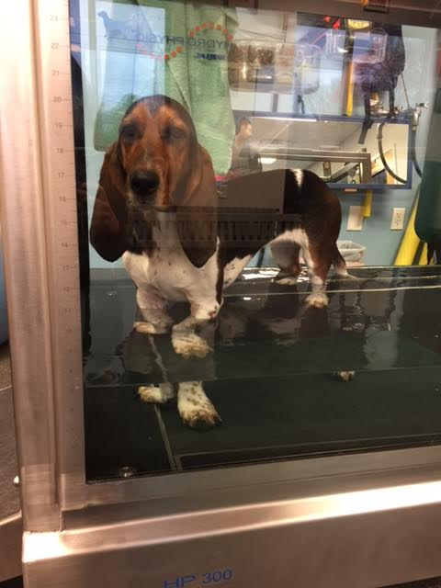
Animals can do therapy too!

Slide 17
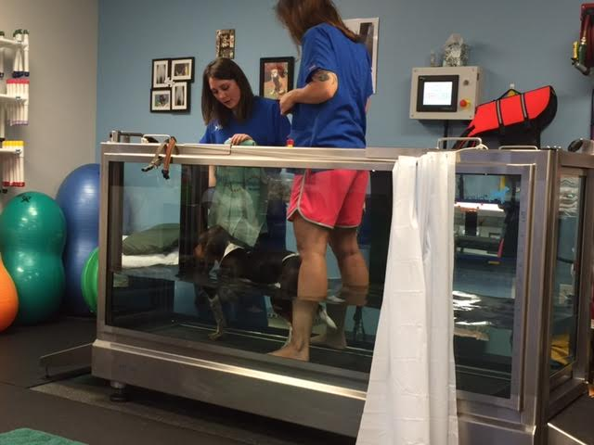
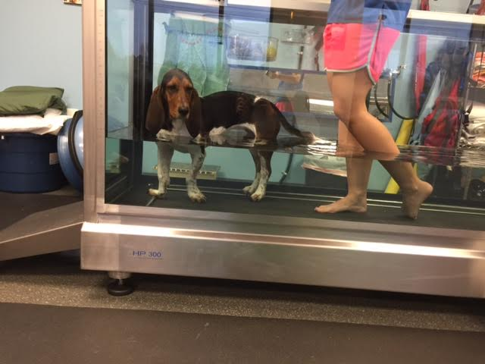
Animals can do therapy too!

Slide 18
PT is hard work!
Physical therapy is physically challenging!
Maintaining motivation is also challenging!
Therapy can be mentally challenging!
Finding ways to keep patients engaged in therapy exercises is key to helping them recover and continue with the program. This is where engineering comes in!

Slide 19
More PT Examples
What is physical therapy like for people of different ages? It’s very different based on the age of the patients and injury type.
This clip is about pediatric physical therapy, which is for children. https://www.youtube.com/watch?v=bn9Ibg7zCHw
This clip is about using video games during therapy.
https://www.youtube.com/watch?v=cBb4XIb5PCk

Slide 20
Project Walk Atlanta/NextStep Atlanta
The next video was made at Project Walk, which is located in nearby Alpharetta. They specialized in helping people with spinal cord injuries. https://vimeo.com/174958783
Project Walk is now called Next Step Atlanta Paralysis Recovery
How do you think engineering is involved in a facility like Next Step Atlanta?

Slide 21
Recap
You’ve learned about the nervous system
You’ve learned techniques to help people with injuries to the nervous system
Solutions were found by scientists, researchers, and engineers
One hurdle physical therapy is patient motivation
Today, you’ve seen many examples of therapy solutions. What is the role of scientists and engineers as it relates to creating those solutions? What is the role of artists or designers in creating therapy solutions?

Slide 22
Recap
You are going to be an engineer who designs a solution to aid with physical therapy and maintaining client motivation. You will create a therapy based game and controller that could be used by a person who has an injury to the nervous system to help them recover from the injury. You will also apply your knowledge of dynamic video games when creating a therapy game. What you will create can have real implications and impact!

Slide 23
Lesson 4
Project Motivation/Inspiration

Slide 24
You are an engineer! You are a problem solver!
You are going to be an engineer who designs a solution to aid with physical therapy and maintaining client motivation.
You will create a therapy based game and controller that could be used by a person who has an injury to the nervous system to help them recover from the injury.
Your game will also be dynamic in the way that it is balanced to help the player maintain a satisfactory level of challenge.
Before you get started, let’s explore some background information about the project.

Slide 25
Project inspiration
HumAnS (Human-Automation Systems) Lab at Georgia Tech
Dr. Ayanna Howard and PHD researcher Brittney English
Developing a way to encourage stroke patients complete physical therapy exercises using video games
Video of Brittney explaining her project: https://vimeo.com/194162353 (Password: Ryko)

Slide 26
Project motivation
A stroke happens when blood flow to a part of the brain is blocked. This causes the brain to lose oxygen and cells in that area can die.
Strokes can have many, but varied, devastating side effects. The effects of a stroke depend on the location of the blockage and the severity, but some examples of impacts include memory loss, paralysis, etc.
Brittney is researching how to use robotics combined with therapy video games to help stroke patients
Stroke patients often need physical therapy to help them regain bodily functions

Slide 27
Project motivation
Often stroke patients need to rehabilitate the movement of their wrists and hands.
Having proper wrist/hand motion is important in maintaining quality of life and independence.
People who have lost functionality of those parts cannot easily provide personal care for themselves and might need assistance with daily events like bathing or going to the restroom.
As a result, the patients lose privacy when they need assistance with personal care.

Slide 28
Project motivation
Patients do not always enjoy participating in physical therapy
Results in low morale and slower recovery time
Britney hypothesizes that if dynamic games are used in therapy, then patients will engage longer in the exercises and stay motivated, which will improve patient outcome
Additionally, the adaptability allows the game to have a longer life since it can grow with the player and be used multiple times.

Slide 29
Strokes
Affect over 795,000 Americans per year
While most strokes occur in people over age 65, up to 15% of strokes occur in people under 45, which can include young people.
Brittney’s research is important because it has the potential to help a wide range of people who are affected by stroke and even their caregivers.
It could even be used by patients with similar other conditions or injuries.

Slide 30
Pilot study
Brittney conducted a pilot study. A pilot study is a small scale experiment that is conducted early on to do quick research prior to further project development.
Below is the robotic wrist system that is connected to a game on a tablet via bluetooth. Participants put their hand in the robotic arm, which is connected to a microcontroller (a small computer brain). The robotic arm contains wrist sensors which measure the angle of the wrist in real time thus allowing the sensor to detect and report movement.

Slide 31
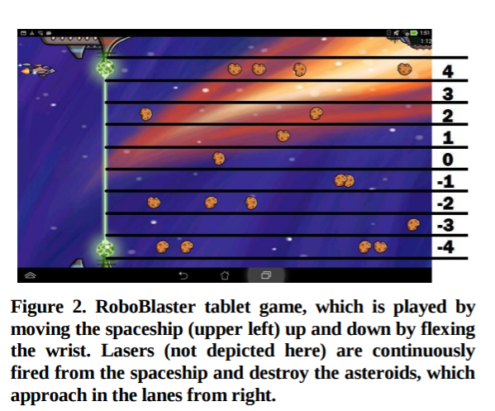
Pilot study: RoboBlaster
Earn points by blasting asteroids
Flexing wrist up or down in the direction of asteroids
3 versions of the game:
Version 1: High frequency fixed game
Plethora of asteroids, not possible to hit them all
Launched every 0.3 seconds
Version 2: Low frequency fixed game
Underwhelming number of asteroids, spread out so it was easy to blast them all
Launched every 3 seconds

Slide 32
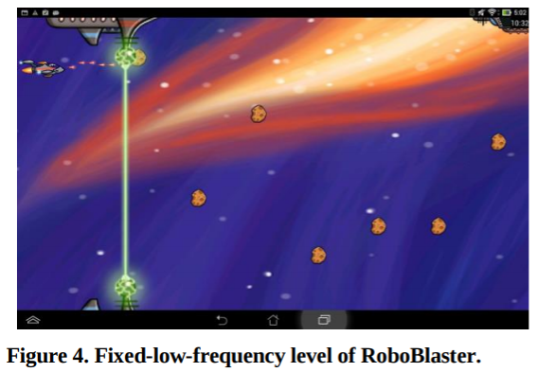
Version 1 and 2

Slide 33
Make RoboBlaster dynamic!
What ways could you make RoboBlaster dynamic?

Slide 34
Version 3
Brittney created an adaptive (dynamic) level in which the asteroids were programmed to ensure a 50% accuracy throughout the game. This version changed the frequency of the asteroids based on participant performance in real time.

Slide 35
STEAM
Brittney’s research is a great example of how engineers solve problems and can improve the human condition. It is multifaceted and shows how engineering is a field that relies heavily on all STEAM areas. For Brittney’s research, she needs to know the science behind physical therapy and strokes. She needs to know how to program the robotic wrist and video games. She needs to know how to analyze results of the game play with statistics to ensure that patients are making progress. She needs to know how to make the games visually and functionally appealing.

Slide 36
STEAM
Brittney believes that art is a key component in her project because the graphics, colors, character design, music, and theme all need to engage the user. People will not want to play the game if it doesn’t have artistic appeal, no matter how dynamic it is!
Additionally, this project requires Brittney to collaborate with a variety of other people, including Dr. Howard, graphic designers, programmers, physical therapists, stroke researchers, other engineers, etc. Now it’s your turn to do the same using Scratch and Makey Makey.

Slide 37
Adaptive PT example
Goal: Pet Ladybird by leaning forward
Each time she gets pet, she moves farther away on the screen.
Designed for someone with a spinal cord injury who is practicing the motion of leaning forward.
Leaning forward is the first step in the process of getting up from a seated position, such as from a wheelchair.
Adaptive because Ladybird only moves farther back on the screen once she has been pet up close.

Slide 38
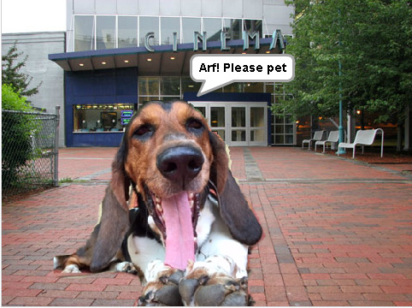
Adaptive PT example
The game on Scratch: https://scratch.mit.edu/projects/113651960/
Password: Ryko
Game demonstration: https://vimeo.com/194165914

Slide 39
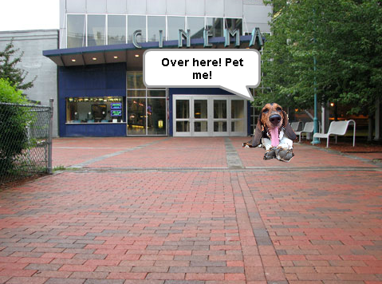
Adaptive PT example
When the dog is closest on the screen, hit the closest target on the wedge.
When the dog moves to the middle of the screen, hit the middle target.
When the dog moves to the farthest point on the screen, hit the farthest target.
The farther the dog, the farther the reach.

Slide 40
Using the Makey Makey
the controllers in these examples are not traditional handheld, rectangular boxes with buttons.
In Brittney’s game, the controller was a computer chip attached to a device that connected to the wrist. Moving the wrist up and down then controlled movement on the screen.
In the dog game, the controller was a wedge with strips of foil on it that were spaced out at equal intervals.
Touching different foil strips changed what happened the in game.

Slide 41
Using the Makey Makey
When you create your therapy game, the game controller you will design with the Makey Makey in actuality will be more like a touchpad, like in the last example. Maybe your controller is a pad that you step on. Maybe it’s a basketball hoop with a switch that gets activated when a ball goes through. Maybe it’s a set of tweezers that activate the circuit when the ends touch. When it comes time to brainstorm ideas, don’t be limited by the word controller; think more along the lines of it being a touch pad or switch.

Slide 42
Recap
How are the example games you’ve seen today dynamic?
How can you incorporate art in your project and why should you?
An engineer is a problem solver. What problem are you solving by making a therapy game?
What are the potential societal impacts of this engineering project?

Slide 43
Lesson 5
Design Thinking

Slide 44
Step 1: Select a scenario
Find a group
Choose one of 4 scenarios
Scenarios indicate the age and injury of the person that you will use as inspiration for your game design
Scenarios guide your human-centered design process (which you will learn about shortly).
Scenarios represent fictional people, but you can use these personas to help you make decisions related to the game design and function.

Slide 45
Scenario briefs
Please read the scenario handout for more details. Here’s an overview:
Scenario 1: Mia is a 6 year old who had an accident that resulted in a spinal cord injury. She is completing physical therapy to regain the use of her legs.
Scenario 2: Mary is an older adult who had a stroke. She is completing physical therapy to regain the use of her right hand.
Scenario 3: Bennett is preteen who had an accident that resulted in a spinal cord injury. He is completing physical therapy to regain the use of his arms.
Scenario 4: Brian is a young adult who had a stroke. He is completing physical therapy to regain the use of his fingers.

Slide 46
Design Thinking
The reason you were given scenarios was to help you use design thinking.
Let’s apply design thinking to our therapy games!
Design thinking is a way of approaching a problem and engineering solutions.
It uses a human-centered angle to help create innovations that are meaningful and useful.

Slide 47
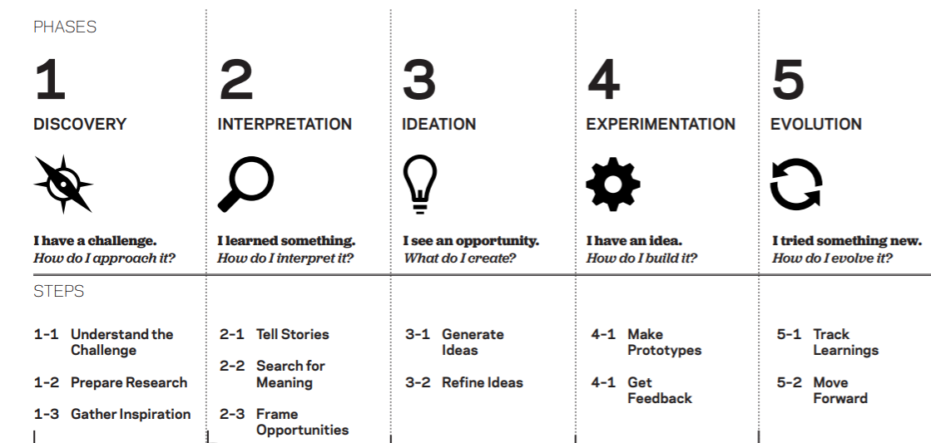
Design Thinking
Design thinking is similar to the engineering design process that engineers follow when developing solutions, except it uses a more personal approach.
This methodology was created by a renowned organization called IDEO, which helps companies with design projects and is a leader in design techniques.

Slide 48
© 2012 IDEO LLC. All rights reserved. http:// designthinkingforeducators.com/
(This diagram is borrowed from the Design Thinking for Educators toolkit, which is created by IDEO.)

Slide 49
Design thinking
Purpose is to delve into the people who will eventually use the product
Need to carefully consider where and how it will be used when making a design.
This is called human-centered design.

Slide 50
Human Centered Design with Design Thinking
Say you are an engineer and your job is to create a new type door knob. Your task is to make a mechanical device that can open and close a door. It will probably have a latch, a lock, a handle, etc. The design will be done when it’s been tested to show that it works, right?

Slide 51
Human Centered Design with Design Thinking
Maybe not. Just because you have created a product that is functional, doesn’t necessarily make it the best design.
While the new door knob you created might have filled the requirements of opening and closing a door, what are other considerations that could further improve the design?

Slide 52
Design Thinking Phase 1: Discovery
Gather as much background information as possible by:
Conducting interviews with potential users
Reading relevant article
Visiting the places where the product could be used.
What are some questions you could explore related to designing a door knob?

Slide 53
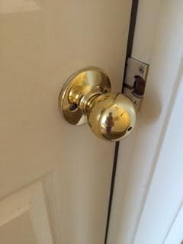
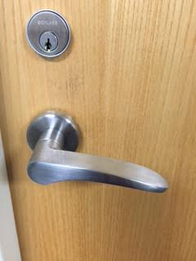
Design Thinking Phase 1: Discovery
Where will the door knob be used?
Who will use it?
What other options are available in place of a door knob?
What materials should be used?
What shape should it be?

Slide 54
Design Thinking Phase 1: Discovery
What if you are an architect or interior designer who is working on a project related to the construction of an assisted living facility. During the construction process, eventually you will need to decide the type of door knobs that should be installed in the facility. While it seems like a simple question, it doesn’t necessarily have an obvious outcome.
What kind information would be useful to explore during the discovery phase of this project?

Slide 55
Design Thinking Phase 1: Discovery
Did you consider if the door knobs should be round knobs or flat handles?
Think about the life of someone who needs assisted living. What is their age normally? What is their health like?
What are some design considerations needed when creating a comfortable place for senior citizens?
Getting the answers to those questions will help make the design optimal.

Slide 56
Design Thinking Phase 1: Discovery
Go and observe!
Explore how people use the building (including staff, not just residents). Interview users!
Talk with other stakeholders (construction team, building manager, etc.)
Getting as many perspectives as possible
It is important because it helps you have empathy.
Empathy is when you put yourself in someone else's shoes to see things from their perspective.

Slide 57
Design Thinking Phase 1: Discovery
Let’s say that after interviewing residents at an assisted living facility, you found that many residents suffer from arthritis in their hands.
Arthritis causes joint pain, stiffness, and reduces range of motion.
How could this knowledge influence the type of door knob you install at your facility?

Slide 58
Design Thinking Phase 1: Discovery
A round door knob might be difficult for arthritic hands to grasp.
A flat door handle would be more comfortable to use because it only requires a pressing down motion instead of a grasping motion.
Even though selecting/designing door knob seems simple, it is a little detail that could make a huge difference for stakeholders.

Slide 59
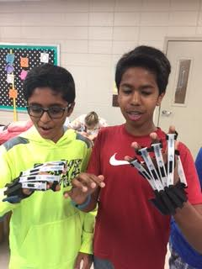
Discovery: Empathy through immersion
Besides interviewing, another way that some designers practice empathy is to immerse themselves in the user experience.
Example: gloves for inclusive design
Simulates limited range of motion in your hands, such as with arthritis
Gives a better perspective of what someone experiences

Slide 60
Discovery: Empathy through immersion
You can then apply that knowledge to make better decisions, such as in the door knob example.
When wearing the gloves, it is easy to understand how a round door knob is much more difficult to use than a flat handle in the case of someone with arthritis.
https://www.youtube.com/embed/gMFhF6XFP-E

Slide 61
Design Thinking Phase 1: Discovery
Can design thinking help you create your therapy game and controller?
The Discovery phase has been partly completed
Now, you need to gather background information
Then, apply all your findings when designing the project

Slide 62
Design Thinking Phase 1: Discovery
Remember that one way to gather information is to interview the stakeholders that you are designing for. This has already been accomplished by creating the scenarios.
Additionally, you have knowledge of physical therapy and nervous system injuries from previous lessons.
You can also use the video clips you’ve seen as observations, since you aren’t actually going to a therapy facility to observe in person.
Reviewing the scenarios and making observations will help you have have empathy.
This is important because you might not know of someone with a nervous system injury and you might not have ever done therapy before.

Slide 63
Design Thinking Phase 1: Discovery
Fill out questions 3-11 on the Planner Handout
Next, we will move into the next phases of design thinking: Interpretation and Ideation
You will need your scenarios for those next phases!

