Slide 1

Notes:
We found that students can learn a lot and do a lot with Scratch, in a very short time, in a summer enrichment class. I’m Barbara Manchee from Pittsford NY. I work for the Pittsford Central School District. We are near Rochester, NY.

Slide 2
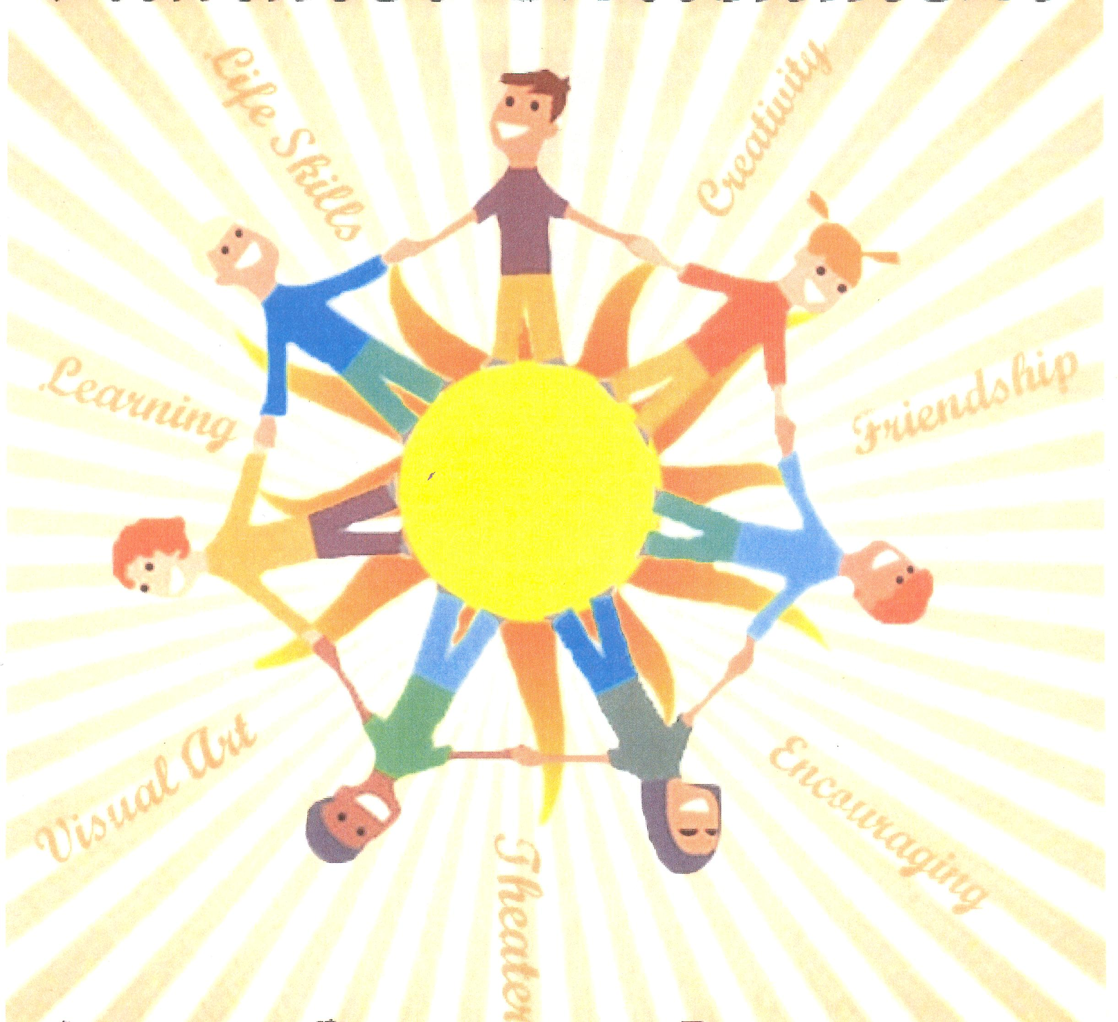
Creative Thinking through Game Design and Multimedia
Notes:
In the summer of 2011, Emily Natoli-Burns and I taught a summer enrichment class called Creative Thinking through Game Design and Multimedia. I will explain what we did in this short class.

Slide 3

“Would you like to design your own game, create your own animation and multimedia project? Using an easy programming language developed by MIT, you can learn about game design, programming, creative thinking and you can have fun!”
Notes:
This is the course description as it was listed in the catalog. Perhaps we should do some tweaking, as this description did not entice any girls to sign up. While here at the conference, I hope to gather insights and ideas regarding increasing the participation of girls.

Slide 4
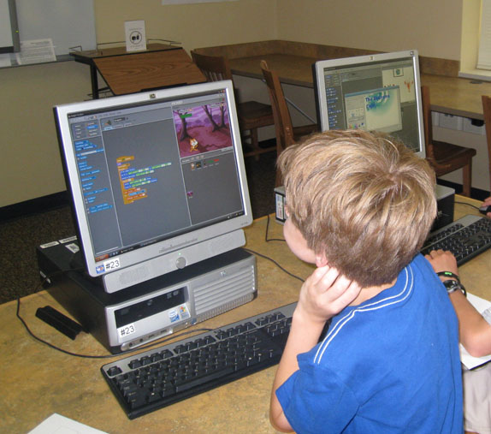
Goal
Notes:
Our goal was for students to understand that games are made with programming languages.

Slide 5
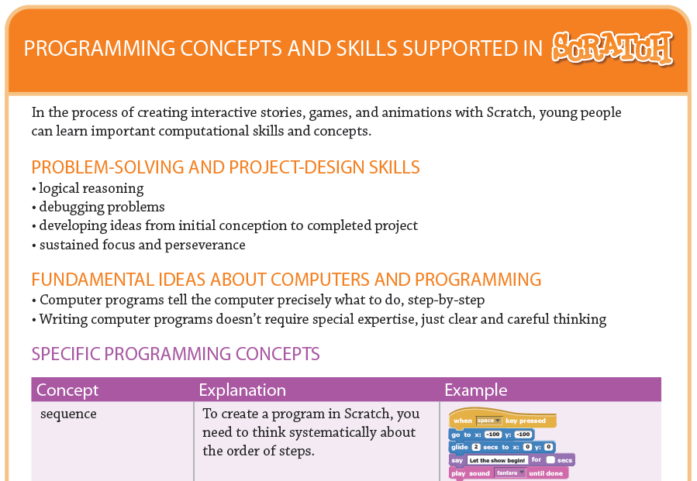
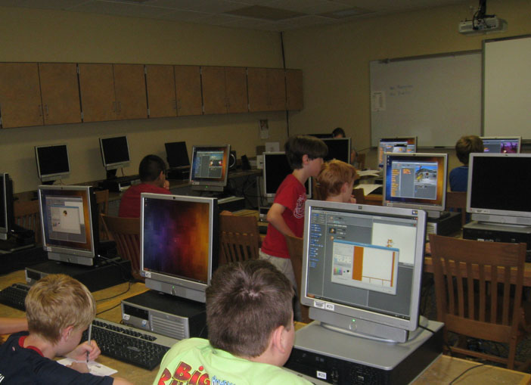
Objectives
Students will 1.)
2.)
Notes:
Our objectives stated that students will 1) be introduced to fundamental ideas about programming and 2) create their own Scratch projects.

Slide 6








Notes:
Between 11:00 am and 3:00 pm, the two of us taught 8 boys who ranged from grade 6-10. We worked for two hours, took a fifteen-minute lunch/snack break and then worked for approximately 2 more hours.

Slide 7

Notes:
The class was only held for three days. The images here representing “three days” are scanned from milk bottles from our local dairy. The logo says, “morning, noon and night” …

Slide 8
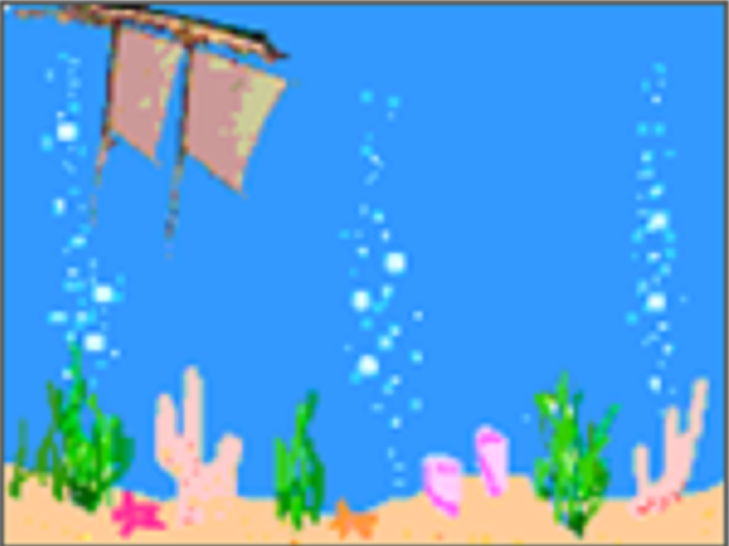
Flipped
Notes:
…and we were able to accomplish so much because the learning took place “morning noon and night” as we used a flipped classroom model. Instead of teaching them how to use Scratch and then sending them home to practice, after the first day students and parents were given a list of tutorials and resources, so they could learn at home and then come to class ready to work together on building their projects.

Slide 9
www.pittsfordschools.org/webpages/bmanchee www.pittsfordschools.org/webpages/enatoli
Notes:
The resources we sent home are listed on my website and you can get them there to use with your students. Emily Natoli-Burns is the teacher I worked with.

Slide 10
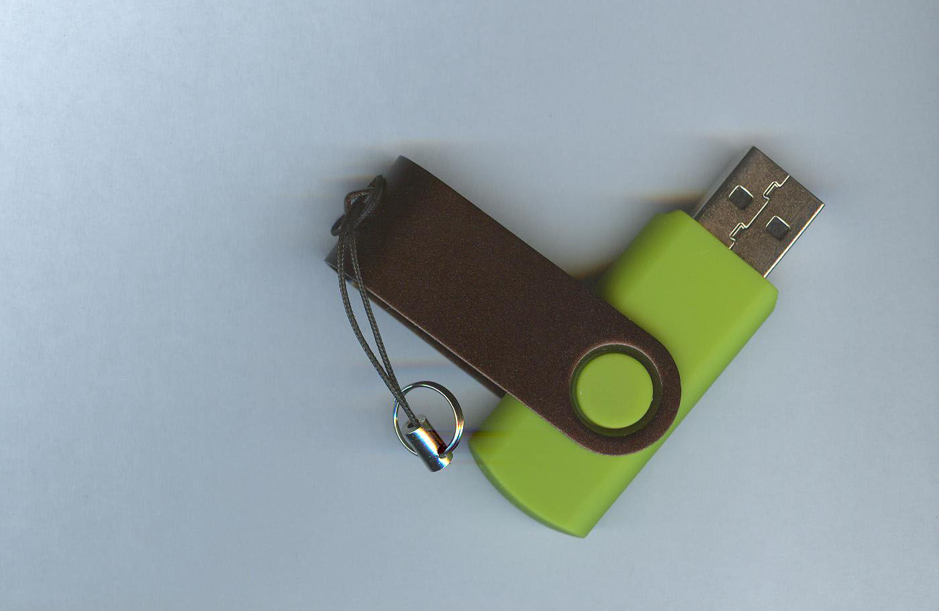
Notes:
Students went through the tutorials on their own time at home and they used flash drives to bring work back and forth. We had motivated, engaged students that were excited to learn so it didn’t seem like “homework”. They took control of their learning and taught themselves the skills necessary to design the functions they wanted to incorporate in their Scratch projects. We worried they might not do their “homework” but they did more than the tutorials; they started right in on designing their projects. They came in with work already started.

Slide 11

Notes:
We started the first day with ice-breaker activities, discussed the process (we talked about creative and critical thinking; that we would program our own projects and share them online), viewed and analyzed Scratch projects, and generally explored the Scratch website.

Slide 12
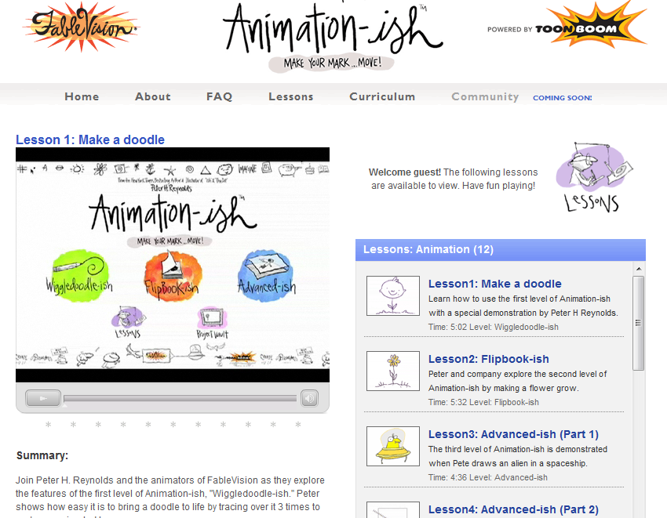
www.animationish.com/lessons.php
The Fablevision Animationish site was also used to explain animation.
Notes:
We also did the lessons on animation at the Fablevision Animation-ish site so that students would understand the concept of animation. After the first day, the students went home to do tutorials to learn how to create in Scratch.

Slide 13
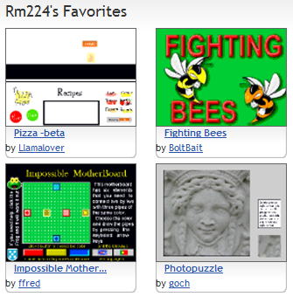
Notes:
The students were also given the assignment to choose an exemplar to present to the class with critical analysis. They shared these at the beginning of the second day.

Slide 14
Notes:
In order for students to create their own projects, these are the components we relied on: tutorials & videos, storyboard creations, the use of the Scratch Cards, downloading and analyzing scripts, collaborative learning, and peer instruction.

Slide 15
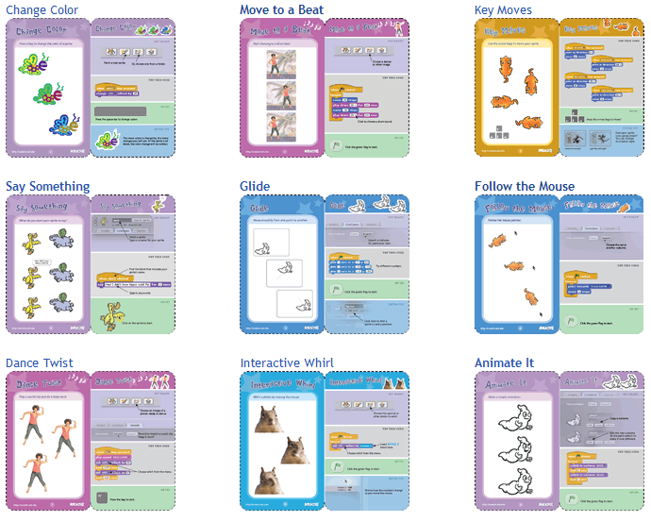
Notes:
On the second day, students uploaded simple projects based on Scratch Card instructions. The student's creativity blossomed after the initial success. Then they completed a storyboard to plan their own project.

Slide 16
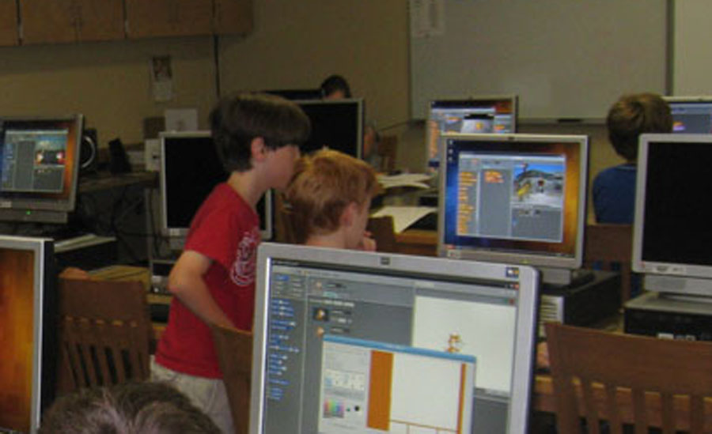
Notes:
Most of the second day and the beginning half of the third day, they worked on their own projects. Peer instruction and mutual problem solving proved essential. Midway through the third day, students presented their projects to each other and then we spent some time talking about careers in the industry and how important math skills are.

Slide 17
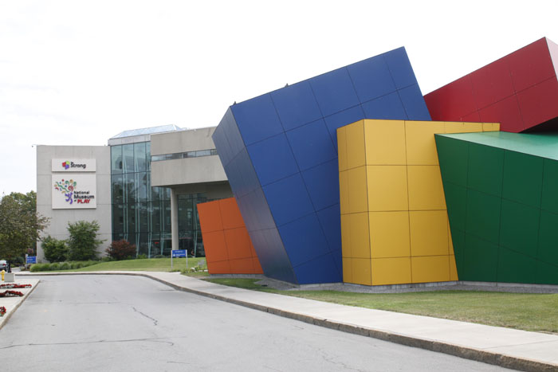
Notes:
We are fortunate to have the Strong Museum of Play and their International Center for the History of Electronic Games located in Rochester, NY. Students were encouraged to visit. We encourage you to reach out to them as a resource.

Slide 18
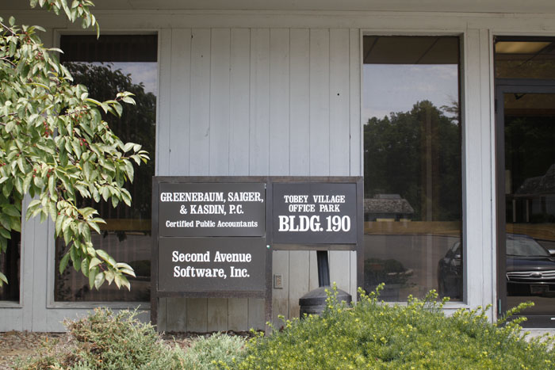
Notes:
When we discussed career possibilities, we highlighted a local company, Second Avenue Learning, to emphasize the opportunities available. They design educational games. We reiterated the importance of math skills. (Pointing out to the students how they were using math in their projects, their use of the grid system etc.)

Slide 19
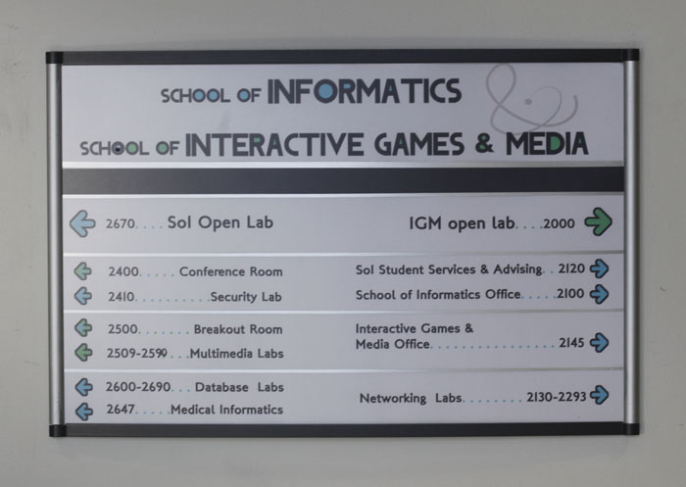
Notes:
We also introduced the idea that students can study game design in college. We told them about the local Rochester Institute of Technology Game Design program and we also talked about MIT.

Slide 20
Notes:
We realize that we were able to do all of this because we are fortunate to have supportive administrators. We do want to remind you that we did all this in three days. If we can do it, you can do it…and imagine what you can do with even more time!

