Slide 1
Update on the Integration of Scratch Programming as a Tool for Assessment in K-12 Curriculum
SCRATCH AT MIT 2012
Presenter
Leslie Daniels

Slide 2
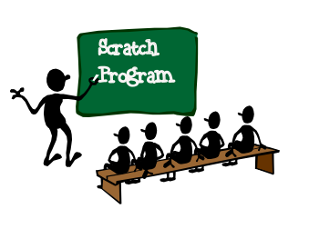
ELEMENTS OF 2010 PRESENTATION
Notes:
Needs Analysis
Declining career interest in computer science (CS)
Tech industry is a bright spot in a dim economy – CS is a neglected topic in K-12 curriculum
Underrepresentation of minorities and women in the field – ethical issues
Declining creativity…

Slide 3
ELEMENTS OF 2010 PRESENTATION
Notes:
Design and Development
Graduate course - teaching science and math in an urban setting
Action research projects with focus on technology infusion using Scratch programming
Support with videos and hands on activities

Slide 4
ELEMENTS OF 2010 PRESENTATION
Notes:
Evaluation
Teacher buy-in mixed – time, schedule and lack of confidence limiters
Teacher transformation – witnessed student learning within Scratch environment – all levels
Most teachers planned to integrate Scratch into their curriculum in future

Slide 5
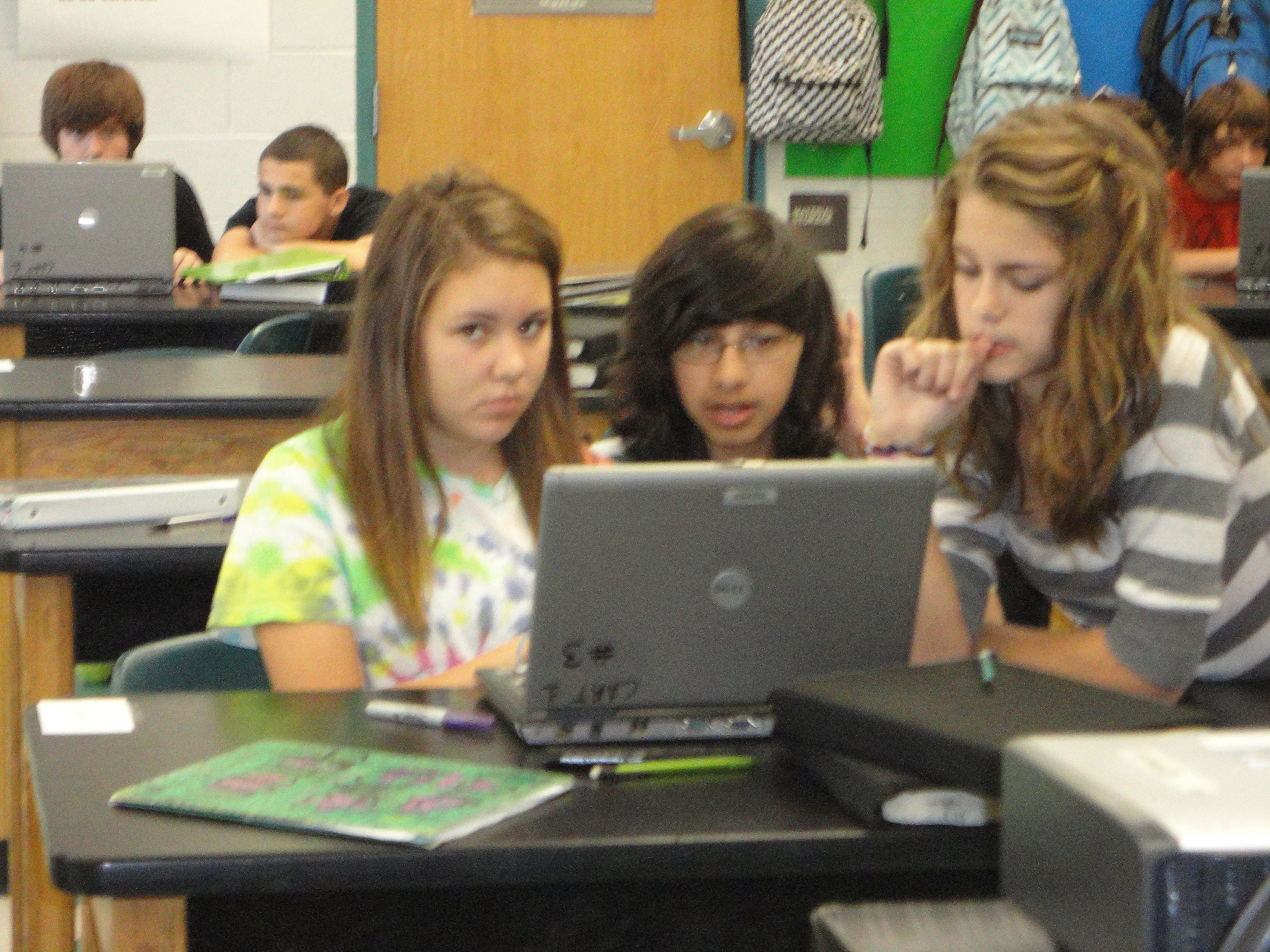
Scratch Programming Integration Eighth Grade Physical Science Curriculum
Then came my turn….
First project: Newton’s Laws of Motion
Poster to multimedia animation
Scratch cards focusing on animation
Driver/Navigator technique
Collaborative project
Notes:
First Project:
Newton’s Laws of Motion

Slide 6
Scratch Programming Integration Eighth Grade Physical Science Curriculum
Second Project: Romance of the Atoms
NSTA Science Scope article – chemical bonding
Individual project
High level of learning evident
Class projects

Slide 7
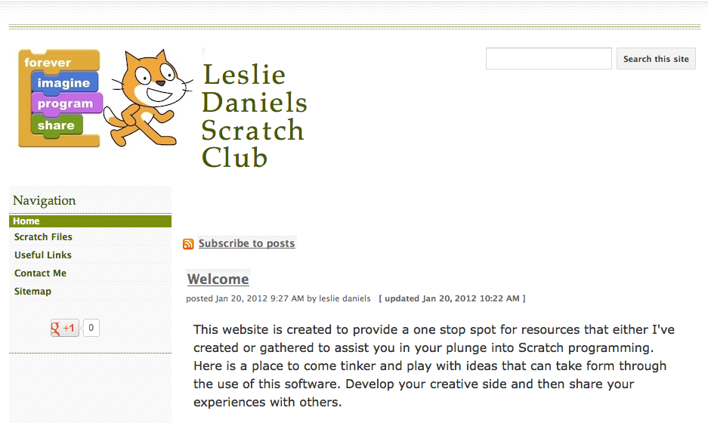
Work as a Master Digital Educator

Slide 8
Recipient of Paul Hagerty Technology Teacher of the Year

Slide 9
Arising Challenges
What a difference a year can make…
86% of Florida schools did not make AYP based on test results for 2010

Slide 10
Arising Challenges

Slide 11
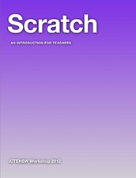
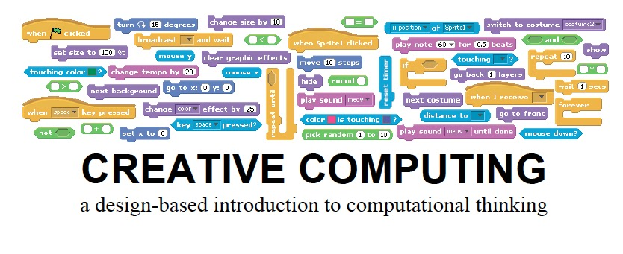
Solutions
S
.
1
6
1
4

Slide 12
Solutions
How to convince the stakeholders ???

