Slide 1
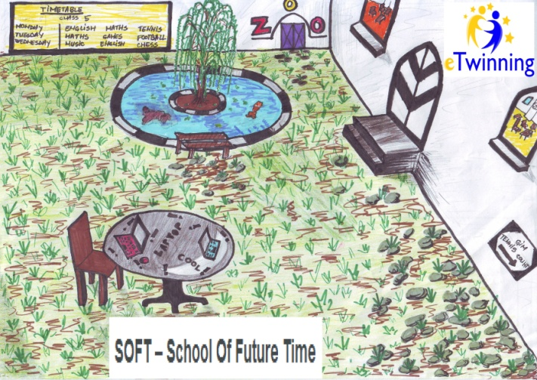
SOFT – School Of Future Time
- eTwinning Project 2013-2014 -
Presentation of the
Portuguese school
by
Romanian students

Slide 2
What does
the curriculum for age 11
contain?

Slide 3
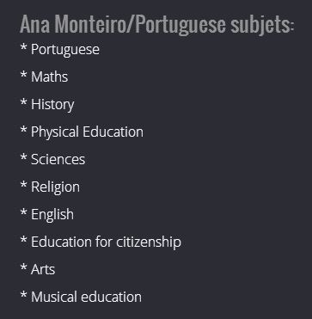

Slide 4
What is
teaching and learning
like?

Slide 7
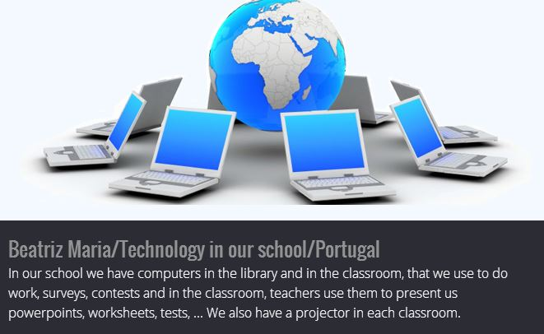

Slide 9
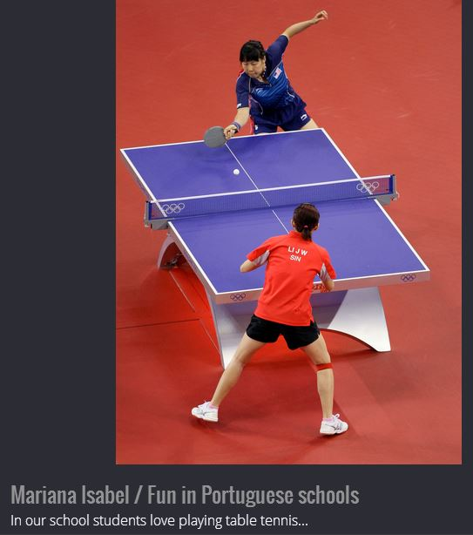

Slide 10
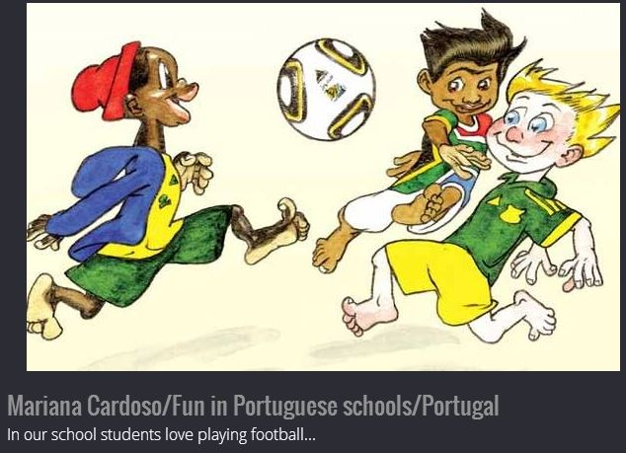

Slide 11
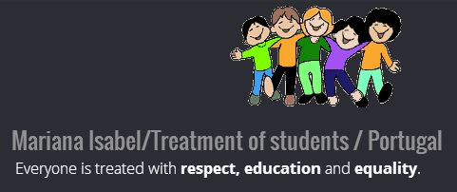

Slide 12
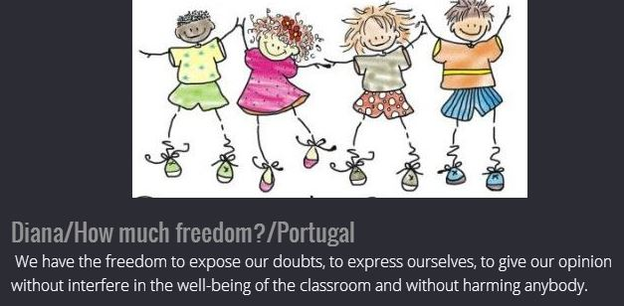

Slide 13
What does
the school campus
look like?

Slide 17
What are
the different parties’
roles?

Slide 18
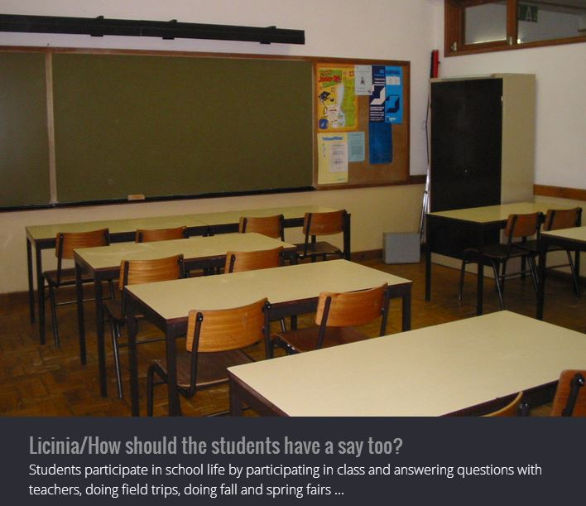

Slide 20
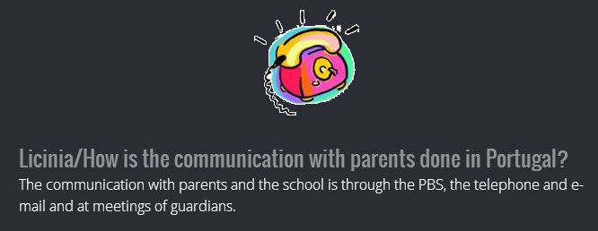

Slide 22
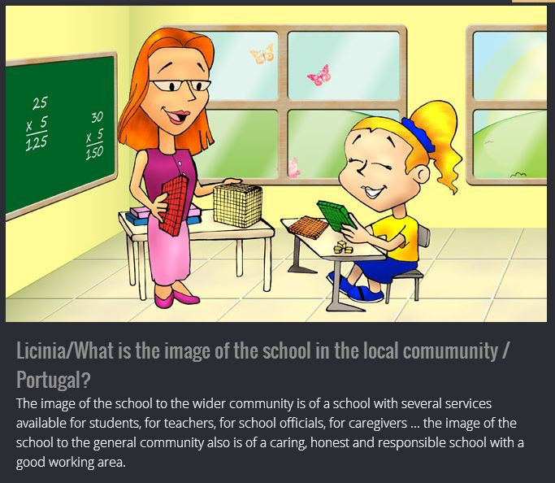

Slide 23
SOFT – School Of Future Time
- eTwinning Project 2013-2014 -
Presentation of the
Portuguese school
by
Romanian students

