Slide 1
WHAT IN THE WORLD IS SCRATCH???
AN INTRODUCTION TO COMPUTER PROGRAMMING
By MD Showman

Slide 2
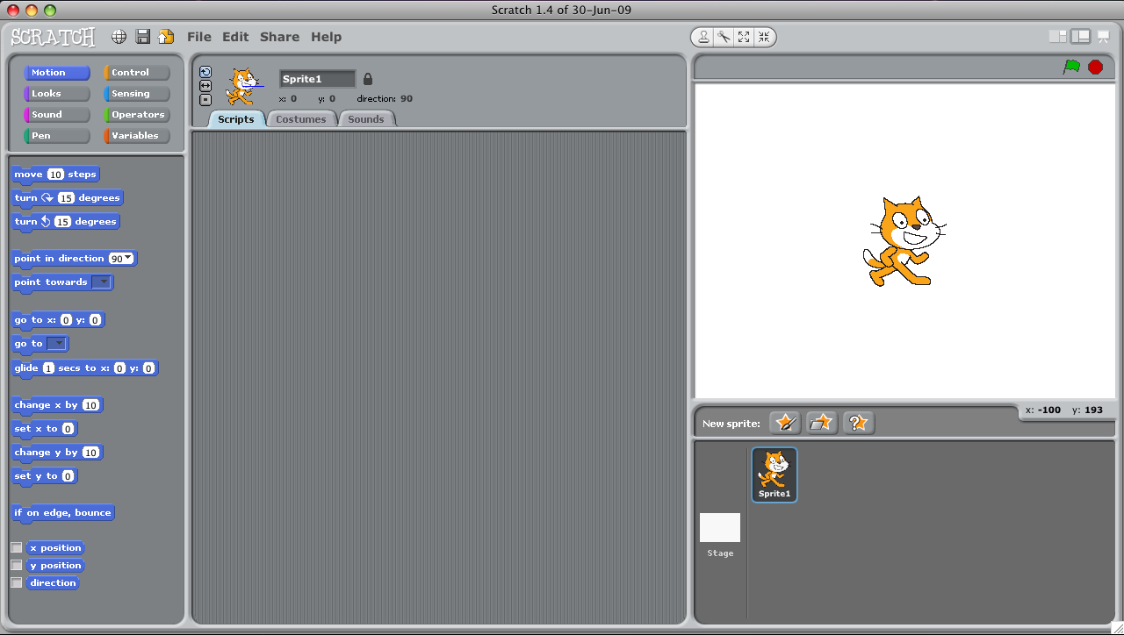
This is Scratch

Slide 3
Scratch is…
Free software used to teach beginners computer programming
Click and drag programming, WYSIWYG
REALLY COOL!
http://www.youtube.com/watch?v=jxDw-t3XWd0

Slide 4
Give it a try!
Wait, how do I run Scratch?
Finder ➔ Applications ➔ Scratch 1.4 (folder)
Drag Scratch (application) to Dockbar
Click on Scratch Icon in Dockbar
Well, what do I do?
Pull in blocks into script window to test them out
Link blocks together to create a code puzzle
Try adding new sprites or changing what is already there

Slide 5
Ready for a CHALLENGE?
Read the goal
Use ONLY the pieces in the picture
Test your program
Test your program again
Test your program a third time

Slide 6
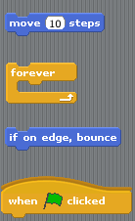
CHALLENGE #1
Rearrange and connect the pieces to make the cat move across the screen changing directions when it hits the edge.
REMEMBER!!!
Repeat and forever must have something INSIDE of them.

Slide 7
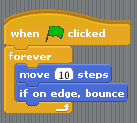
CHALLENGE #1 -- SOLUTION

Slide 8
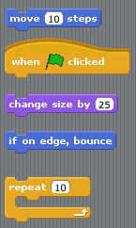
CHALLENGE #2
Rearrange and connect the pieces to make the move 10 spaces and bounce if it touches the edge, 10 times. Then, make it bigger by 25%.
REMEMBER!!!
Repeat and forever must have something INSIDE of them.

Slide 9
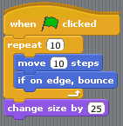
CHALLENGE #2 -- SOLUTION

Slide 10
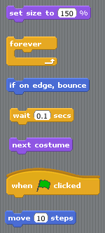
CHALLENGE #3
Rearrange and connect the pieces to set the cat’s size to 150%. Then, make the cat move, change costumes, and bounce if it touches the edge.
REMEMBER!!!
Repeat and forever must have something INSIDE of them.

Slide 11
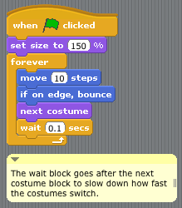
CHALLENGE #3 -- SOLUTION

Slide 12
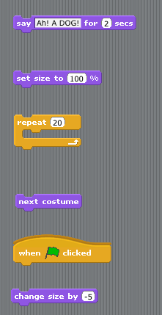
CHALLENGE #4
Rearrange and connect the code pieces to make the cat say “Ah! A DOG!” then shrink while changing costumes 20 times.
REMEMBER!!!
Repeat and forever must have something INSIDE of them.

Slide 13
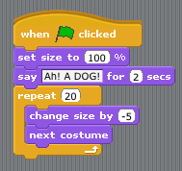
CHALLENGE #4 -- SOLUTION

Slide 14
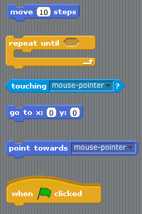
CHALLENGE #5
Rearrange and connect the code pieces to make the cat start at X:0 Y:0.
Make the cat chase the mouse pointer until it touches the mouse pointer.
REMEMBER!!!
Light blue blocks fit INSIDE yellow pieces, making a LOGIC STATEMENT

Slide 15
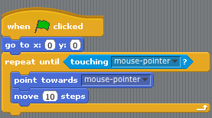
CHALLENGE #5 -- SOLUTION

