Slide 1
Evgeniya Gushchina EPAM e-kids volunteer computer science teacher
I
Sergei Rudenkov EPAM e-kids volunteer programmer from EPAM
IT
EDUcation
The best result
Notes:
S: Do you want your child to become a cool programmer?
E: There are many modern people who will answer: Yes, we want.
S: But do you know how to achieve this? What is cool about this?
E: I know one secret. Develop procedural thinking.
S: What's it? Visit the doctor and do a procedure to develop the mind?
E: No, attend Scratch classes and learn how to distinguish parts from the whole by meaning, and then use them many times ...

Slide 2
"Procedural Thinking: The Ways Of Obtaining"
1
Notes:
Procedural thinking for kids: ways of obtaining.
Simple projects on the movement of sprites, pen drawing, animation – all of these children learn to do very quickly and easily in Scratch. But there comes a point where
simple solutions are no longer so good. Let's consider an example.

Slide 3
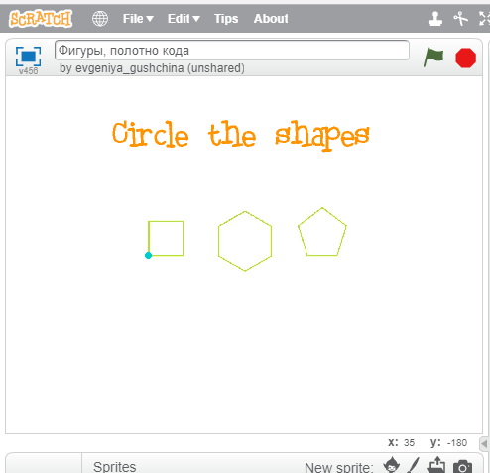
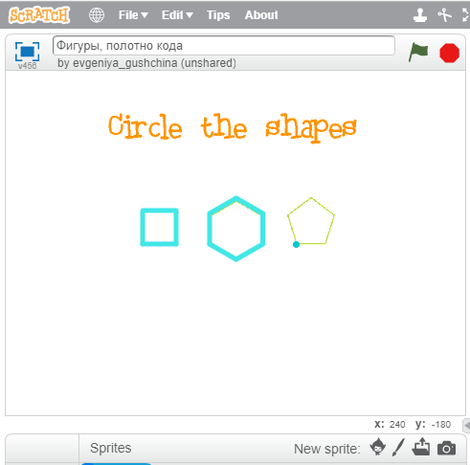
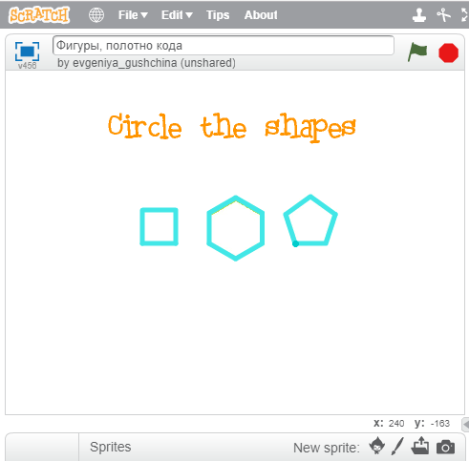
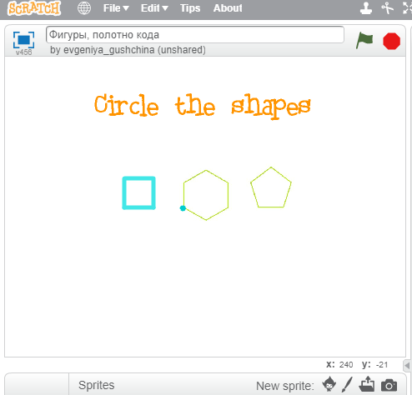
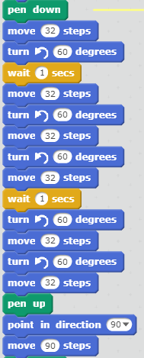
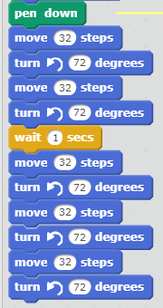
2
Notes:
Circle the shapes. For example, a square, a hexagon and a pentagon. Let’s suppose that the child already knows most of the basic commands. We told him/her a secret with the angles in the equilateral shape 360 / n. And off we went rolling. So the child wrote the first piece, the second one turned out good, and then the third one. We got the program and we got a happy kid. But ... The program is already so long that it is completely inconvenient to understand it, if you need to fix it or add something ... Well, in this case, to begin with, it is worth looking for pieces of code with repetitions. What is repeated? How many repeats are there?

Slide 4
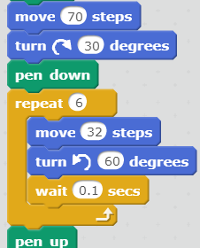
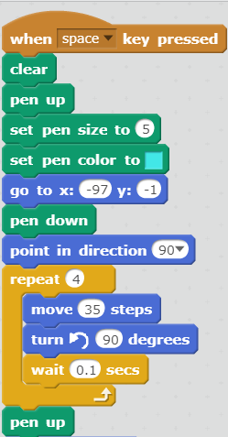
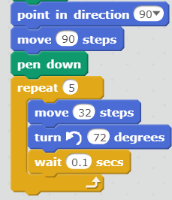
prepare
to draw
hexagon
square
pentagon
3
Notes:
Let's just use the REPEAT command! One, two, three. We used repetitions and our program became significantly shorter. Is this a plus for the program? Of course, a plus. And yet again we get - a happy child. But ... What will we say about this program in a week, a year? What is what? Maybe we'll remember, maybe not ... And if we want to use these shapes in different combinations many more times, will we have to write the same pieces with cycles every time? So let's come up with such new commands that will draw a square, a hexagon and a pentagon. And even the remaining piece at the beginning of the program can be given a self-explanatory name. For example, we prepare to draw. How can we create such a new command in Scratch?

Slide 5
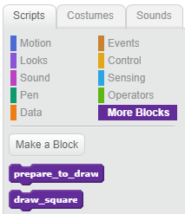
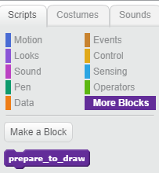
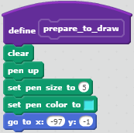
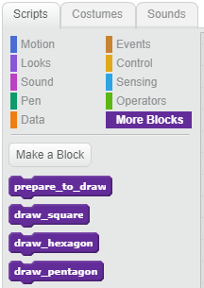
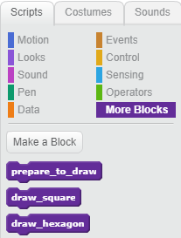
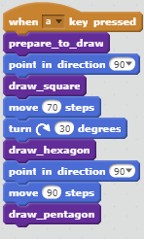
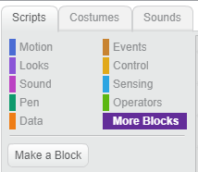
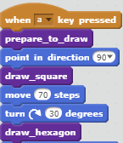
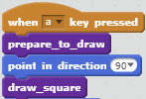
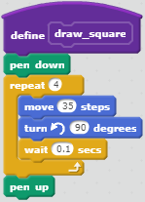
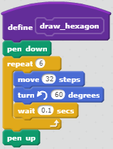
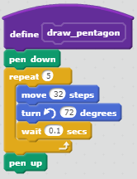
4
Notes:
For this we have the purple group OTHER BLOCKS. And the CREATE BLOCK button. One: This is a new block - prepare for drawing. Two: This is a new block - draw a square. Three: It's a new block - draw a hexagon. Four: It's a new block - draw a pentagon. The very body of the program has become very short. It’s clear what happens next. And if we decide to change something, then it is clearly visible in which part it should be done. Here it is important to discuss what can be the name of the procedure block, and what is not desirable. For example, the name ‘Draw a square’ is much clearer than a block called One. Can we now use the new blocks many times in any combination? Of course yes!

Slide 6
5
Notes:
And again - We get a happy child…

Slide 7
6
Notes:
But ... Is it worth dwelling on this? Of course not! Let's look at our code with the new blocks again. Looking closely we can recognize that three procedures - a hexagon, a square and a pentagon - are very similar and differ only in the number of angles and the length of the sides. And actually the fact that the angle of rotation depends on the number of angles according to the formula 360 / n -was already known to us. What if we only add one block procedure, to which we will say: "Now, for example, the number of sides is denoted by the letter q, and the length of the side we will denote by the letter L."

Slide 8
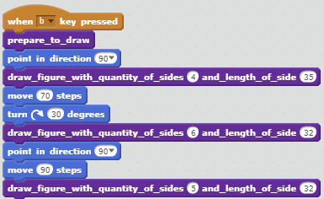
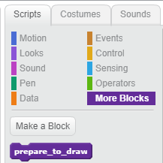
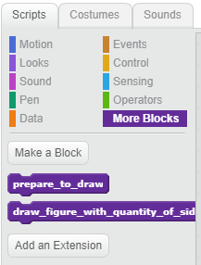
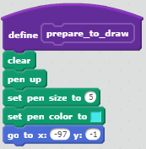
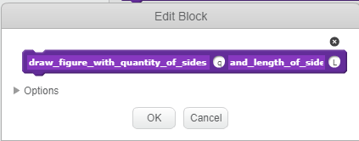
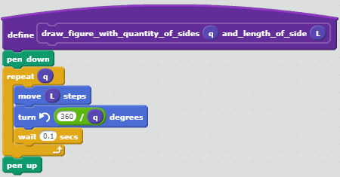
square
hexagon
pentagon
7
Notes:
Scratch gives us this opportunity. It is called a Procedure with parameters. Initially, you can leave a simple “Prepare” block as it was. Next, create a procedure with two parameters: q - the number of sides in the polygon, L - the length of the side. Note: inside the procedure, the variables q and L are used, equal to the values that we have indicated. Where are the square, hexagon and pentagon? And here they are! We received a short, vivid, easily upgradable program. And, most importantly, a child who is willing to try these principles on many other programs. We have been going to this mountain for a long time, but it's so cool! And now we will try to formulate some stages we have passed on this way and what emphases were revealed in the course of work.
.

Slide 9
STAGES:
Accents:
1. Long linear Program.
from simple to complex
every step is worked out
a lot of various examples
blocks have only speaking names
multiple usage of procedures
retrospective call back to the old program realizations
pair and team programming and usage of blocks-procedures
2. Usage of loops and conditions.
3. Select and aggregate program pieces by it meanings. Giving them speaking names.
step back and edit
4. Create a library of procedures.
5. Combine procedures multiple times.
6. Looking for similarities in procedures. Create parametrized procedures.

Slide 10
"Procedural Thinking: The Ways Of Obtaining"
9
Notes:
Procedural thinking - can we assume that we have reached the top of the path in programming? Partly, yes. But…

Slide 11
https://scratch.mit.edu/studios/4226124
10
Notes:
There is still a long way to go. We passed it and it was not so scary and difficult, because every stage of the journey was clear, everything turned out good and now we have a HAPPY CHILD who likes to program!
And now here are some examples.
https://scratch.mit.edu/studios/4226124
Evgeniya.It.Edu@gmail.com

