Slide 1
The earlier, the better:
Kindergarten-Aged Kids
Creating Their World with Scratch.
www.telmexeducacion.com
Vera de Leon

Slide 2
Carlos Slim Foundations
Education
Healt
Natural Disasters
Justice
Culture and Human Development
TELMEX Institute of Sport
Soumaya Museum

Slide 3
TELMEX Education
TELMEX EDUCATION
TELMEX PROGRAM OF EDUCATION AND DIGITAL CULTURE
TELMEX Digital Library
TELMEX Digital Classroom
TELMEX House
Educational
Support

Slide 4
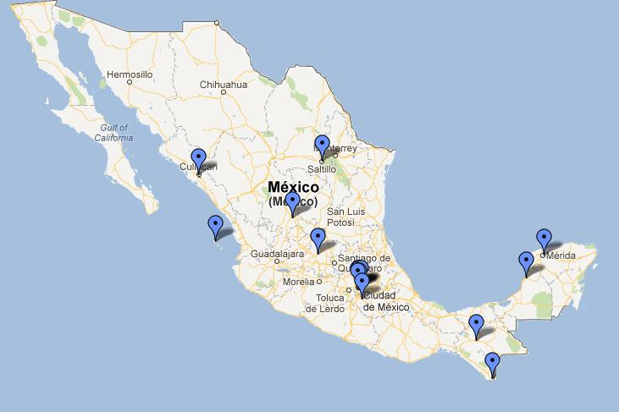
There are 13 TELMEX Houses in Mexico.

Slide 5
TELMEX House
After School Program
More than 350 workshops

Slide 6
When
Why
How
…did we do it?

Slide 7
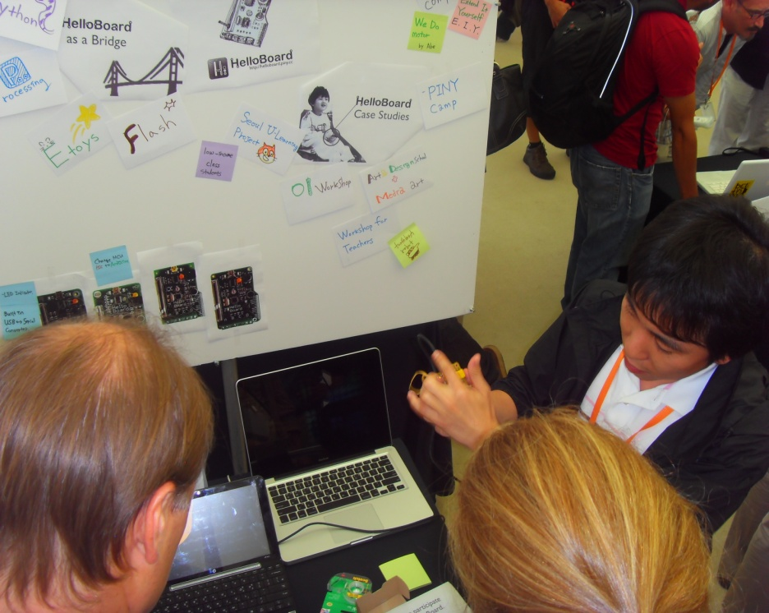
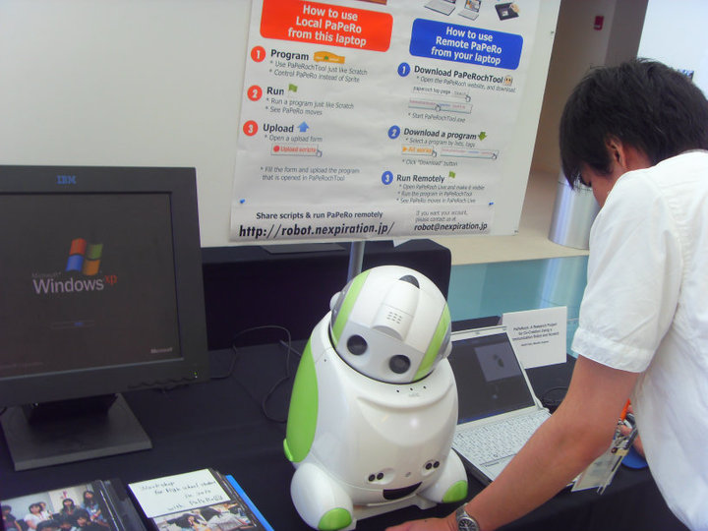
When did we start?
2010

Slide 8
Workshops for Kindergarten-Aged Kids
Digital Art/ Science
Computing, Internet and Electronics
Programming
and
Robotics

Slide 9
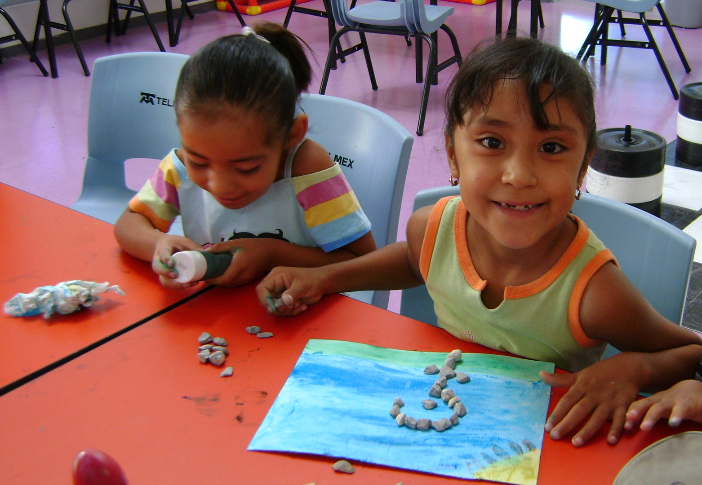
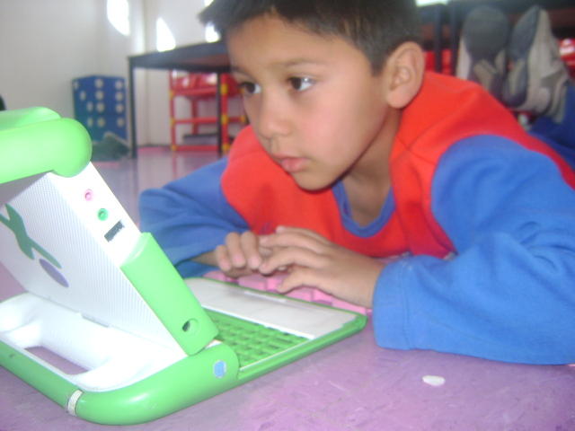
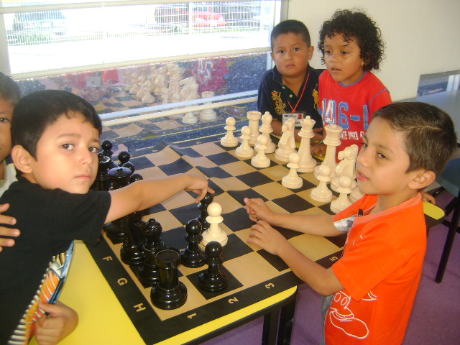

Slide 10
OUR GOAL
Digital Art/ Science
Computing, Internet and Electronics
Programming and Robotics

Slide 11
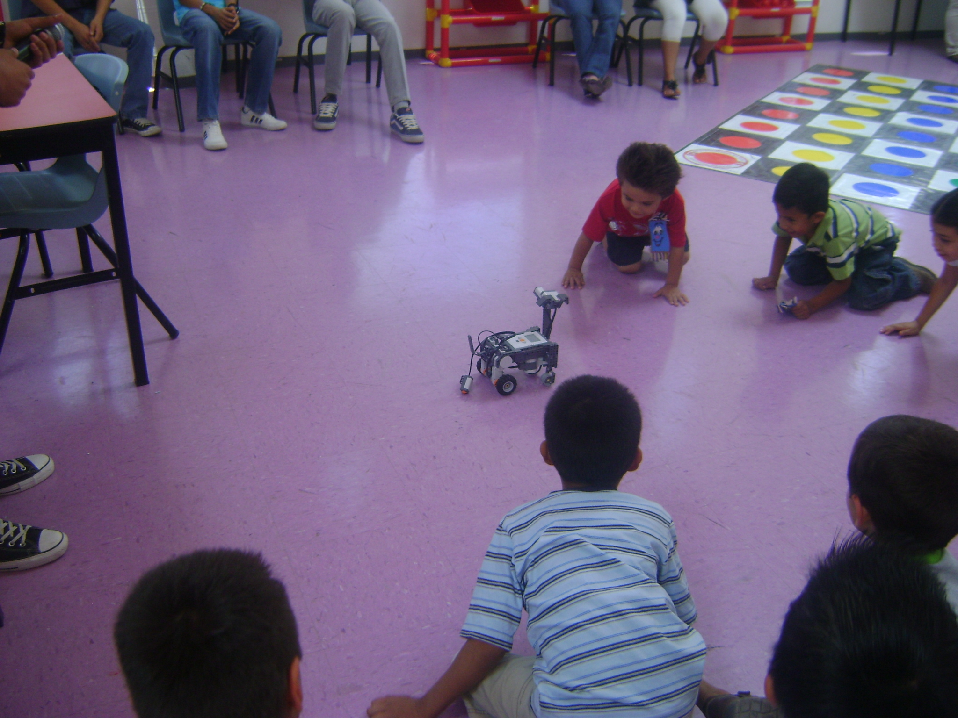
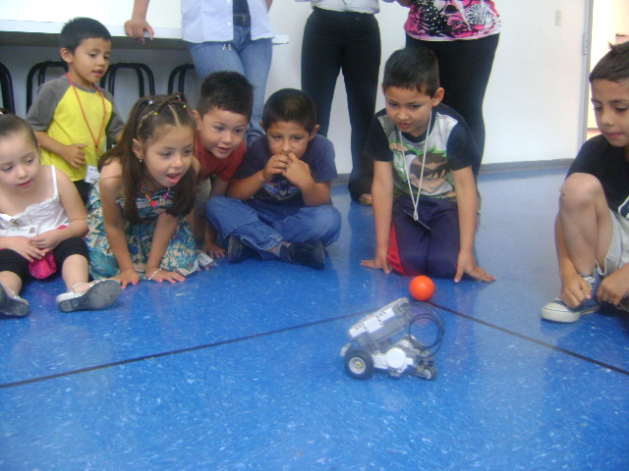
Kindergarten-Aged Kids wanted to BUILD IT!

Slide 12
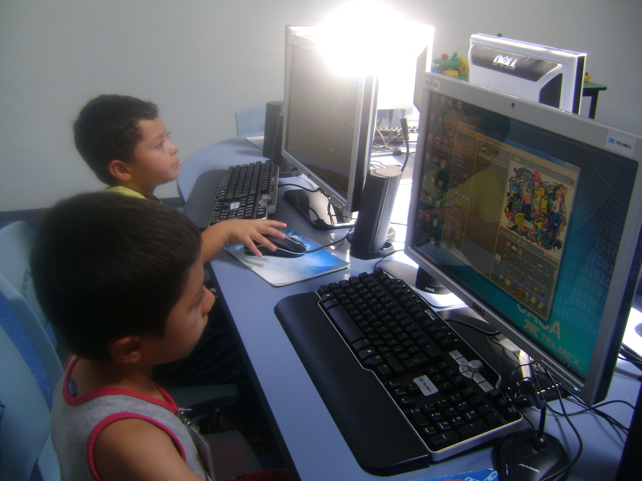
Programming with Scratch / Robotics
Getting to know Scratch
Process of “Programming”.
Robotics (with PicoCricket).
Sensing and PicoBoards.

Slide 13
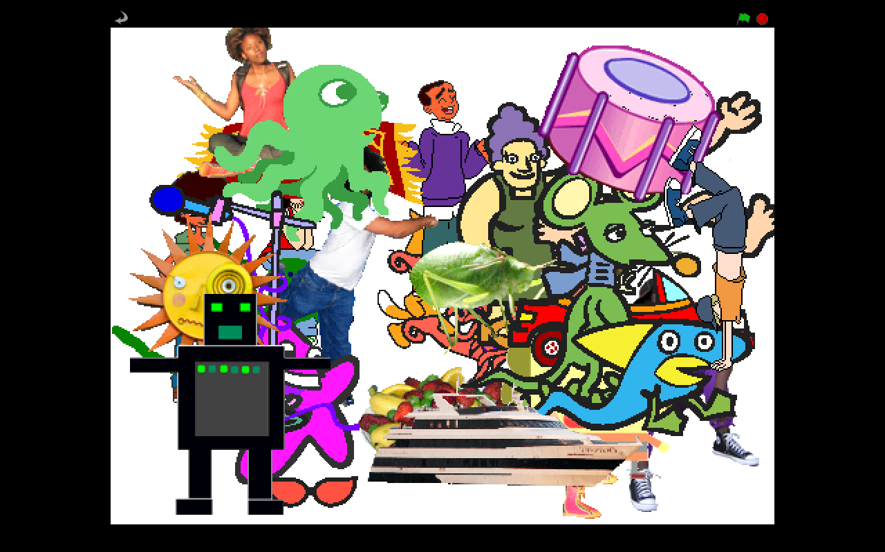
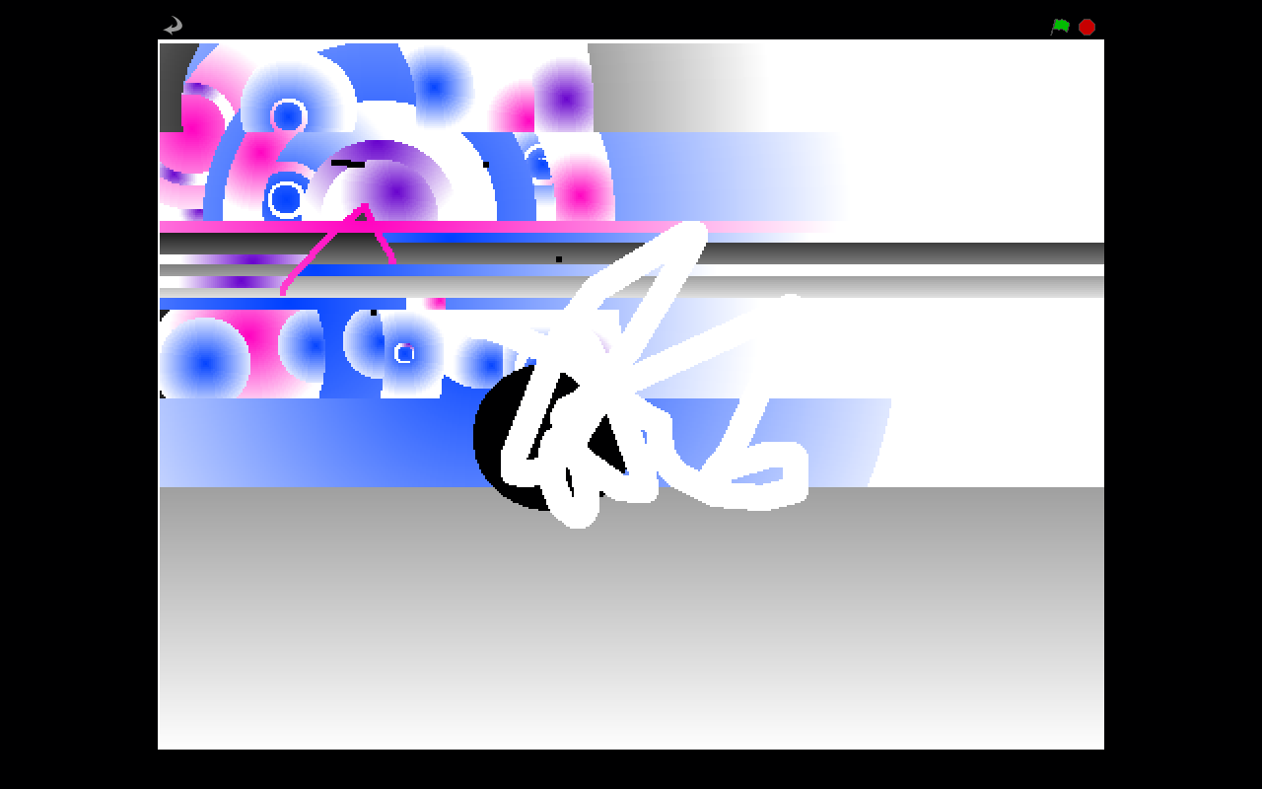
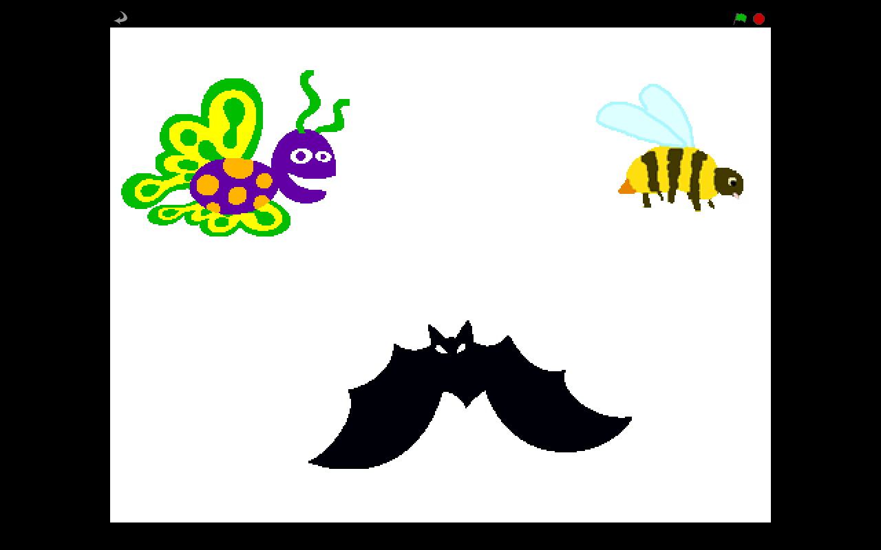

Slide 14
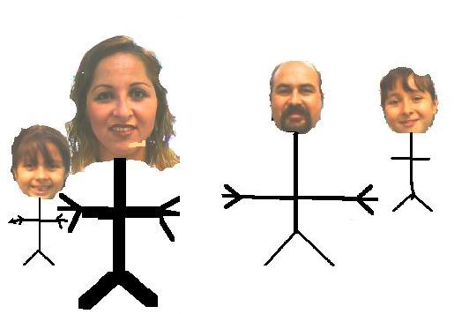
Projects

Slide 15
Robotics Club/ Kindergarten.

Slide 17
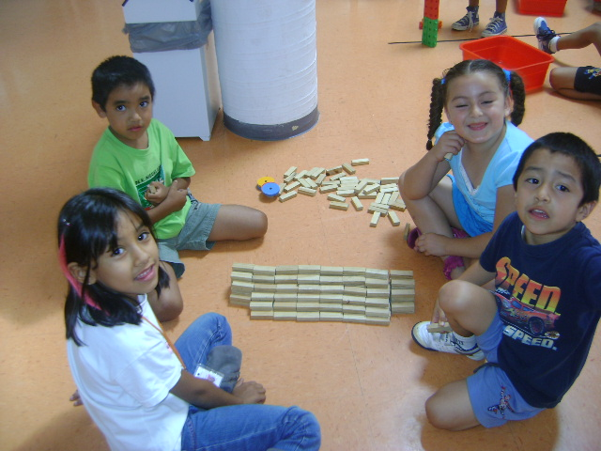
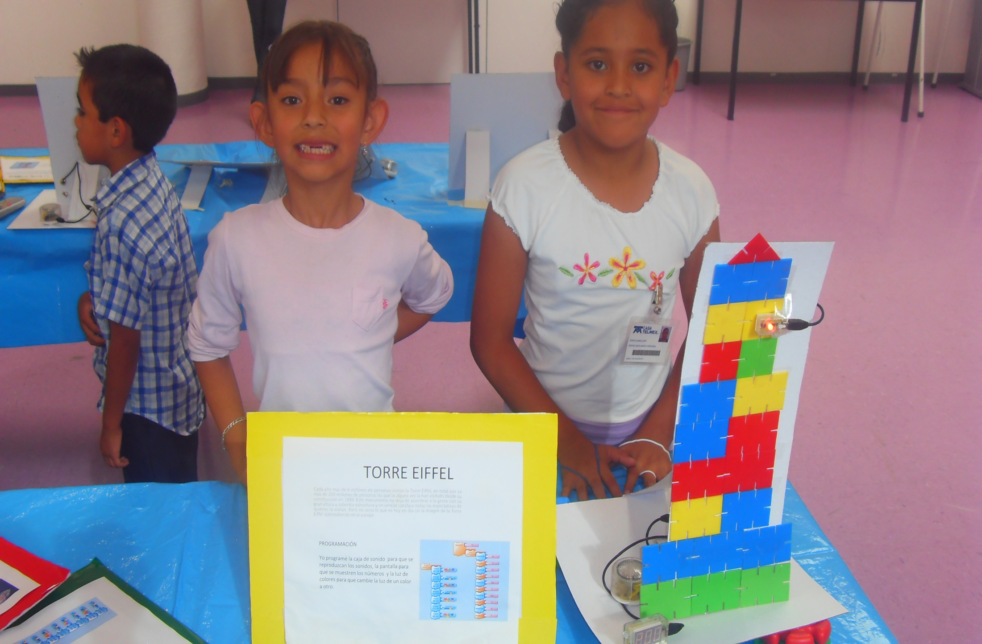
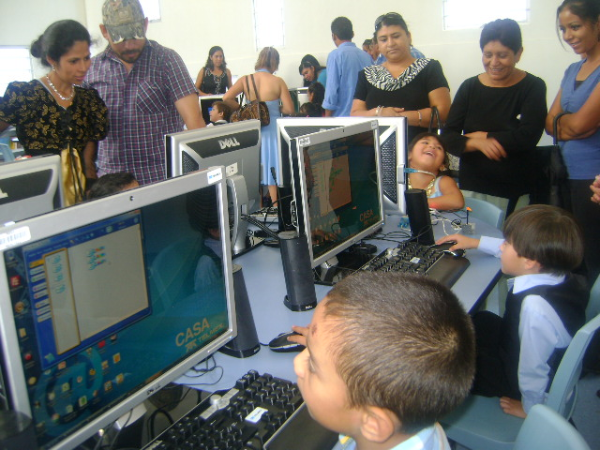

Slide 18
Saltillo TELMEX House
PROGRAMMING
Scratch Club
ROBOTICS
Robotics Club (Kids).
Robotics Club (Youth).

Slide 19
What is next?
Share our experience with other Educators.
Create and share resources .
Engage Public Schools to add Programming into the Curriculum .
Encourage girls to join the Scratch and Robotics Clubs.
Young Mentor’s Group: “One-to- One” .

Slide 20
Thanks a lot!

Slide 21
Contact
msveradeleon@yahoo.com.mx
Facebook – Vera D Leon
Twitter - MsVeraDLeon
www.youtube.com/casatelmexsaltillo

