Slide 1
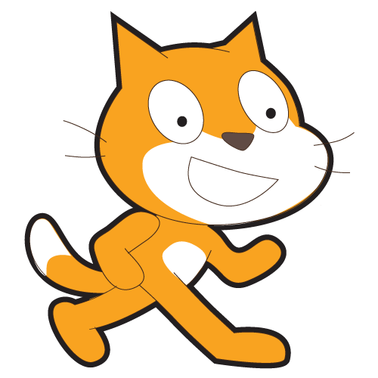
SCRATCH
This Design Notebook belongs to:

Slide 5
What are the different ways you interact with computers?
List your answers here:

Slide 6
How many of those ways involve you creating with computers?
List your answers here:
(You can add to this list later.)

Slide 7
Scratch Challenge #1
Make something surprising happen to a sprite. You can write some of your ideas here:
What is your first step going to be?

Slide 8
I Learned Something New!
List new things that you have learned here:
(You can add things to this list later.)
Did you know? A sequence is a series of instructions.

Slide 9
What are three aspects of yourself that you could represent through images or sound?
1.
2.
3.

Slide 10
Scratch Project: All About Me
Create a Scratch project that represents you and has clickable sprites.
Brainstorm some ideas here:
ME

Slide 11
About Me Reflections
What was your inspiration?
How did you do that?
What did you get stuck on?
How did you get unstuck?
What are you most proud of?
What might you do next?

Slide 12
Original Ideas
Here is one of my original ideas for a Scratch Project:

Slide 13
Notes:

Slide 14
What are 5 situations where you use instructions?
1.
2.
3.
4.
5.

Slide 15
How do you know when the instructions are good?
Write your answer here:
How does understanding how to give good instructions affect your work using Scratch?
Did you know? A series of instructions that repeats is a loop.

Slide 16
What are two strategies that you could use when you get stuck with your project or design?
Strategy #1:
Strategy #2

Slide 17
Scratch Project: Dance Party
Create a dance party. This is a Scratch Project in which the sprites have cool costumes and dance to funky beats.
Write your notes here:
Incremental Thinking: Add and test small amounts of code at a time.

Slide 18
Check for Understanding
What is the difference between a sprite and sprite’s costume?

Slide 19
Notes:
Do you know what parallelism is? It’s making things happen at the same time.

Slide 20
Gallery Walk
Take a walk around the room looking at our dance projects. Ask questions:
How did you get the sprite to do this?
What was your inspiration for doing this?
Give a compliment.
Write any notes or ideas you discovered here:

Slide 21
Sketch an art idea that uses Scratch.
Examples:
1. Create a project that uses an orange square and a purple circle.
2. Creating your own musical group by pairing sprits with sounds.
3. Create a self-generating drawing project.

Slide 22
What was a challenge that you overcame in your last project?
Parallelism: Things that happen at the same time.

Slide 23
What is something that you still want to figure out?
Events: One thing causing another thing to happen.

Slide 24
Write a story using six words.

Slide 25
What are the different ways in which things were happening at the same time?
What are the mechanisms that enable parallelism in Scratch?
What are the different ways that actions are triggered?
What are the mechanisms for events in Scratch?

Slide 26
What is remixing?
Write here:
Reusing and Remixing are valuable skills. You need to be able to read code written by other people, in order to improve your own.

Slide 27
Things we need for a story:
Characters:
Plot:
Scene
Additional Elements:

Slide 28
How was working with someone else different from your prior experiences of designing your Scratch projects?

Slide 29
Open Ended Designing Ideas
Use say and wait blocks with two characters to have a conversation.
Use the broadcast and when I receive blocks to create a multi-scene story.
Create your own slideshow using a collection of background images. Narrate your slideshow.

Slide 30
Did you know?
Conditionals are
Operators are

Slide 31
Debugging Strategies
What was the problem?
How did you identify the problem?
How did you fix the problem?
Did others have alternative approaches to fixing the problem?

Slide 32
Games
Games I Like:
What do games have in common?
What features of their design make them a game?

Slide 33
What do you like about your maze project?
How might you want to change it?

Slide 34
Maze Extensions
Score: Demonstrate how to set and change a score. Receive 10 points every time the Scratch cat is clicked.
Timer: Demonstrate how to use a timer. Use the mouse to navigate the Scratch cat to Gobo.
Enemies: Demonstrate how to add an enemy. Avoid the crazy tennis ball using the up and down arrow keys.
Levels: Demonstrate how to change levels. Score increases by 1 every time the space bar is pressed. Level increases by 1 for every 10 points.
Rewards: Demonstrate how to collect items. Use the arrow keys to move the Scratch cat around to collect items for his quest.

Slide 35
Here’s what I figured out:

Slide 36
What is a variable? What is it good for?

Slide 37
Project Ideas
Collide: Help Scratch cat navigate a field of Gobos
Catlibs: Create an interactive word game.
Scrolling: Create the foundation for a side-scrolling game.
New Project Ideas:

Slide 38
Independent Projects
What has been your favorite Scratch project to work on so far?
What are 3 ideas for something your could work on next?

Slide 39
Independent Projects
What part of your project will you be working on today?
What are your first steps?
What do you need help with?

Slide 40
Independent Projects
What part of your project will you be working on today?
What are your first steps?
What do you need help with?

Slide 41
Feedback
What aspect of your project could someone give you feedback about? When your provide feedback to someone think about the following:
Clarity:
Did you understand what the project is supposed to do?
Features:
What features does the project have?
Does the project work as expected?
Appeal:
How engaging is the project?
Is it interactive?
Is it original?
Is it sophisticated?
Is it pretty?
Is it funny?
Is it interesting?
How do you feel as you interacted with the project

Slide 42
Feedback Page
What aspect of your project could someone give you feedback about?
This feedback is for: | This feedback was provided by:
Parts of the project I really liked: | If this was my project I would fix or change this:

Slide 43
Independent Projects
What part of your project will you be working on today?
What are your first steps?
What do you need help with?

Slide 44
Independent Projects
What part of your project will you be working on today?
What are your first steps?
What do you need help with?

Slide 45
Independent Projects
What part of your project will you be working on today?
What are your first steps?
What do you need help with?

Slide 46
Independent Project Reflections
What?
What is your project?
How does it work?
How did you come up with the idea

Slide 47
Independent Project Reflections
So What?
What was your process for developing this project?
What was interesting, challenging, and surprising? Why?
What did you learn?

Slide 48
Independent Project Reflections
Now What?
What are you most proud of about your project?
What would you change?
What do you want to create next? Why?

