Slide 1
THINK YOU CAN’T CREATE RUBRICS? Think Again!
Assignments, Assessments, and Rubrics, Oh My! Rosemary Slattery

Slide 2
Create your own assignment or choose one from the curriculum guide.
Decide what specific criteria you are measuring.
Create the rubric aligning it with the specific criteria being measured. Keep it simple but be as specific as possible.

Slide 3
Review the projects.
Assess the projects using the rubric checking for the criteria.
Have fun with Scratch!

Slide 6
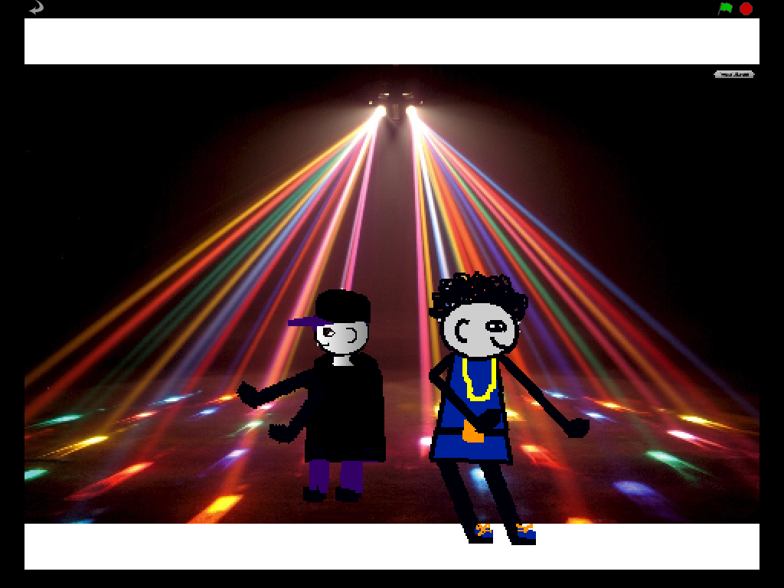
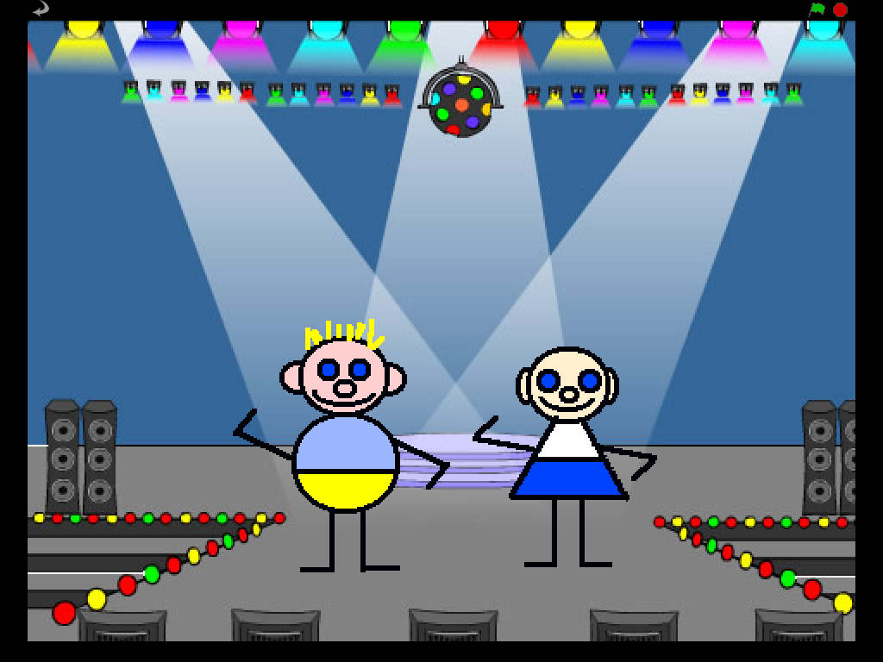

Slide 7
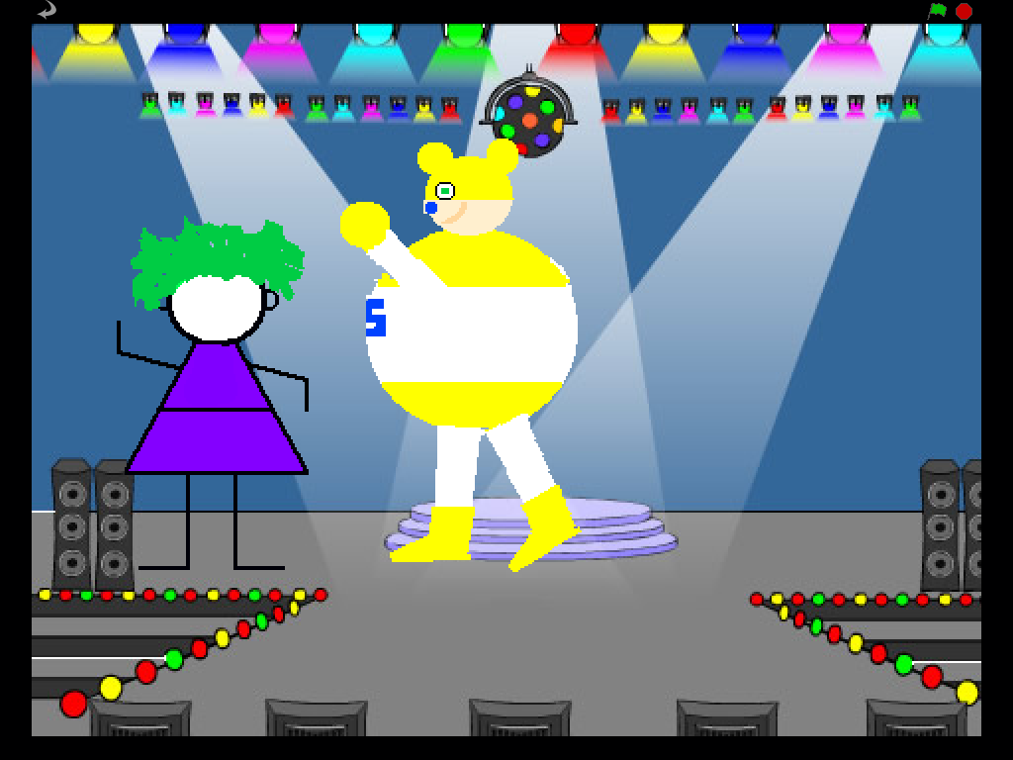
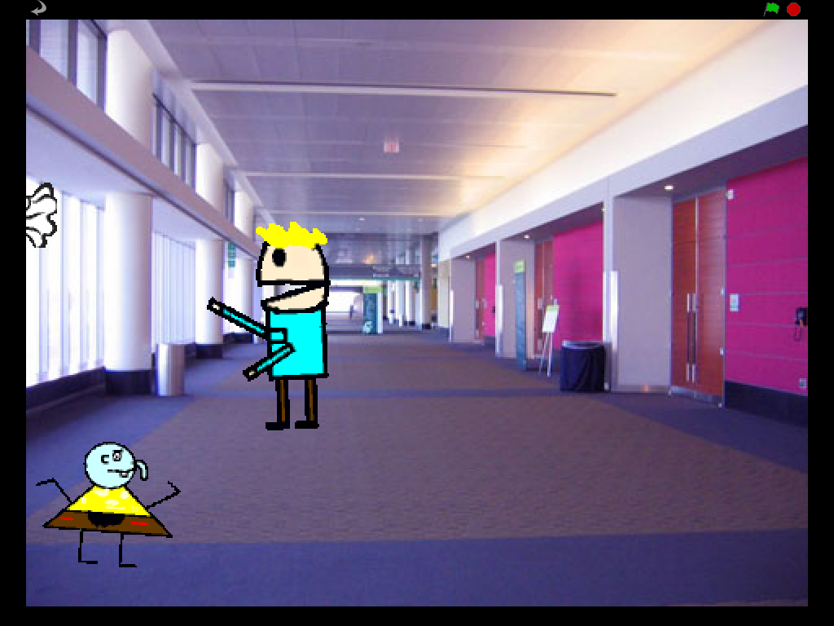

Slide 8
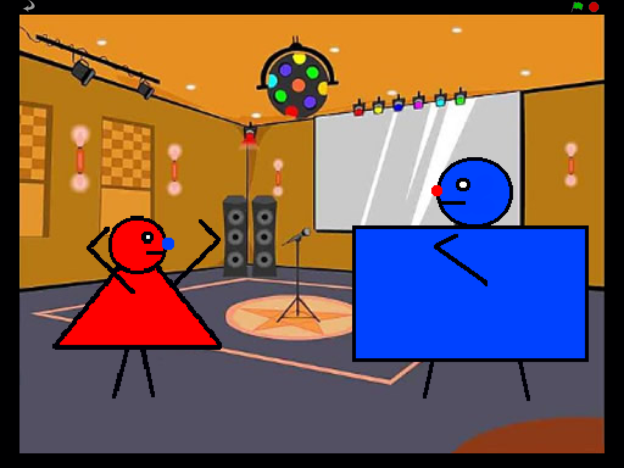
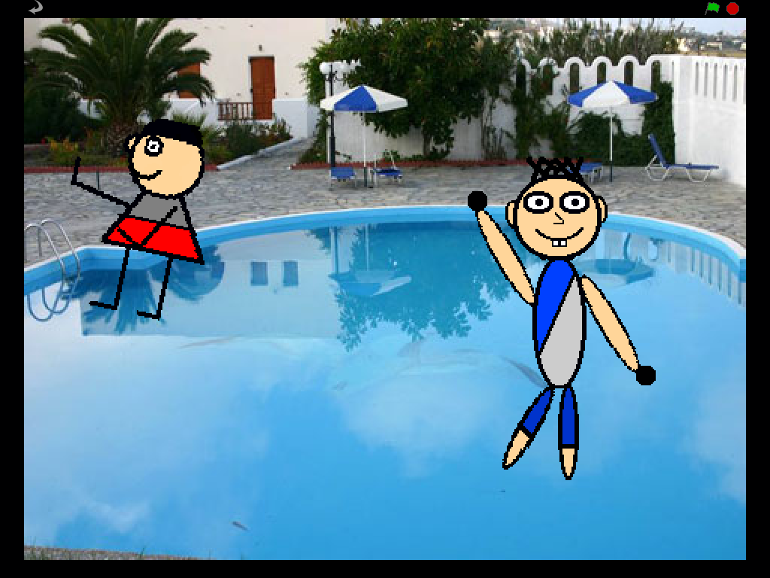

Slide 13
Additional rubric samples
are available on
Scratch Ed
by searching for
Rosemary Slattery
Rosemary Slattery
slatteryr@peabody.k12.ma.us

