Slide 1
Developing a Scratch
Science Curriculum
Brian Foley & Sergio Millan
California State University Northridge
bit.ly/scratchscience
Notes:
<number>

Slide 2
Papert’s Microworlds
Student generated simulations of phenomena
In these dynamic Turtle Microworlds, [students] come to a different kind of understanding---a feel for why the world works as it does.
Papert (1979)
Constructionsim
Learning through building and testing
Notes:
Being at the Media lab it makes sense to start with the idea of microworlds
Microworlds are
This idea has sparked a loose learning theory called constructionism
Particularly valuable for physics – but valuable in many subjects
Why does constructing things help students learn?
As Papert say here – students understand why things work the way they do – more specifically, students have a productive mental model (GROK)
<number>

Slide 3
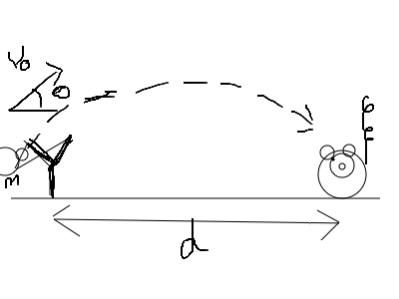
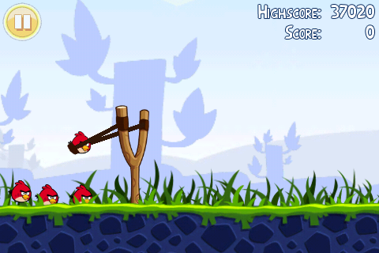
Articulating Models
From eduflix.tv
Notes:
Our goal is to enable student to articulate a model of science phenomena
Any familiar with the literature on scientific modeling knows there are many ways
Diagrams, equations or concept maps are unsatisfying
Depictive computer simulations are much better
viewing a sim is not enough
A game is just a simulation where you keep score
<number>

Slide 4
Microworlds = Computational Modeling
Have students construct simulations
(aka games)
Develop a working model of a phenomena
Get feedback on their thinking
Have a language to talk about science
See the value of math
Learn about modeling and natures of science
Develop computational thinking skills
Notes:
So to connect these ideas – the microworlds that Paper described are a way of doing computational modeling
There are lots of advantages to doing this (and some drawbacks)
<number>

Slide 5
Where are the microworlds?
Software for World building
Early systems faded/disappeared
Logo
Hypercard
BOXER
New generation emerges
1999 NetLogo,
2001 Squeak (Etoys)
2006 Scratch
2008 StarLogo TNG
Notes:
Looking historically at the efforts to support microworld creation. There was a lot of attention in the 1980s with Logo and new tools like Hypercard and BOXER – but then there was a drop off in the 1990s – recently a new generation and renued interest in computation for kids.
What happenned in the 1990s that got everyone distracted from coding?
<number>

Slide 6
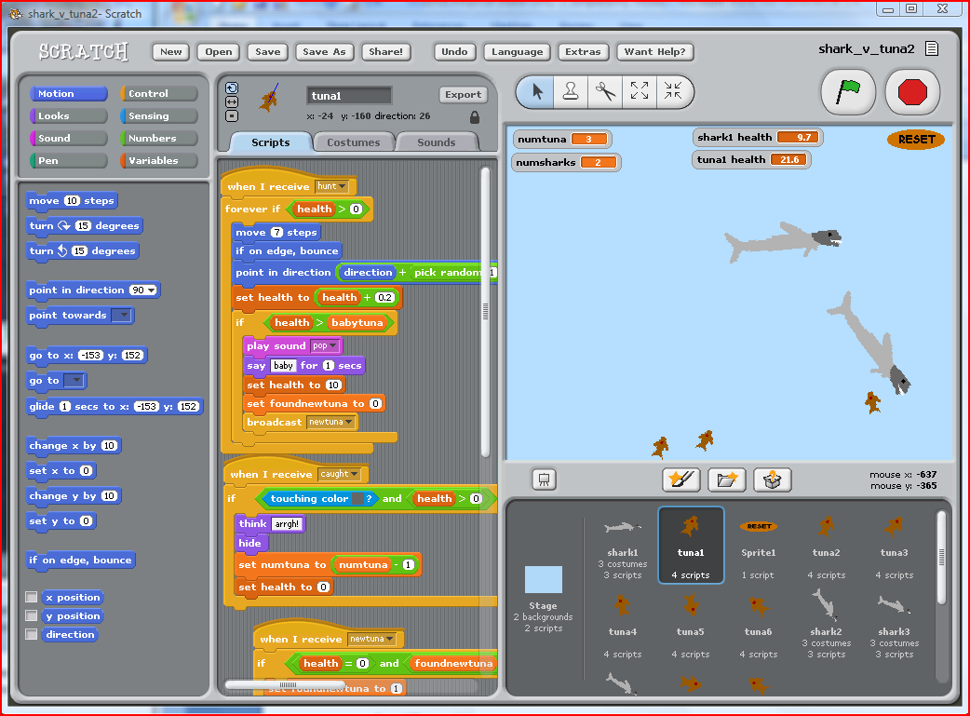
Microworlds with Scratch
Notes:
I don’t need to tell this group how great scratch is
Easy in – don’t need to know much to start
Scaffolding for beginning programmers
Online community – open source ethic
<number>

Slide 7
Making worlds is not easy
Prerequisits for microworld building?
Computational Thinking Skills (Wang)
Understanding of modeling (Gobert et al)
Skills & knowledge develop over time
Time is hard to come by in schools
Notes:
<number>

Slide 8
Scratch Science Project
Goal – to get students to construct models of science phenomena
Summer class 2009, 2010, 2011
Motion curriculum:
Car velocity
Train graphing
Asteroids
Angry Birds
Shoot the falling monkey (paintball)
Notes:
The scratch science project is an effort to see if tools like scratch along with our growing knowledge about CT has lowered the bar enough to make this a feasible idea
Our primary effort has been to run a summer class to explore these ideas and try out different approaches.
What has emerged is a set of activities around ideas in motion – which we can map onto the Calif 8th grade science standards
<number>

Slide 9
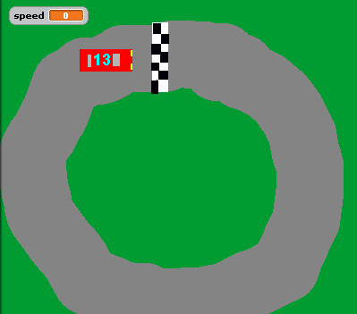
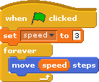
Driving Game
Intro to scratch
Use speed variable to move

Slide 10
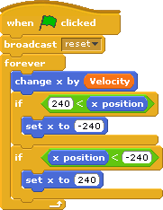
Train Simulation (1D motion)
Motion along X axis only (velocity)
Graphing position vs time

Slide 11
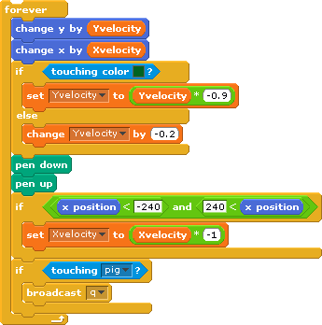
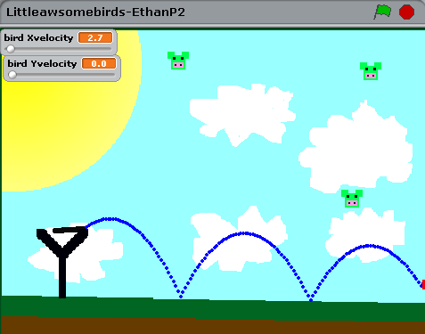
Angry Birds Game
Motion in 2D
Gravity

Slide 12
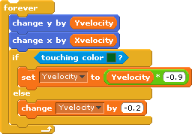
Angry Birds Game (cont)
Bouncing
Rubber bands (Hooks Law)

Slide 13
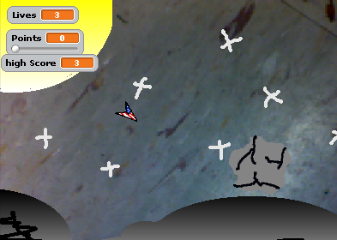
Asteroids
2D motion again (no gravity or friction)
Acceleration (trigonometry!)
Keeping score

Slide 14
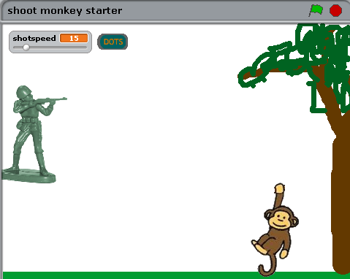
Shoot the Monkey
Solve the classic physics problem
Instead of building the microworld, they use the microworld to answer a question
Explore the code and tinker

Slide 15
Science, Art and Computer Games
Summer class for middle & high school students
5 week (50 hours!) course on Scratch and science
Currently in year 4
Testing ground for a lot of the scratch science and research on computational thinking
Not enough girls!

Slide 16
Results from Summer Class
Question topic | Pretest | Posttest
Interpret a short sequence of computer instructions | 5% | 52%
Describe the motion from a position vs time graph | 32% | 47%
Explanation of spring force | 11% | 0%
What variable does gravity cause to change? | 21% | 21%
Notes:
The summer class results have been mixed.
We have been doing a lot of changing the curriculum – so there is not consistent data yet
We are able to help students understand how to interpret scripts and some improvement on science tasks
But we are not seeing improvement in their ability to explain
One thing that we have been struggling with is how to assess what the students are learning very effectively
<number>

Slide 17
Lots of Questions
How much help/time?
Group work vs individual?
How to help students to work through problems?
Integrate into the curriculum
Connect to hands on labs
Problem solving
Essay writing
How to assess students modeling skills

Slide 18
Ball Drop Activity
Originally part of the Scratch Motion curriculum
Potential as an assessment of modeling skills
Short activity
Easy for some students, challenging for others
Requires science knowledge and computational thinking
Notes:
So we are interested in developing a test that captures both the science and the CT
<number>

Slide 19
Notes:
Here is the ball drop starter
We use starter programs like this to shorten development – students will take
<number>

Slide 20
Scratch Motion Blocks
Notes:
Here are the choice that students have to work with
Any guesses on which ones students like?
Notice that there is noting about speed or velocity
<number>

Slide 21
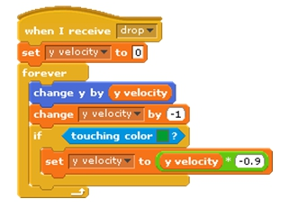
Potential Solution to the Ball Drop
Standard line to instantiate velocity
Gravity
Bounce
Notes:
Here is what is probably the ideal solution for the ball drop
Notice that it is very short – but each line has a lot of meaning both scientifically
<number>

Slide 22
Ball drop transcript
Four students in 8th grade at a technology magnet middle school
Completed three scratch activities in class (one period each) – limited memory
I: Do you remember how we did the movement for the train and the car and stuff? … What was the script for that?
S2: For the car we used arrow keys
I: We used arrow keys for what?
S1: For changing the direction
I: And how did we move forward?
(pause)
S3: The arrow?
Notes:
So to study ball drop we had some of students from the 8th grade classes we are working with work the problem in groups. I am just going to show one group now – this group had 4 kids in it. Two girls (S1 and S2) a 2 boys (S3 and S4)
<number>

Slide 23
Case 1: first attempt - glide
S2: Well right now when you click the drop ball button it just has the fingers opening so we have to make it where it opens then the ball drops
S4: So when the ball drops change y
S3: Shouldn’t we have it glide? Because that would be a more smooth motion. So glide… (gets the block for glide)
S4: Glide 2 or 3 seconds
S3: So let’s set it to 2
S2: But we don’t want the x
S4: We don’t want the x to change
S2: That way (points down)
S3: X is -4 right now, -4 is about the center.. or maybe it is already pre set...
S3: Now let’s test that

Slide 24
Case 1: first attempt - glide
S2: Well right now when you click the drop ball button it just has the fingers opening so we have to make it where it opens then the ball drops
S4: So when the ball drops change y
S3: Shouldn’t we have it glide? Because that would be a more smooth motion. So glide… (gets the block for glide)
S4: Glide 2 or 3 seconds
S3: So let’s set it to 2
S2: But we don’t want the x
S4: We don’t want the x to change
S2: That way (points down)
S3: X is -4 right now, -4 is about the center.. or maybe it is already pre set...
S3: Now let’s test that

Slide 25
Checking for realism
I: Alright so how do you think that looks?
S3: Kind of slow still
S4: It’s kind of slow but the speed is the same the whole way down
I: Speed is the same the whole way down - so is that good or bad?
S2: Bad
(pause - S3 speeds up the glide)

Slide 26
S3: Oh wait - if we did forever move - how many steps did we try - 100
S1: That won’t work it’s too much
S3: But then what we could do is - since it is forever move it would just keep going down (try’s out the new script)
S1: That does work but that is way too fast
…
S1: Maybe you should change the 100 steps to something smaller
S3: Maybe 50? But since it is forever
S4: 50 not 500
S3: Since it is forever it will just keep repeating (tests again)
S3: It did stop the script when it touched there and it was at a different speed so maybe we can slow it to 20 - that would be slower (tests again)
S4: Yea that works/
S1: /Make it glide up after

Slide 27
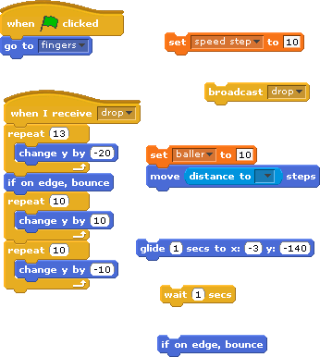
Final script

Slide 28
Conclusions
How to get students to care about the model
Appeal to realism helps, but it is not enough
Students need to learn about what is modeling (Schwarz, 2004 )
Computational thinking is the both the process and outcome of modeling
Even experienced students will try to avoid it

Slide 29
Next steps
Computational Thinking assessments
Fairy assessment: cross platform (Alice, Scratch) assessment (Werner, Denner)
Ball drop – scientific modelling assessment
Advanced scratch science summer course
Expand the scratch motion curriculum

Slide 30
Thanks
CSUN Summer Academic Enrichment Program
Dawn Herbert
Roman Slavinksy
Joel Brenner
Rachel Goodfriend
Julia Woo
Paper and materials online at
bit.ly/scratchscience
Notes:
<number>

