Slide 1
Attaining government recognition for a Scratch outreach programme in a small country: our building blocks described
27 July 2012
Clare McInerney
Education and Outreach Officer, Lero
Stephen Howell
IT Tallaght

Slide 2
Scratch Programme in Ireland
Teaching Materials
Competition
Teacher Training/Training
Computing Camps

Slide 3
Teaching Materials
All materials freely available on www.scratch.ie

Slide 4
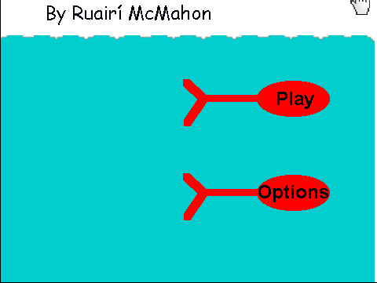
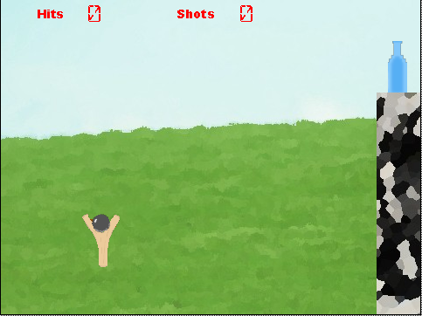
Scratch Competition 2012

Slide 5
Scratch Competition

Slide 6
Teacher Training/Training
Summer 2011 : 65 teachers in Irish Computer Society and UL
Autumn 2011 : Education Centres 116
Spring 2012 : Education Centres 136
Primary Level Summer 2012
Scratch programming and Numeracy in Senior Primary Classes
Computer Education Society of Ireland Annual Conference
Coder Dojo

Slide 7
Summer Computing Camps
University of Limerick
Scratch
Arduinos
Computer Music
Introduction to Electronics
Robotics
Greenfoot
Year 3 of summer camps
2011 – 50 students over 3 weeks
2012 – 54 students over 2 weeks

Slide 8
Government Recognition

Slide 9
Junior Cycle Short Courses
Junior Cycle Short Course on programming/coding
Commissioned by the National Council for Curriculum and Assessment
100 hours over 3 years
Assessed by the teacher
Any school/organisation can develop a short course
Who certifies the course?

Slide 10
Challenges Encountered
Not much time for research
Keeping track – Uptake is optional
Working for the most part with champion teachers
Scratch 2.0
Materials update
Training Update

Slide 11
Plans for the future
Continue to support existing programme for teachers and schools using Scratch
Junior Cycle Short Course

Slide 12
Clare McInerney
Clare.mcinerney@lero.ie
Stephen Howell
Stephen.Howell@ittdublin.ie
www.scratch.ie

