Slide 1
"Young Developers"
Elementary School students
Develop computer games
Notes:
My name is Amitai Gat and Today, I am going to talk about a special program called "Young Developers".

Slide 2
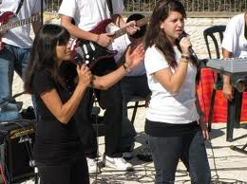
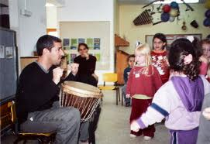
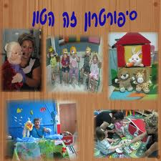
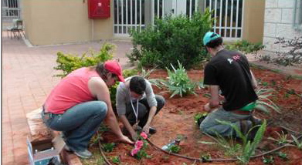
Educational activities in Karev
Notes:
I work for Karev Educational Program-the largest educational intervention program in the Israeli school system. The program provides various activities to over 260,000 children and teenagers in approximately 110 communities all over Israel.
Karev’s main goal is to create educational & social change in the Israeli society by reducing gaps and giving equal opportunities to all students especially those from low socio economic level.
Karev activities range from visual and performing arts to music to communication and high-tech activities.

Slide 3
Educational IT activities in Karev
Basic IT skills
"Young Developers"
Advanced IT skills
Notes:
The Karve program has intergraded computer activities into the program for the past 13 years.
The computer program can be divided into three concentrations.
Basic IT skills-focuses on using basic Microsoft Office and basic Internet orientation.
Advanced IT -training in Web 2.0 applications and various open source programs. Among them Audacity for music editing in our musical instruments research program and Artweaver- Photoshop best substitute to date which is our leading tool in our Graphic Design program. We also use blogger and Google apps
The 3rd and fastest growing part of our programs is Computer games development thru the "Young Developers" program, which is the main focus of my presentation today.

Slide 4
"Young Developers" program-Overview
2010
42 schools
4000 students
2009
25 schools
2000 students
2008
Scratch-Pilot
3 schools
75 students
2006-2007
Game Maker
1999-2006
MS Office
1999-2006
MS Office
2006-2007
Game Maker
2008-2010
Scratch
Notes:
"Young Developers" is an annual program in which children, ages 9-12 (grades 4-6 in the Israeli school system); learn how to develop computer games.
During the school year, the students learn about the tools that they will need to use, to develop the games and at the end of the school year, students send their games to a national convention for a competition match.
The program has shown a constant growth in scope and number of students. In 2010 half of our schools were involved in game development.
At this point in the presentation, I would like to talk about how we integrated Scratch into the program. We have tried several game authoring tools but what we needed was an easier tool for our instructors and students alike; this was achieved by applying Scratch into the program,
In 2008 we started a pilot program and from its success, starting with the 2009 school year, we have fully integrated Scratch as our main game authoring tool.

Slide 5
Scratch in "Young Developers"- Challenges
Pedagogy
Students
Training
Notes:
We identify three elements that are the main challenges for us when implementing a new technology- These elements interlocked together.
The big one Pedagogy moves the other two.
Pedagogy
We didn’t find any adequate learning materials that were connected to game development in Scratch
There is a constant tension between students tendency to develop fun games and our goal of developing educational games.
students
A language barrier-. the English interface was a problem at first.
The differentiation of learning- I can roughly divide a typical class into three-
"Young Developers"- these students comprehend very quickly the principles of Scratch, programming and interaction,
Average students- These kids showed motivation, and wanted to learn, but it was harder for them to understand how to program
Non-programmers- in this group I recognize two sub groups-
Computer enthusiasts- these kids didn't like Scratch and wanted to use other programs that were easier for them. Others had shown interest only in the graphic editor of the Scratch such where they could draw sprites and background.
Struggling Students- these kids can’t handle Scratch at all for various reasons
Fast decline in number of students during Scratch orientation-Most of the attrition happens when students are introduced to programming concepts such as coordinate system, variables, loops and IF sentences. Training
The biggest challenge we face is Training our staff. As of 2010 From 80 instructors in the organization only 10% actually teach Scratch.
Game development authoring tools such as Scratch present a special challenge because of the steep learning curve and the technical proficiency it demands.

Slide 6
"Young Developers"- evolution of Training aids
Pedagogy
Training
Student
All To Know
Need To Know
2009
2010
2011
2008
2007
MIT’s Activity Cards
Eduware
Eduware
Manual
Lesson Plans
Karev’s Activity
Structure* cards
*Activity Structure is a term coined by Prof. Judy Harris in 1999.
Notes:
The answer to the challenges I showed you was coming to the realization that people just don’t need to know everything about Scratch in order to succeed. So the evolution of our training aids shows a distinct trend of going from all to know to Need to know.
In 2007 we didn’t know anything and from the Scratch cards we thought that people needed to know it all in order to teach scratch.
Today, I can tell you that what isn’t relevant to the learning, is not only useless but slow down the learning of both staff and students.
In a few weeks from today, our students will have the most complete training aid to date to start their training as young developers.

Slide 7
Programming Concepts-coordinate system
Game
Sample
Scratch
Interface
Programming
Concepts
Menu
X= Negative
Y= Positive
Y= Positive
X= Positive
Y= Positive
Right
100
Left
50
Up
10
X= Negative
X= Positive
Down
X
X=0
Y=0
150-
100-
50-
10-
10
50
100
150
Right-Up
10-
Right-Down
50-
X= Negative
Y= Negative
X= Positive
Y= Negative
Left-Up
Y= Negative
Y
100-
Left-Down
Notes:
This is a screen shot of our Power Point Learning presentation. This eduware that had animation and other bells and whistles, proved absolutely useless in field because students and staff had to go back and forth from the Eduware to Scratch. It also had way too much information.

Slide 8
Karev Activity Cards
Notes:
The same topic is shown here in our latest training aid- Karev Activity cards
Our activity cards are a modification of MIT’s idea.
The pedagogy behind them is based on Judy Harris’s Activity Structures and the topics had been decided after content analysis that defined what a student need to become a game developer.
The cards are also important in other aspects:
Knowledge documentation- this is the first attempt to transfer oral knowledge to print
Self study learning course- The cards cover all the topics we identified, but can also be used as a need to know basis card for a specific topic,
differentiation of learning- these cards can help our top students to progress independently while helping the average students to over come his/her difficulties.
One unexpected outcome is that these cards are actually an activity structure that can be used for other applications.
What you see is two sided card that one side give valuable information and screenshots that save excessive use of text.
The other side is a task that asks the student to implement what he have just learned.
In this card after the kid reads about Coordinate system, he needs to program his sprite to move diagonally which affect the values of both X and Y.
In an assessment. 85% of the subjects reported that they would use the cards in class, 74% reported that they think this will be a good learning aid for self learning of children, the same number has answered that they suit both adults and young students.
The most promising result is that 95% of the subjects will recommend these cards to other instructors.
So, perhaps, we may have found a balanced way between all to know and need to know. In 2010-2011 school year we will test this cards in our schools.

Slide 9
Students Games-Tic Tac Toe
Notes:
I want to show you three samples of games that represent the full spectrum of game development to date
Tic-Tac-Toe- This game represent how 2 5th graders girls who had to deal with the complicated algorithm of comparing the squares in the game

Slide 10
Students Games-The Mall
Clothing
Accessories
Pets
Shoes
Money
Exit
Food court
Ice cream
Soap shop
Electric shop
Notes:
The Mall-This game represent a “genre” that is in debate among us- fun games. 3 4th grader girls created a shopping mall with stores and a lot of game play option. But they also sent the player with 10,000 NIS (2500$), so what is this game teaching and what message does it deliver? Can we allow for such games? A dilemma both for us as educators and both for marketing reasons (we promote development of educational games)

Slide 11
Students Games-Eco-Aliens
Notes:
Space Aliens-this is the game that won 2009 competition it’s about 6 eco-conscious aliens who are sent to save earth.
The game is about ecological problems and thru the missions the students learn about resources exploitation, pollution etc.

Slide 12
Scratch and social intervention
Organization
Community
School
Student
Notes:
Young Development is a mean to an end. Beyond the technological accomplishments we wish that are students will grow sensitive to gaps in the Israeli society and involved in their communities. Scratch and “Young Developers” has social value in in all levels.
Student level-empowerment of female students, we have identified that female students are more engaged in Scratch.
considering the constant decline in number of young women who choose computer science, “Young developers” shows promising results.
Most of the games I’ve sent as an instructor this year, had been developed by my female students
School Level-We have launched a program of distinguished students from 11 schools in a major metropolitan in Israel. The students developed educational games about the history of this city. This project created cooperation between schools and individual students.
Community Level-The winners of our Office category this year come from a rural community in the eastern border of Israel. This community, hardly known outside its area had been published because of the children’s effort. In principle words “no one ever talked about us, now everyone is talking about our achievement”.
Games from the distinguished students had been donated to the children department in the hospital in that city.
Next year we will be working with 3 more hospital and plan to have at least 3 more groups of distinguished students.
Organization Level – For Karev Educational program one of the biggest effects of "Young Developers" is the establishment of Academic cooperation with the Department of Learning Technology in Holon Institute of Technology.
This cooperation involves academic research and mutual projects. One such research is Gender differences in game development.
The development of activity cards as a final project in the department and future plans to present our work in Israel’s biggest academic conference about learning technology next spring.

Slide 13
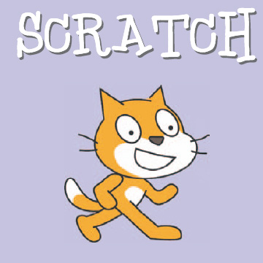
Final words
Notes:
"Young Developers" is growing really fast, Scratch as a platform enable us to engage a lot more children in Karev program
Scratch has allowed us to develop a unique program that is affecting the lives of children all over Israel.

